Slide 1
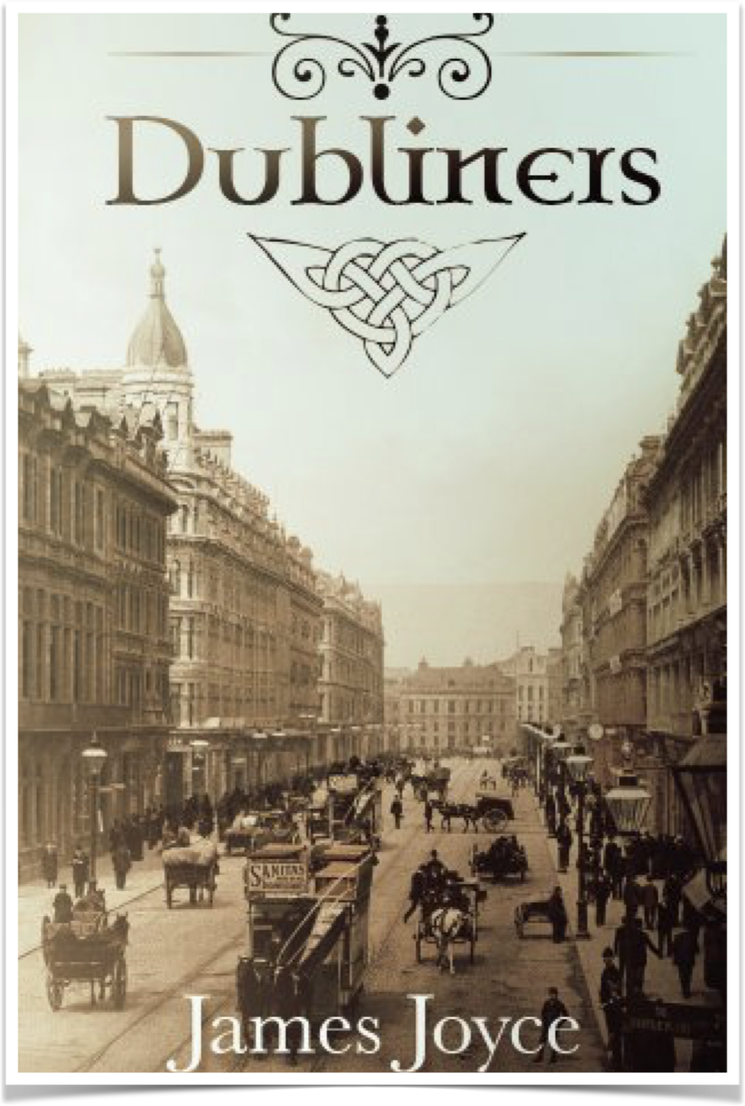
“The dead”
Written by James Joyce
TUNIZ GIORGIA
5LSCA
A.S. 2019-2020

Slide 2
TITLE AND STRUCTURE
Considering the title, an intelligent reader may aspect the short story to be about death or someone talking about it maybe referring to somebody he/she cares who died.
Undoubtedly the title evoke to the reader a feeling of sadness and inquietude which disappear when the reader starts reading the short story.
The story is not divided into chapters or subtitles, instead it is arranged in many paragraphs which are clearly visible from the start of the story.

Slide 3
CHARACTERS
LILY: she is the first character the reader face during the reading. She is the caretaker’s daughter and do housemaid’s work in Morkan’s house.
KATE AND JULIA MORKAN: They are the owners of the house where the dinner took place. They appear as kind women who love music and like singing and playing the piano. They seem like very connected with family traditions and they do not like when these are not respected.
MARY JANE: she is Kate and Julia’s niece and they decided to take care of her after the death of their brother Pat. She is the main prop of the Household and she is very linked with music as her aunts.
GABRIEL CONROY: he is the main protagonist of the story and his point of view is the main one used to narrate the story. He is an intellectual professor who thinks to be more cultured than the other guests at the dinner; although he had a superior education and many times he felt embarrassed that the quotations he used may not be understood from all of them. He is a very kind and generous person.
GRETTA CONROY: she is Gabriel’s wife. She is a very sensitive person, really bonded to her passed life and to the person she met when she was younger. In particular of Michael Furey, a guy who was in loved with her and died just to see her one more time before she lived from Galway to Dublin.
FREDDY MALINS: he is Gabriel’s friend. He is a young man around forty who has the bad habit to drink at every time of the day. Indeed Kate and Julia would not be surprised if he had come drunk to the dinner.

Slide 4
SETTINGS AND TIME
The short story is sett in several places:
Dublin, Ireland (during the 1800);
Julia and Kate Morkan’s house in Usher’s Island;
The cab;
Gabriel and Gretta Morkan’s hotel room;
Galway ( only when Gretta told his husband about Michael Foray)
This story develops in a single night during which events occurred are so articulated that the story seems to extend for more than a few days.

Slide 5
MESSAGE
The message highlighted in the short story is that people’s past life is a very important element that can not be overlooked or forgotten. It can suddenly reappear and if it has not yet passed, it can have devastating results on the respective subjects. It can influence their lives, positively or negatively, based on how they have been able to manage it previously.
In order to be able to face it and overcome it, it is necessary to externalise al the emotions it has aroused and live them to the full, even if this means feeling very bad. Only in this way it can be archived and remain in the past with our affecting the present.
In the short story, Gretta’s character seems to have never had the strength to face her past and the death of Michael Furay, a young irishman who, very sick and in love with her, decides to go and greet her one last time, putting his life fatally in gender.

Slide 6
NARRATIVE TECHNIQUES
In the short story James Joyce used many narrative techniques in order to express his message. Firstly he used:
the third person narrator mainly using the point of view of Gabriel, who is the principal character. The aim of Joyce was to going through the mind of the reader and reaching his stream of consciousness;
the use of telling and showing which is very important. Especially showing is important because through the character’s dialogues, Joyce describes the structures of the various characters, highlighting some of their behavioural characteristics.

Slide 7
USE OF THE LANGUAGE
The language used by Joyce, changes according to the point of view used to tell the story in that moment of the story.
It varies from every character, for example it’s really evident the discrepancy between Lily and Gabriel. Joyce used for her a very simple register in order to underline her social conditions where she quit the school in order to maintain herself. Indeed Gabriel who is seen as an intellectual, has to use an high quality of language so that everyone can understand that he has studied and he is more cultured than them.
The language used from Lily and from the others characters like her, is very simple and characterised from short sentences, rich of nouns and adjectives that express directly the main concept.

Slide 8
SYMBOLS
Gabriel Conroy’s discourse during the dinner —> It is really important because gives to the reader a slice of the irish population;
The Lass of Aughrim —> it is the song that provokes in Gretta that unexpected feeling of sadness. It is important because gives a turning point to the story, indeed from that moment till the end Gabriel will change his vision of how he loves his wife;
Snow —> it is one of the most important symbols of the story. The figure of the snow assumes both a physics and a sentimental connotation.

Slide 9
PERSONAL CONSIDERATIONS
“The dead” is a short story that invites the reader to reflect on many issues that regards the Irish’s condition of the 1800. Obviously only after have reading a few lines, the real objective of this text is not clear. In my initial opinion on the texts where so different from those I had at the end of the lecture because, after analysing it win all its aspects, clearly emerge the intention of Joyce to give to the reader a fully vision of the Irishmen’s culture; of the importance of traditions, of love as the main sensation that tends to guide all of people’s actions and on the predominant figure of the past, which influences people’s present life greatly.
From this text I understood that in order to live a peaceful, happy and satisfying life, people must be able to deal with past events that may have hurt them and to archive them. Therefore people must leave it aside in order to be able to go on because, as Nietzsche says, the past is past and must be let go, and no longer has to do with the present.

Slide 10
WHY SHOULD ONE READ IT?
People should read it because it helps understand that people and their way of behaving are the product of past events and how they have faced life. Therefore, they should not be evaluated only by the passing of recent events, but on the whole; even because their past life won’t go away.

