Slide 1
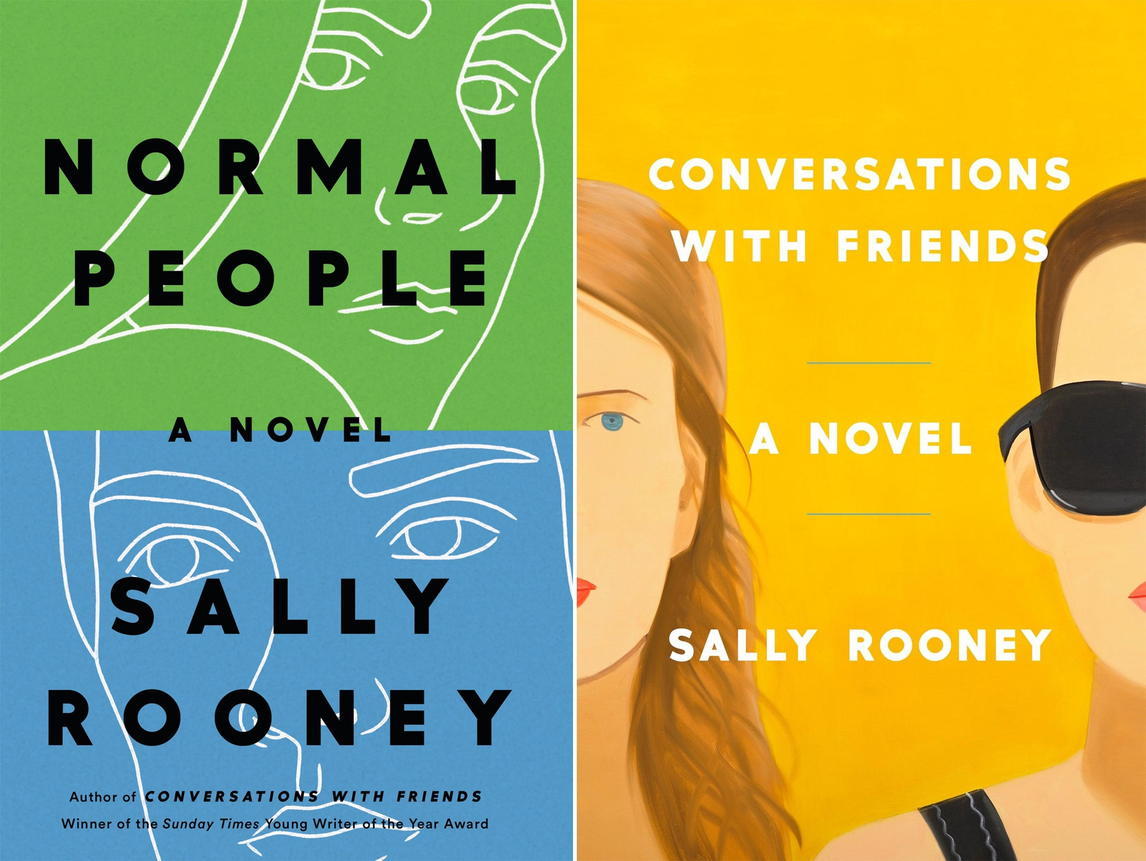

Slide 2
Summary
Connell and Marianne are watching a romantic movie together. Suddenly Marianne starts to to be upsetting because of the ending of the film: the protagonist is pregnant. Marianne remembers when she had her period last time, which is why she is discouraged. Connell realizes that something's wrong, so he'll buy you a cup of tea. After which he asks her if she is pregnant, but she tells him she had her period this morning. She asks him what he would do if she were pregnant, he answers vaguely. She admits that she wanted to keep her son if she got pregnant, to see if she could be a mother. Then he asks Connell if he thinks she might be a very good mother, he says yes, saying he is good at everything he does. Marianne reiterates that he would not be involved in any case by his decision, Connell replies that he would have supported her in any case, even though in reality he has not the slightest desire to become a father.

Slide 3
BODY LANGUAGE ANAlysis
ANALYSIS – Extract from chapter Two months later ( April 2012)

Slide 4
CONNELL
BODY LANGUAGE
He want to make her a cup of tea;
In panic;
He touched her hair
He smiled, he inhaled through his mouth.
ANALYSIS
Connell's body language suggests that he is in a state of agitation and fear. Marianne's physical reaction to the film made Connell think of the possibility of becoming a father.
This fear is explained by some of his behaviors, such as: caressing marianne and preparing her tea. After receiving the news that Marianne has had her period, Connell feels more relaxed, we are told by : his nerves calmed, he smiled and inhaled from his mouth.

Slide 5
MARIANNE
BODY LANGUAGE
She cried
A white tendon in her neck pressing outwards;
She shook her head;
She smiled;
ANALYSIS
Marianne's body language suggests that she is in a state of weakness and needs to be reassured. Even knowing she had menstruated, at the sight of the protagonist of the film, she started crying and her nerves stiffened. Because she wanted Connell to be interested in her. She didn't look at him, nodded (annuire). When he touched her hair he finally smiled, because he got his attention.

