Slide 1
J. WINTERSON,FRANKISSSTEIN. A LOVE STORY
Narrative technique. Analysis
Alice Santoro
5LSCA
Anno Scolastico 2019-2020
Liceo Scientifico Albert Einstein

Slide 2
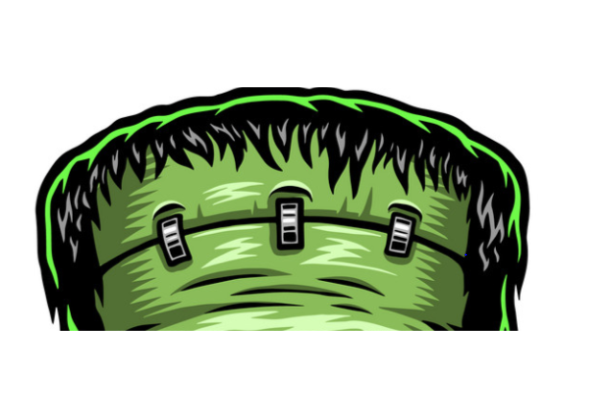
cover
Main colours
Blue ⇨ male gender
Neon pink ⇨ female gender
Red ⇨ “ A LOVE STORY”
Image:
Wound and “x” stitches → reference to V. Frankenstein’s wound
}doubleness

Slide 3
title
FRANKISSSTEIN
FRANKESTEIN + KISS
by Mary Shelley ↓
A LOVE STORY

Slide 4
UNCONVENTIONAL PLOT two parallel plots
Switzerland ,1816
How Mary Shelley wrote Frankenstein + her life after writing the novel
Bedlam (asylum)
Mary Shelley meets her creature Victor Frankestein
Manchester, Memphis, Phoenix, 21° century
Postmodern update of Frankenstein story

Slide 5
characters
1816
21° century
Mary Shelley
(writer)
Victor Frankenstein (scientist)
Lord Byron
(poet)
Polidori
(physician)
Claire Clairmont
(Mary’s stepsister)
Ada Lovelace (mathematician)
Ry Shelley (transgender doctor)
Victor Stein (professor)
Ron Lord (creator of sex bots)
Polly D (Vanity Fair journalist)
Claire (Ry’s reference person in Memphis)

Slide 6
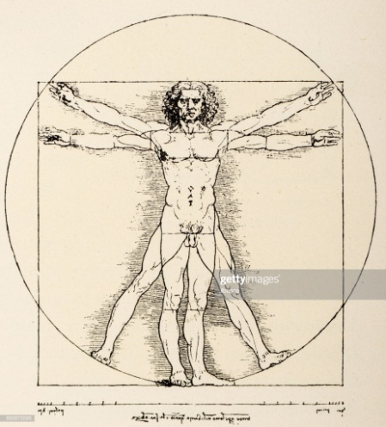
How are the two plots related?
Characters correspondence
Same themes: artificial life artificial intelligence
Same quotations: ex pp.14, 30, 61
Same elements ⇨ ex. Vitruvian man pp. 73, 191
Frequent references to Frankestein ex p.96
“The year could be 1816”
Same ending

Slide 7
Speaking voice
First person narrator
Mary Shelley Ry Shelley
Inner thoughts Examples below
p.234 p. 112

Slide 8
visible presence of the author
p.133
p.226
Notes:
Mary Shelley dice che sposerebbe the contented pig
Ron dice che non vorremo indietro tutte le persone che muoiono ogni anno

Slide 9
Postmodern themes
Quotations along the whole novel and before the beginning of every chapter
We live by language p.62
There is only production (stories made by other stories) p. 65/68
Temporal distortion p.108 “The fututre always carries something from the past”
Intertextuality
Self - reflexivity

Slide 10
Message
Everything you know is in your mind
⇩
reality is an invention
REALITY IS WATER SOLUBLE

