Slide 1
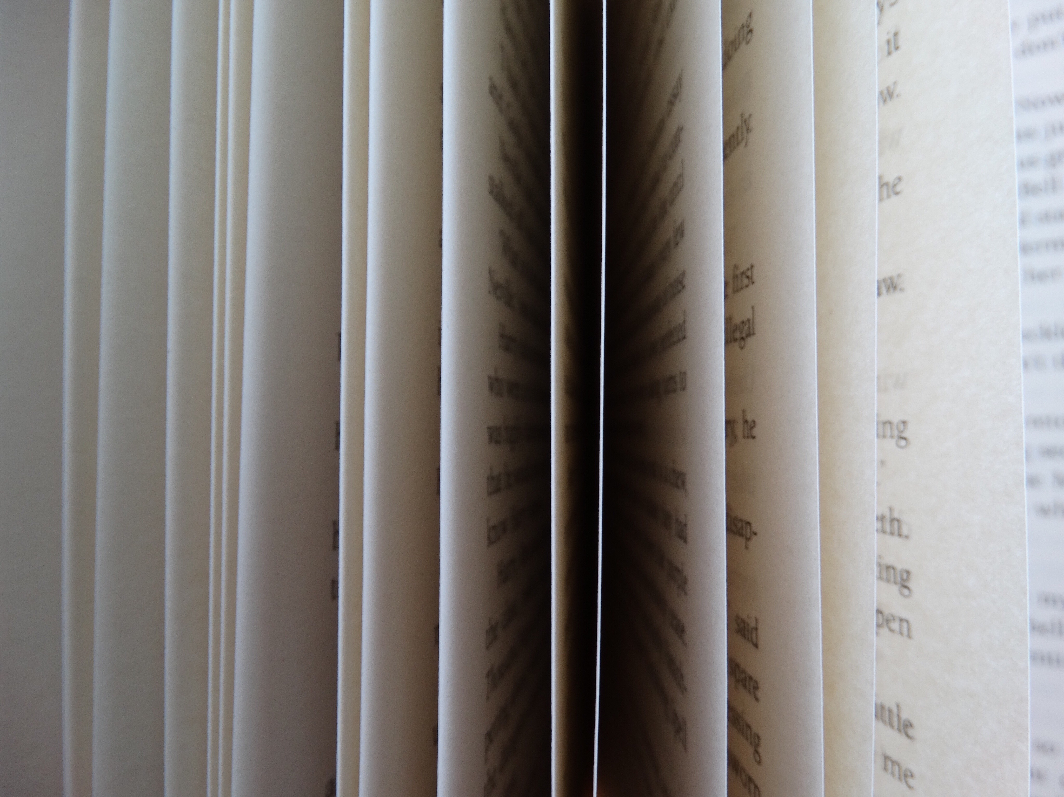
Normal People Sally rooney
Arianna Peruzzi
5LSCA
2019-2020

Slide 2
Narrative Techniques
Normal People: third personnarrator ⇨ he seems to watch the scene outside, and alternates the two characters’ inner reality
Chapters are dated and unusually arranged
They follow the characters’ student timeline with gaps of a few weeks and a few month in duration.
→ The novel alternates the use of the present tense (when events are referred to chapters date) and the past tense, for the periods falling between the dated chapters.

Slide 3
Structure
Normal people does not adhere to a strict chronology.
The novel is arranged into sections according to the lapse of time (‘Three Months Later’)
It emphasises the gaps between lovers and provides a real-world timeline (‘January 2011’)
The pattern is there even when the lapse of time is trivial (‘Five Minutes Later’).

Slide 4
January 2011
The novel starts with a brief introduction ⇨ the social conditions of two characters: Connell and Marianne.
The writer highlights Marianne’s personality and behaviour.
Connell has a feeling of shared confidentiality when he talks to her
Marianne tells Connell she loves him
He does not answer and he keeps his eyes down.

Slide 5
Three Weeks Later (February 2011)
Presentation of Alan’s physical abuses to Marianne;
The affection from male figures Marianne receives is only through violence, humiliation and submission.
Connell’s personality: popular and well-adjusted teenager.
He is successful in soccer, has good grades
Marianne accepts the secrecy of her relationship with Connell without questions ⇨ she finds it exciting.
Connell kisses her.

Slide 6
One Month Later (March 2011)
Connell is insecure and not autonomous in taking decisions alone
He looks for help and advice from Marianne⇨ encourages him to apply to Trinity and to study English.
Connell asks Marianne to keep their relationship secret from his friends ⇨ he feel free to be himself without his peers’ judgments.
Connell looks for physical contact with Marianne ⇨ he is sexually attracted to her.

Slide 7
Six Weeks Later (April 2011)
Connell wants Marianne’s attention
He looks for Marianne’s confirmation to feel self-assured
: He does it this through body language
Connell reveals his protective instinct and therefore Marianne can trust him.
He does not want a contact with her when he is in public ⇨ fears his friends’judgment
He wants attention and he tries to protect her from domestic and psychological violence (from her father and brother)

Slide 8
Two Days Later (April 2011)
Connell needs Marianne’s approval and confirmations
He is insecure ⇨ they belong to different social classes.
Connell needs to know what Marianne feels for him.
He wants Marianne to tell him she loves him to be reassured about her feelings.

Slide 9
Four Months Later (August 2011)
Connell wants to talk to Marianne
He wants to understand the reason why she dropped school and she started ignoring him.
Connell tries to avoid having a serious conversation with Marianne ⇨unable to admit he hurt her and humiliated her going out with Rachel.
He feels ashamed but he is too selfish to change his decision

Slide 10
Three Months Later (November 2011)
Marianne and Connell meet at a party
Marianne has a popular boyfriend, Gareth, and everybody knows her
Connell feels marginalized.
Marianne still is his reference point, his way to feel confident.
Connell uses irony to make fun of Gareth⇨ needs to know if Gareth is better than him, and if yes in what ways.
He feels possessive.
Connell admits he made a mistake going out with Rachel and to judge her boyfriend.
His use of language sounds malicious.

Slide 11
Three Months Later (February 2012)
Introduction of Peggy and comparison with Marianne.
Both Connell and Marianne’s interest in keeping their friendship and commitment to each stable
Marianne would feel ashamed if people knew of their relationship
She considers Connell’s request to keep it secret humiliating
She does not have the courage to rebel to his request.
Connell’s attitude suggests he is aware he has committed a mistake with his request

Slide 12
Two Months Later (April 2012)
For the first time Marianne tells they are seeing each other.
Connell has feelings for her but pretends not to and tries to cover them up joking around.
He feels he has the responsibility to make her happy.
He understands the emotional power he has over her.

Slide 13
Three Months Later (July 2012)
He limits the use of language to simulate false indifference
He expresses his need to feel close to her with irony.
Connell shows urgent need to stay alone with Marianne.
He wants to find out if she missed him and how his absence has affected her daily life.
Connell is aware of belonging to Marianne's heart and body.
Connell is insecure, shy and needs to be sure to have a relevant position in Marianne's life.

Slide 14
Six Weeks Later (September 2012)
They are attracted to each other by their mental connection.
Connell is afraid Marianne may lose interest and esteem in him.
Connell informs Marianne he is broken and cannot pay the rent.
Connell’s effort to tell it ⇨ he says it light-heartedly but he hides insecurity.
Connell wants to tell Marianne he would like to live with her but he is afraid of showing his feelings.

Slide 15
Four Months Later (January 2013)
Marianne feels uncomfortable and embarrassed to speak freely with friends.
She suffers verbal and physical violence from her boyfriend Jamie
She feels entitled to their attitude: she seems to like suffer ing violence and submission
She feels sad and angry when she learns of Connell’s girlfriend.
She shows an attitude of indifference to get over the pain.

Slide 16
Six Months Later (July 2013)
Connell wants to reassure her and make her feel protected when she argues with Jamie.
He is protective over Marianne ⇨ she is one of the most relevant people in his life and the only point of reference.
He also need to have physical contact with her.
He feels confused and ashamed for t Marianne’s domestic violence.
Role and social class differences between Marianne and Connell ⇨ highlighted by the different reasons of their scholarship.

Slide 17
Five Months Later (December 2013)
Lukas and Marianne have a playful relationship
Lukas makes her feel like nothing.
Marianne undergoes a moment of deep depression and her life does not seem real at all.
Lukas takes pictures of Marianne while she is tied up with a tape and tells her that he loves her.
While Lukas ties her up, she finally understands that what he does is not for love.
Marianne thinks of Peggy and Jamie, who enjoyed humiliating other people.
She reflects on her family and her relationship with Peggy and Jamie and imagines she is free from them.
She realizes that her life is sterile.

Slide 18
Three Months Later (March 2014)
Connell's in a state of confusion after Rob's death.
He identified with him for what he wanted in high school:
social recognition,
other people’s approval,
to be considered and enjoy prestige.
Rob's death is like losing the life he could have had.
Connell becomes aware that only with Marianne he can really be himself.

Slide 19
Four Months Later (July 2014)
Marianne’s awareness that life must:
count for something
help against the violence of the strong against the weak.
The protagonists reflect on their relationship and what their life could have been like without the attraction they feel between them.
They are both aware that they are at an age when life can change for any decision, even the slightest one.
Marianne believes she is a bad, corrupt, wrong, evil person and her efforts to improve do not help to "be right, say and do the right things".

Slide 20
Five Minutes Later (July 2014)
Connell feels like he ruined the lives of everyone who like him.
He is strongly conflicted about whether or not to publish his story,
He feels anguish about any judgment that won't come later.
He believes his relationship with Marianne has always generated confusion and suffering, he considers it an “ immense dark and terrible emptiness ”.
He is aware of his power over Marianne
He wants to avoid her but does not want to be forgotten by her.

Slide 21
Seven Months Later (February 2015)
There is a certain serenity and calm in Connell and Marianne's life.
Connell is patient and careful with Marianne's feelings and takes care of her and listens to her.
Marianne compares the two of them to little plants that share the same piece of land.
Marianne feels confident even though she will feel lonely when Connell goes to New York.

Slide 22
Arianna Peruzzi
5LSCA
A.S.
2019-2020
Lingua e cultura inglese

