Slide 1
CITIZENSHIP AND THE CONSTITUTION OF THE ITALIAN REPUBLIC
J.E. ONWUELO
5LSA B
a.s. 2019 – 2020
Lingua e cultura inglese

Slide 2
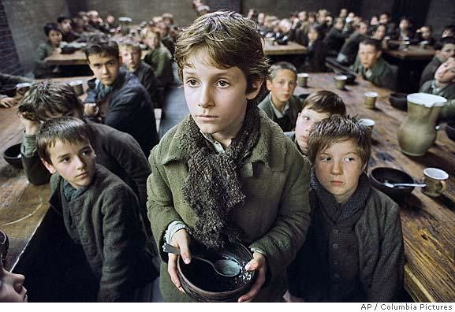
OLIVER TWIST
VIOLATION OF ARTICLE 31
VIOLATION OF ARTICLE 21

Slide 3
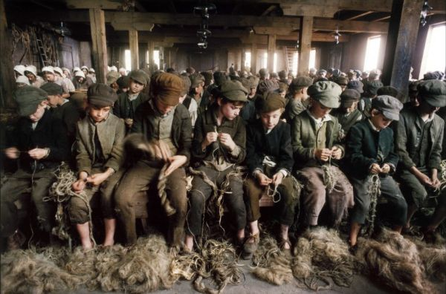
OLIVER TWIST
VIOLATION OF ARTICLE 27
VIOLATION OF ARTICLE 13

Slide 4
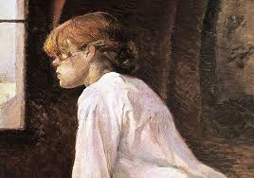
EVELINE
«WOMEN’S RIGHTS ARE HUMAN RIGHTS»
VIOLATION OF ARTICLE 31

Slide 5
FRANKISSSTEIN, 2019
CONTEMPLATION OF ARTICLE 3

Slide 6
MY PERSONAL REFLECTION
« we are all branches of the same tree»
Unfortunately even nowadays many human rights are not respected everywhere
However, the progress made in the western world gives hope for the future

