Slide 1
International migration: The impact of linguistic proximity on preferred destinations
-------------------------------------------------------
Delcuratolo Sebastiano

Slide 2
Migrants’ choice of destination when migrating
Migrants select a host country based on:
Employment prospects;
Safety and openness of the society;
Linguistic and cultural proximity;

Slide 3
Linguistic and cultural proximity
The term “linguistic and cultural proximity” means the degree of similarity between migrants’ mother tongues and cultures and the ones in destination countries.
As a metter of fact, it has a pretty important impact in migration flows nowdays. Indeed Linguistic and cultural proximity make sure to avoid creating linguistic and cultural barriers in the destination countries.
The key to an profitable migration is the both fluency in the destination language and the ability to learn it quickly

Slide 4
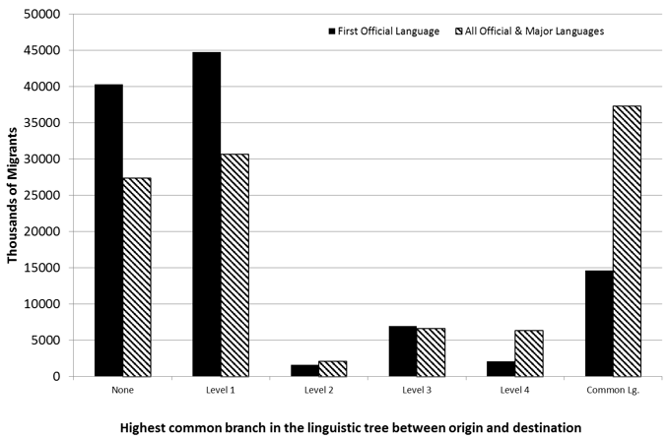
The role of linguistic distance in migration
The graphic represents flows are somewhat larger at high levels of linguistic proximity when we use instead the minimum distance among all multiple official and the two most widely spoken languages in each country rather than just the first official, since the language of the former colonial power is often one of many official languages in former colonies.

Slide 5
Robustness analyses
The results are highly robust to the use of two alternative continuous measures of proximity developed by linguists: the Levenshtein distance, which measures the phonetic dissimilarity between two languages of a core set of 40 common words and is available for all languages; and the Dyen index among Indo-European languages, which is also based on similarities between samples of words.
According to the data, we found out that:
We igration rates are higher between countries whose languages are more similar. Migration flows to a country with the same first official language as that in the origin country are around 20% higher than those to a destination with the most distant language, even after taking account of differences in other socio-economic conditions between origin and destination countries.
Migration rates to countries with similar languages are 19-35% higher than those with no linguistic connection. This holds even when the first official languages are replaced in analyses with the proximity between the most commonly used language in each country (which sometimes is not an official language), or with the minimum distance between any of the official and major languages in both countries.

Slide 6
Widely spoken languages as an additional pull factor in migration
A country where the language is widely spoken constitute an immigration pull factor on its own. Thereupon are two main reasons:
English is widely used in international transactions and media, and it is taught in many countries as a second language. Pre-migration exposure to English by the average migrant weakens the linguistic barriers to migrate;
English is an asset in the labour market across the world. The hope of improving one’s English proficiency may also increase the appeal of English-speaking destinations, even for temporary migrants who expect to use this skill upon returning home;

Slide 7
Linguistic enclaves
Migrants are significantly attracted to destinations that already host large communities with their same linguistic background, where the pressure to learn the local language immediately after arrival is likely to be lower and where they can find psychological support and practical information.
Some examples are Chinatown and Little Italy in New York, where Chinese and Italian people can live quietly and find psycological support.

Slide 8
Language-based immigration policy requirements
The relevance of linguistic proximity in determining the direction and strength of migration flows is also likely mediated by immigration policies that affect the selection of immigrants across destinations. For example, immigration policies in Australia, Canada and New Zealand emphasise candidates’ skills in their application processes for permanent resident visas, awarding points for English language proficiency (and French in Canada), educational attainment and age at migration.
To test whether immigration and naturalisation policies with strict language proficiency requirements may deter migration flows and affect the composition of migrants, we code the existence of both formal (tests) and informal language requirements for naturalisation in 30 OECD destinations for the years 1980-2010.2
Our results show that migration flows to countries with stricter language requirements are smaller. But even when these are taken into account, the linguistic proximity between origin and destination

