Slide 1
GROUP 3: WEB - QUEST
Cassandra Del Pin - Anna Errichiello - Simone Godeas

Slide 2
INDEX
Introduction to Geoffrey Chaucer and “the Canterbury Tales”
The Franklin
The Franklin => Culture
How people should relate with him?
Flavio Briatore
The Franklin and Flavio Briatore
The Franklin or Flavio Briatore

Slide 3
INTRODUCTION TO GEOFFREY CHAUCER AND “THE CANTERBURY TALES”
Geoffrey Chaucer
When was Chaucer born, and when did he die?
What were his links to royalty?
What roles did he fulfill in life?
What wasGeo happening in Europe during his lifetime?
Canterbury Tales
What is a frame story (or frame narrative)?
How does this technique of storytelling apply to The Canterbury Tales?
The Prologue
What season is this? What are the clues Chaucer gives us?

Slide 4
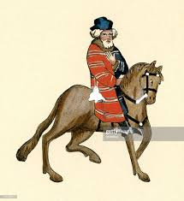
THE FRANKLIN

Slide 5
THE FRANKLIN
The text is an indirect characterization by means of a third-person narrator using the technique of telling.
The mainly strategies used by Geoffrey Chaucer to characterize the Franklin are:
His physical appearance/His dressing style, the text doesn't include a detailed physical description of the Franklin, however in the General Prologue
white beard
not very tall
a little bit chubby
His family background/social class:
career in local government
he was a common
a landowner

Slide 6
THE FRANKLIN
His diet:
hgourmet foods, fine wines, and quality ales or beers
the best wine cellar in his area
His job:
a member of the shire
a justice in the court
His attitude:
enjoyed life and the host of party
truth, generosity and courteousness

Slide 7
THE FRANKLIN => CULTURE
What made people noble in Middle Age?
how you related with other people
your behavior in society
Also, common people could became noble

Slide 8
How people should relating with him?
To leave today’s culture to confront and identify with medieval culture
To gather information about medieval culture and the values

Slide 9
Flavio Briatore is an Italian entrepreneur, company and sports manager.
He is best known for being a team manager in Formula 1.

Slide 10
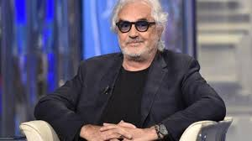
FLAVIO BRIATORE
THE FRANKLIN
Why did we choose this character?
Both:
a white beard
weren’t members of a high social class
noble-men
like to party and eat quality, expensive food
make charity

Slide 11
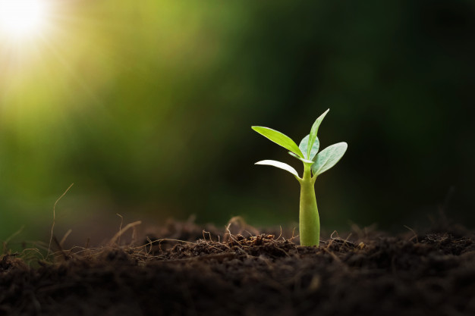
THE FRANKLIN or BRIATORE?
The concept of nobility is changed
The Franklin: landowner, made lot of charity, gentle whit other people.
Briatore: rich, makes charity but only to appear a good man.

Slide 12
SITOGRAFIA:
https://study.com/academy/lesson/the-franklin-in-the-canterbury-tales-description-characterization.html
http://csis.pace.edu/grendel/projs4a/TALES.htm
BIBLIOGRAFIA:
Rizzoli education, “It’s literature from the origins to the romantic age”, A.Martelli - I. Bruschi - I. Nigra, 2018.
Oxford Advanced Learner’s Dictionary, 2015.

