Slide 1
FROM THE ARRIVAL OF THE CELTS TO THE NORMAN CONQUEST
A. MARTELLI, I. BRUSCHI, I. NIGRA, It’s Literature: from the origins to the romantic age, 2018, Rizzoli.

Slide 2
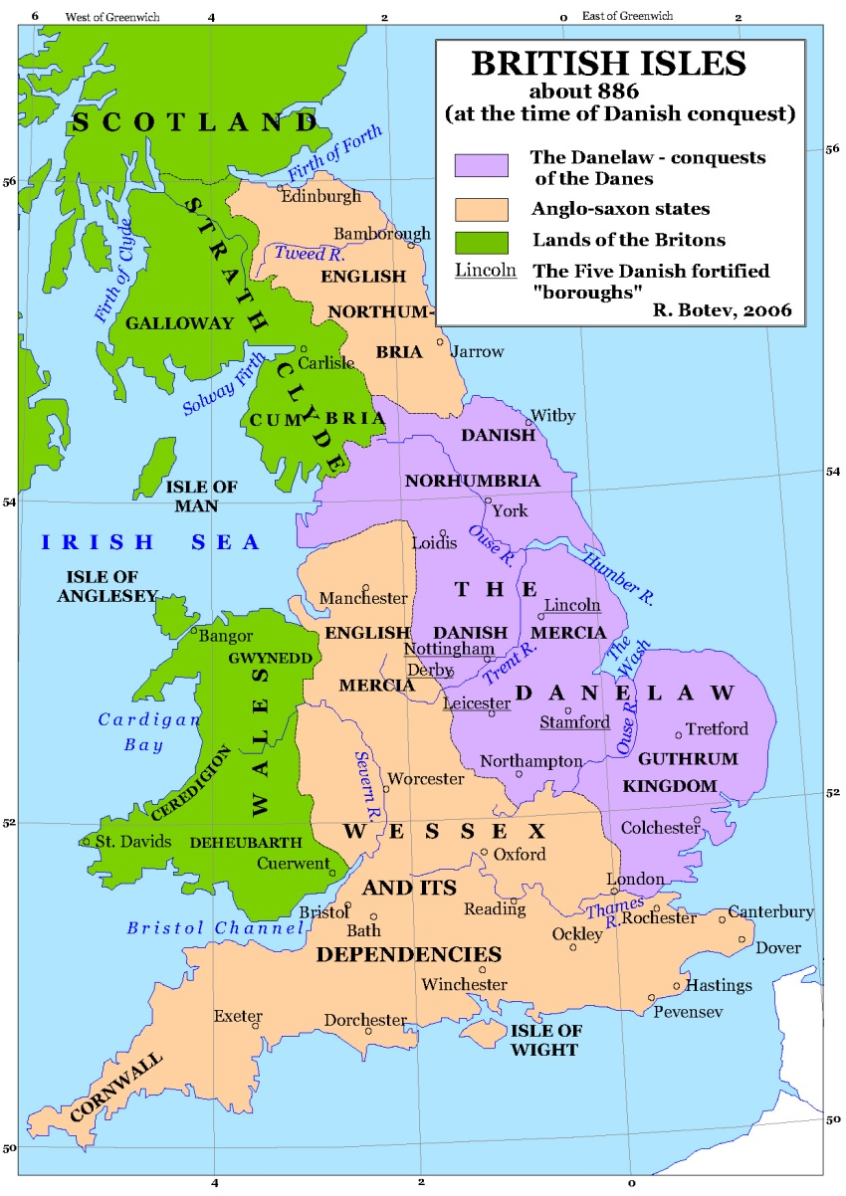
INDICE
The Celts;
The Romans;
The Anglo-Saxons;
The Vikings;
The Normans.

Slide 3
THE CELTS
INVASION
They came from the regions surrounding the Rhyne
Two main tribes: Britons and Gaets
SOCIETY AND CULTURE
The society was based on hunting and farming
Druids, Celtic religious leaders, had to transmit myths and legends through poems

Slide 4
THE ROMANS
INVASION
55BC → they tried to conquer England for the firts time, under Julius Caesar → they failed
43AD → under Emperor Claudius, they gain control of the Central and Southern regions
122AD → Roman Emperor Hadrian ordered the construction of the Hadrian’s Wall → it marked the the Empire’s northern frontier
The area south of it became the Roman province of Britannia → it stayed under Roman rule for nearly 400 years

Slide 5
THE ROMANS
410AD → Roman rule ended → the last Roman troops were called to Italy to fight the invasions of the Vandals and Visigoths
They built a vast network of roads and imported their farming techniques, habits and lifestyle
The effects of Roman were not permanent
Latin did not replace the Celtic language
Christianity never totally replaced pagan rites and beliefs

Slide 6
THE ANGLO-SAXONS
INVASION
Around 450AD → three Germanic tribes began raiding the British coasts → Angles, Saxons, Jutes
They met with opposition from some local British tribes → according to legends, some of them were led by the mythical King Arthur
They raided Britain for over a Century

Slide 7
THE ANGLO-SAXONS
SOCIETY
The society was hierarchical → each leader ruled over his thanes → warriors bound to him by loyalty, in return for their allegians they received land, riches and power
CULTURE
Their culture was based on oral literature → symbolyzed by the mead-hall → a large room in a building or a castle where warriors and kings gathered to feast → scops entertained them with songs
The Christain monks recorded their literature

Slide 8
THE VIKINGS
INVASION
They were a group of pagan tribes from Scandinavia
Between 750-1050 AD → they raided Britain → they carried ot frequent raids, looting villages and monasteries
At the end of the 9th century → King Alfred of Wessex (also knowns as King Alfred the Great) limited the Vikings incursions

Slide 9
THE NORMANS
INVASION
1066 AD → William Duke of Normandy (known as William the Conqueror) defeated the English King Harold at the Battle of Hastings → invasions and conquest of England by the Normans
Old French became the language of the court, the government, the curch and the aristocracy
Old English was confined to the lower orders of society

