Slide 1
ARTICLE 18 The Universal Declaration of Human Rights, 1948
GROUP 4: Gambino Annalisa, Nicola Elisa, Vit Aabhas.

Slide 2
THE ARTICLE IN THE UDHR
“Everyone has the right to freedom of thought, conscience and religion; this right includes freedom to change his religion or belief, and freedom, either alone or in community with others and in public or private, to manifest his religion or belief in teaching, practice, worship and observance”.
It is necessary to include the article to promote respect
Exercising these rights is central to living in an open and fair society

Slide 3
THREE VIOLATIONS OF THE ARTICLE
Some predominantly Muslim ethnic groups, like Uighurs and Kazakhs, have been interned in Chinese concentration camps
Russia has expanded laws tightening control over internet infrastructure, online content, and the privacy of communications
France bans girls under 18 from wearing the hijab in public

Slide 4
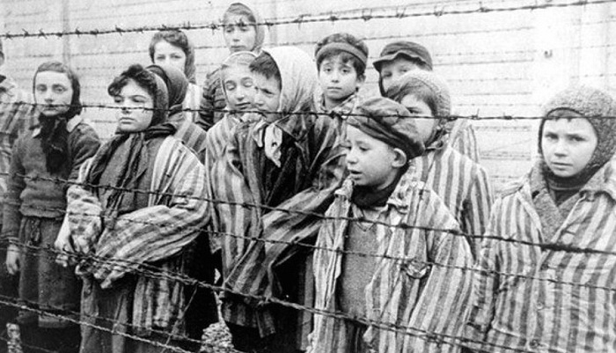
HOLOCAUST
The mass killing of European Jews, homosexuals, Rom, political opponents and disabled people in Nazi concentration camps during World War II
Germany, Nuremberg Laws 1935
AFTERMATH:
About 15-17 milions of victims
The word “genocide” was coined

Slide 5
PERSONAL COMMENTS
Annalisa
Elisa
Aabhas
The right to freedom of thought as a young woman
Taking positions and spreading informations
We can be unconsciously deprived of the right to freedom of thought by outer influences
Standing up against abuses and violations
A reminder of intolerance and prejudice
Fighting against dictators, without always resort to violence

Slide 6
WEBLIOGRAPHY
http://www.un.org/en/documents/udhr/index.shtml
http://www.amnesty.org/en https://www.hrw.org/news/2020/06/18/russia-growing-internet-isolation-control-censorship https://www.google.it/amp/s/www.aljazeera.com/amp/news/2021/4/9/a-law-against-islam https://www.amnesty.org/en/latest/news/2018/09/china-up-to-one-million-detained/
genocide - WordReference.com Dictionary of English
shoah nell'Enciclopedia Treccani

Slide 7
THANKS!
Gambino Annalisa
Nicola Elisa
Vit Aabhas

