Slide 1
PRESENTATION
Group 4:
- Gambino Annalisa
- Nicola Elisa
- Vit Aabhas

Slide 2
ACTIVITY: WEB QUEST
A picture that represents the character’s physical description
The character’s personality
Direct quotations
A symbol that represents the character
How today’s readers can relate to the character
What the character tells us about medieval English society

Slide 3
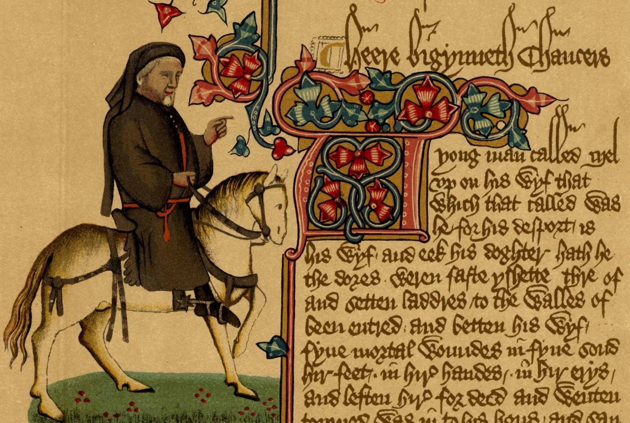
THE CANTERBURY TALES
GEOFFREY CHAUCER

Slide 4
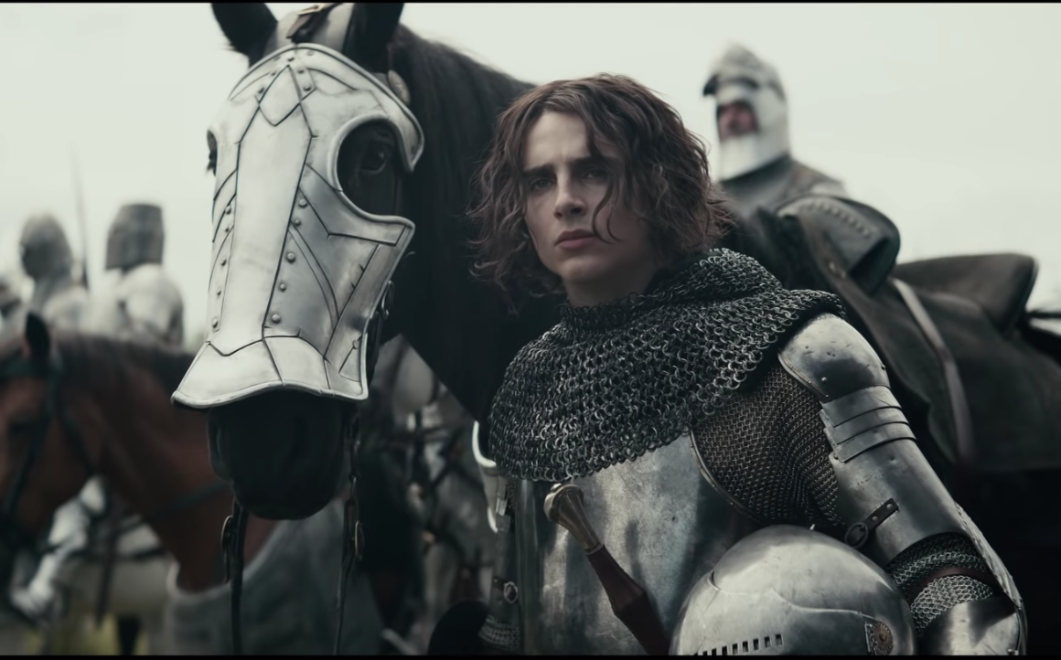
THE SQUIRE
Timothée Chalamet
The King, directed by David Michôd (2019)

Slide 5
THE SQUIRE’S PHYSICAL APPEARANCE
Young, twenty years old
Curly hair
Average height
Strong
Embroidered with red and white flowers
Dressed with a gown, with sleeves both long and wide

Slide 6
THE SQUIRE'S PERSONALITY
Passionate
Active and keen in both chivalry and courtly arts
Eccentric
Passionate about music, reading, writing and drawing
Deeply in love

Slide 7
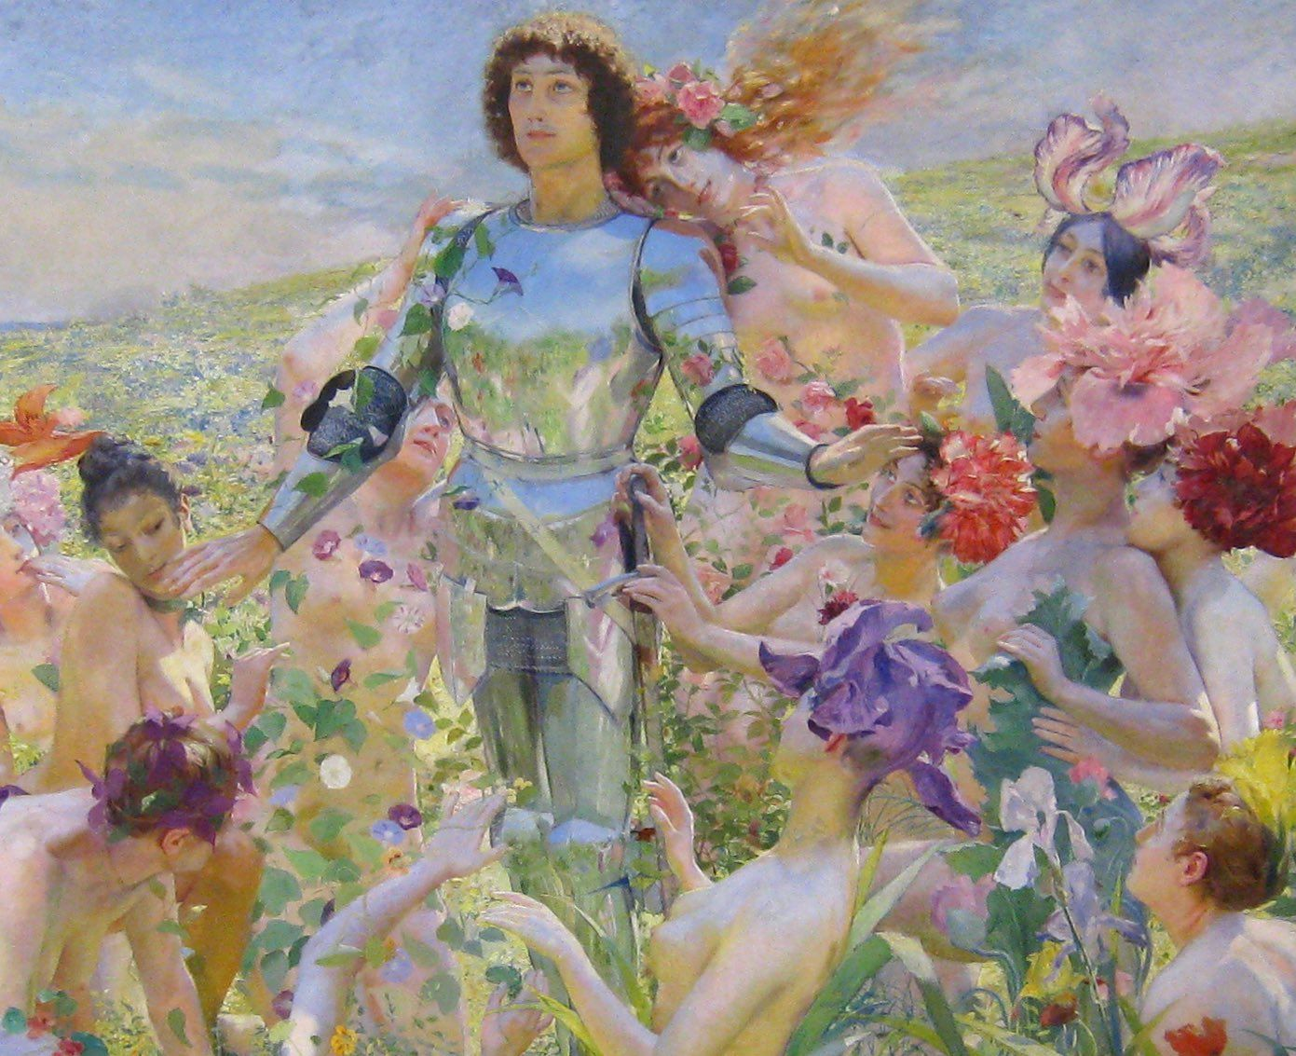
THE SYMBOL
The Knight of the Flowers, Georges Rochegrosse (1859-1938)

Slide 8
“A lover and a lusty bachelor”
“Embroidered was he, like a meadow bed
All full of freshest flowers, white and red”
“With locks well curled, as if they’d laid in press. Some twenty years of age he was, I guess. In stature he was of an average length, Wondrously active, aye, and great of strength.”
“He was as fresh as is the month of May”
“So hot he loved that, while night told her tale, He slept no more than does a nightingale”

Slide 9
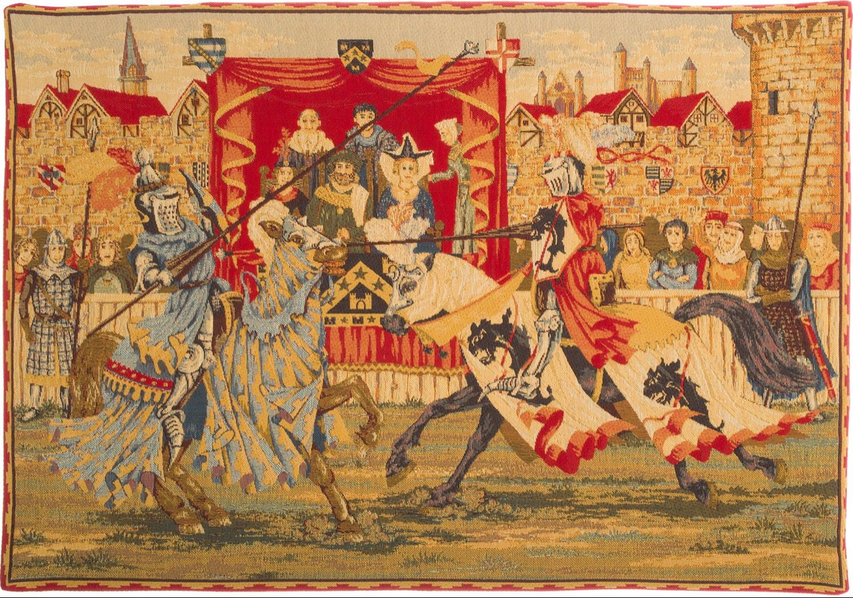
THE JOUST
“Joust, and dance too, as well as sketch and write.”

Slide 10
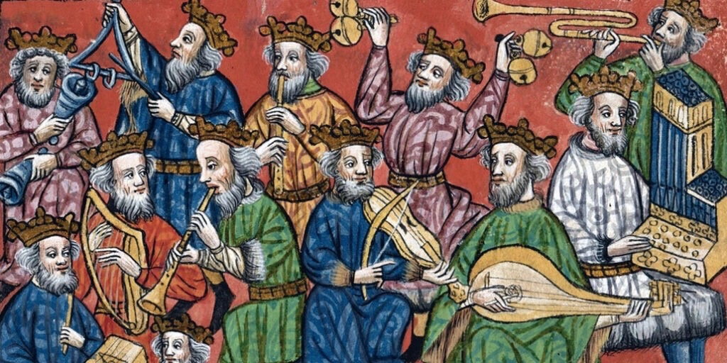
MUSIC
“Singing he was, or fluting, all the day”

Slide 11
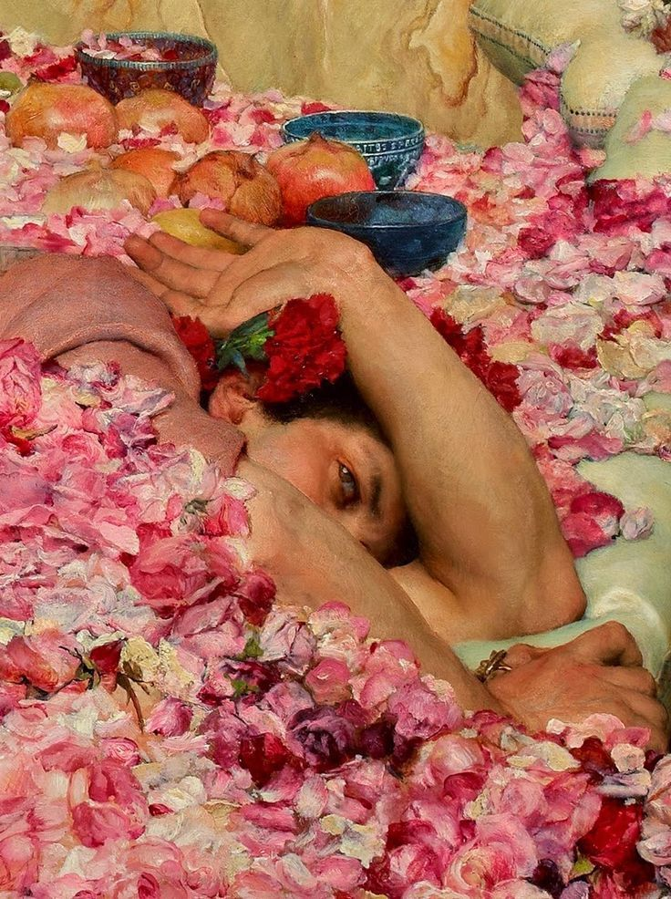
HOW READERS TODAY CAN RELATE TO THE CHARACTER
Prejudices about youth: carefree, cheerful and full of free-time activities
The Roses of Heliogabalus, Lawrence Alma-Tadema (1888)

Slide 12
WHAT THE CHARACTER TELLS THE READER ABOUT THE MEDIEVAL ENGLISH SOCIETY
Courtly life
The middle class’ point of view of the aristocracy and the courtly life

Slide 13
THANK YOU!!
We hope you enjoyed today's presentation!
Gambino Annalisa
Nicola Elisa
Vit Aabhas

