Slide 1
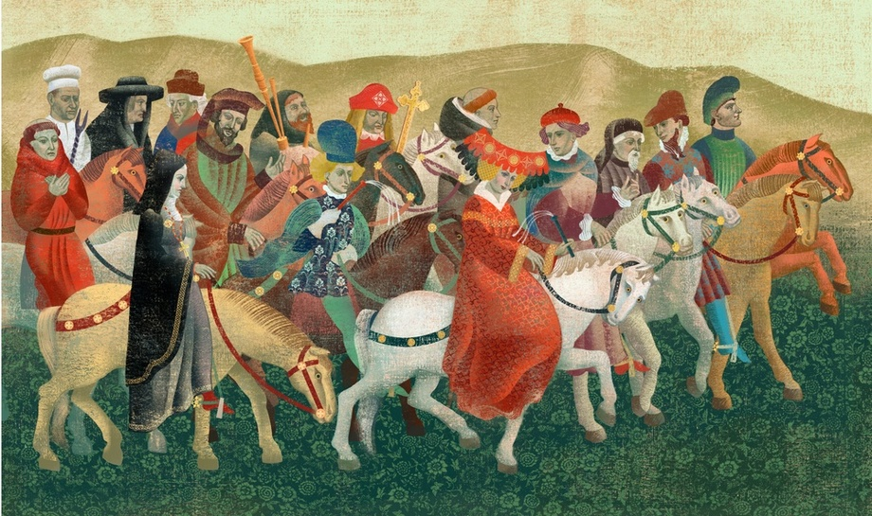
CANTERBURY TALES

Slide 2
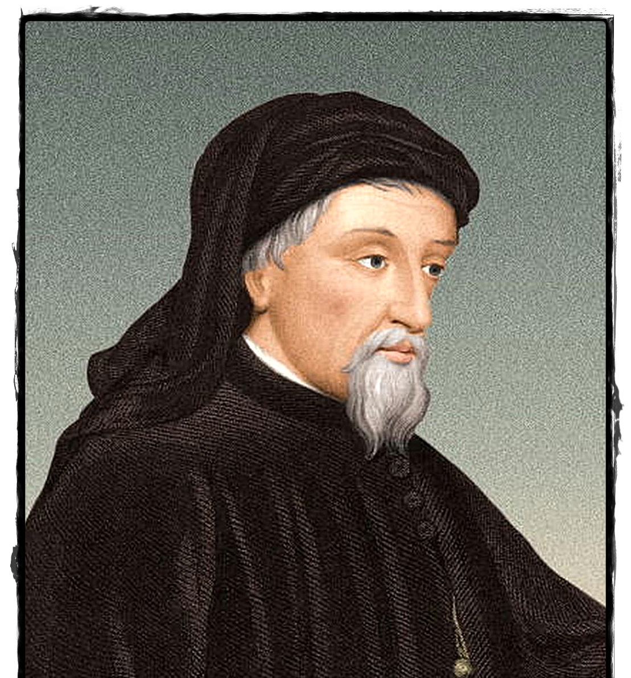
GEOFFRY CHAUSER’S LIFE
Chaucer was born in 1343.
He worked at court as a diplomat and civil servant
He lived in the service of three kings: Edward III, Richard II and Henry IV.
In 1374 Chaucer obtained the job of controller of the customs for the port of London.
In 1386 he became a member of Parliament for Kent.
In 1389 Chaucer was appointed the clerk of the king’s works.
He died 25 October in 1400 in London.

Slide 3
THE WIFE OF BATH

Slide 4
STRATEGIES OF CHARACTERISATION
Indirect characterization
The most frequent strategy is that of irony
Other strategies are:
Narrator’s personal judgment;
Couplet rhymes;
The woman’s reputation;
Dressing style;
Her appearance;
Her actions;
Her family back-ground;
The journeys she takes;
Horse riding skills;
Love skills.

Slide 5
PSYCHOLOGICAL CHARACTERISATION
Character’s personality | Text quotes
With irony the narrator wants to convey the opposite, namely that the woman is not respectable. | “A worthy women all her life”
She is ambitious, vain and courageous unlike other ladies. | “Not a dame dared stir towards the altar steps in front of her”
She fells superior and she is arrogant. | “Somewhat deaf”
The expensive and eye-catching clothes suggest an eccetric and showy personality. | “Her hose were of finest scarlet red and gartered tight”
Bold and rich woman. | “Her kerchiefs were of finely woven ground”
Woman's worldly attitude. | “Apart from other company in youth”
The woman has traveled only to meet new men rather than for religious purposes. | “she was skilled in wandering by the way”
She has the profile of a vital, enterprising and worldly woman. | “And knew the remedies for love’s mischances”

Slide 6
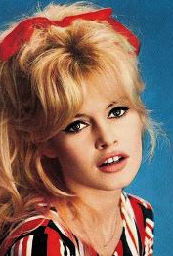
PHYSICAL CHARACTERIZATION
She has got some physical features that constitute the canons of beauty of the Middle Ages:
“Bold was her face, handsome and red in hue”
“gap-teeth”
“large hips”

Slide 7
SYMBOL
The character can be identified with the tornado because:
It is an exceptional event out of the ordinary, as the woman in the middle Ages’ society;
She overwhelms men, as does the tornado.

Slide 8
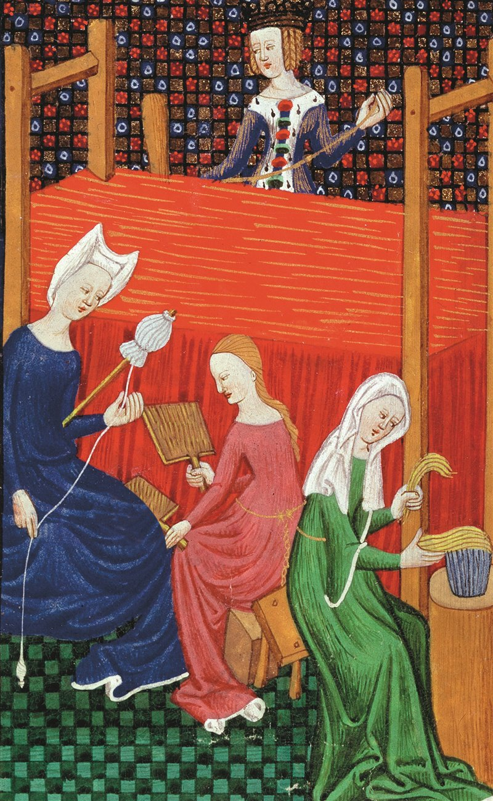
THE WOMAN IN THE IN THE MEDIEVAL SOCIETY
The woman in medieval society had to fill the following roles:
Wife;
Mother;
Nun.

Slide 9
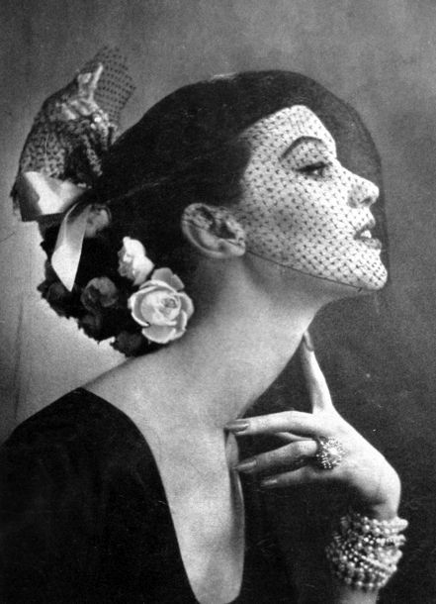
RELATIONSHIP BETWEEN THE WIFE AND TODAY’S READER
The today's readers consider her as negative character because she is arrogant and full of herself.
Nevertheless, the readers would not be stupid about the presence of this figure in today's society as there are many independent women who live and support themselves.
However, there are some readers who, with anachronistic thinking, find the presence of an independent woman unusual.

Slide 10
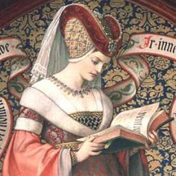
THE ROLE OF WIFE OF BATH IN THE MIDDLE AGES
The Wife of Bath’s portrait is extremely unconventional and contradicts the one usually associated to a medieval women, humble, shy and morally fragile.
Medieval thought is conservative and that is the reason why, throught irony, Chauser criticizes the woman because she is indipendent and so different.

Slide 11
REALIZED BY
SORRENTINO ALESSANDRA
SPONZA ODILLA

