Slide 1
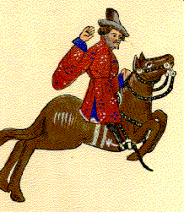
Web quest
GROUP: 2
MEMBERS:
Bosich Simone
Bozza Luigi
Dotteschini Giulia
CLASS: 3lsca
WORKING METHOD: Group project

Slide 2
INDEX
INTRODUCTION
THE MERCHANT’S CHARACTERISATION
THE MERCHANT’S PERSONALITY
THE MERCHANT AS A SYMBOL
THE MERCHANT NOWADAYS
THE MERCHANT IN THE MIDDLE AGES
THE MERCHANT AS A CELEBRITY

Slide 3
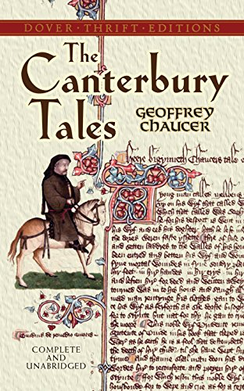
INTRODUCTION
Poetry: “The Canterbury Tales”
Literacy technique: Frame story
Author: Geoffrey Chaucer
Publication date: 1387-1388
Language: middle English
Character: The merchant

Slide 4
CHARACTERISATION
Textual references | Strategies
«Forking beard» | Physical appearance
«Motely dress», «Flemish beaver hat», «Daintily buckled boots» | Dressing style
«High on his horse he sat» | Posture
«In solemn tones» | Speaking style, self consideration
«There should be sae police (he tought)» | Thinking style
«He harped on his increase» | Affected appearance
«This estimable Merchant», «None knew was in debt» | Reputation
Irony

Slide 5
THE MERCHANT’S PERSONALITY
After the analysis of the strategies used by the poet it follows that the merchant is:
an extravagant and eccentric person
a liar with an affected appearance
a self-centred man
not as competent in business as a merchant should be

Slide 6
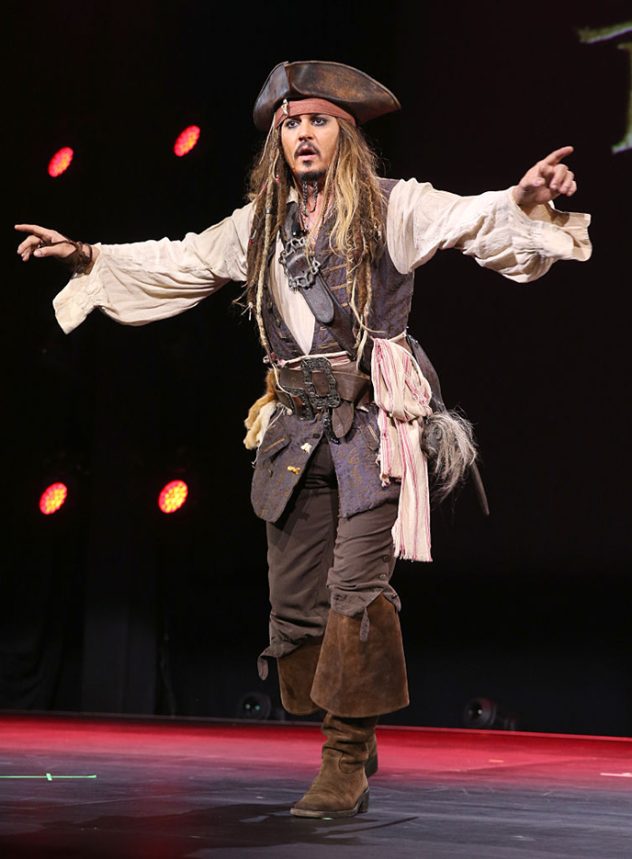
THE MERCHANT AS A CELEBRITY
FLEMISH BEAVER HAT
FORKING BEARD
MOTLEY DRESS
BUCKLED BOOTS

Slide 7
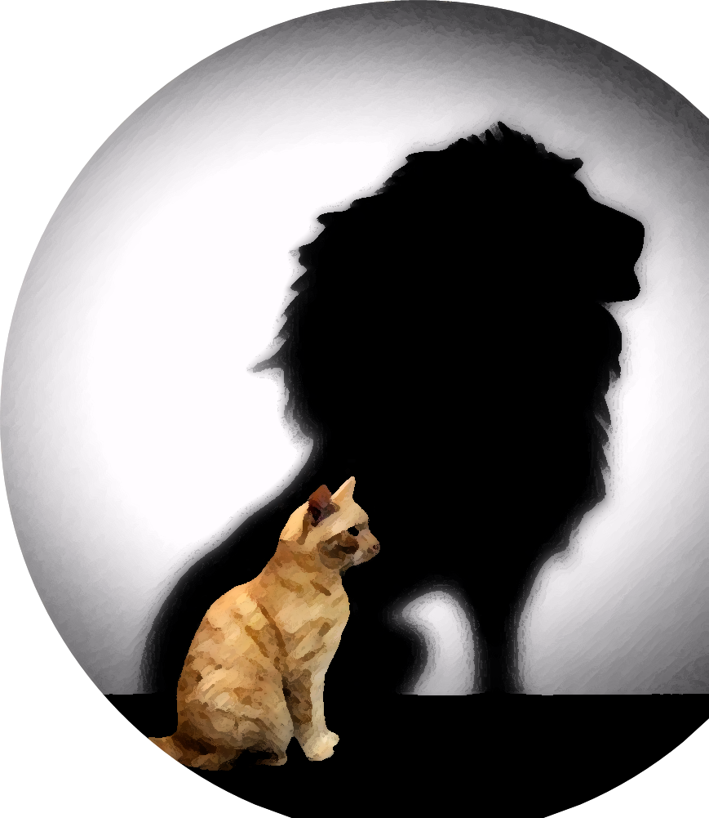
the merchant as a symbol
The image reminds of:
the idea of arrogance
the merchant’s desire to appear different from his true nature.

Slide 8
The merchant nowadays
negative impression of the merchant
contrast between what he tells people and his true nature
anyway
the merchant is a realistic character

Slide 9
The merchant in the middle ages
Affirmation of the middle class in the 14th century
Profound novelty within medieval society static vision of reality
Political satire towards the middle class
merchants
liars who manage to hide their true nature.

Slide 10
CREDITS
Bosich Simone
Bozza Luigi
Dotteschini Giulia

