Slide 1
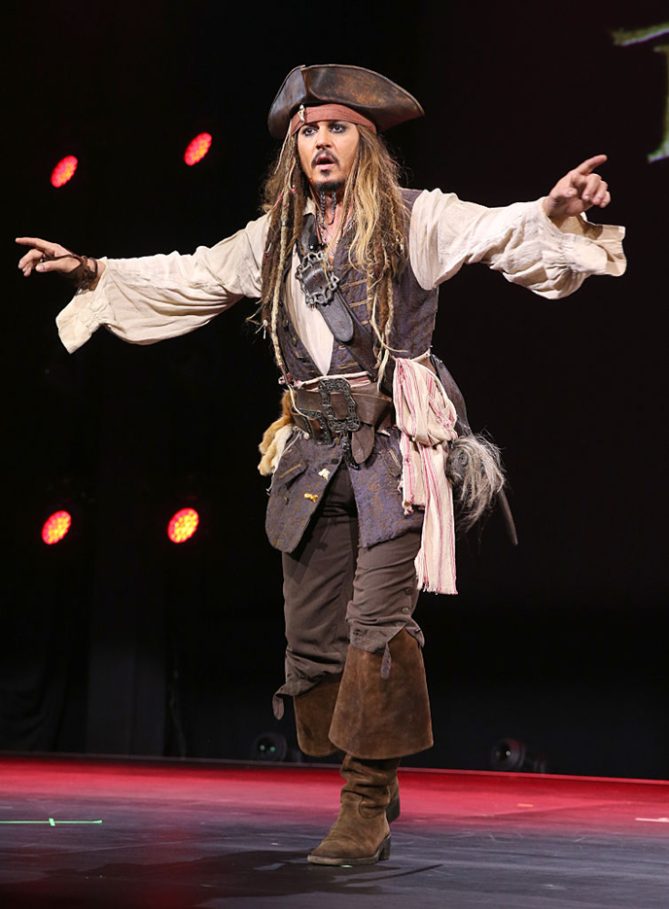
THE MERCHANT
FLEMISH BEAVER HAT
FORKING BEARD
MOTLEY DRESS
BUCKLED BOOTS

Slide 2
INDEX
THE MERCHANT’S PERSONALITY
THE MERCHANT AS A SYMBOL
THE MERCHANT NOWADAYS
THE MERCHANT IN THE MIDDLE AGES

Slide 3
THE MERCHANT’S PERSONALITY
The merchant is an extravagant and eccentric person, as the reader can easily notice by his eye-catching dresses style that underlines his desire to show people his high social status and richness.
His posture, connoted by the expression “High on his horse he sat”
makes clear the merchant’s great consideration of himself.
He always speaks “In solemn tones” about his increase, thus making people
believe he is a wise and intelligent person but to tell the truth, he is
not as competent in business as a merchant should be, indeed he’s always in debt.

Slide 4
the merchant as a symbol
The lion reminds the idea of arrogance, that is the merchant’s feature mostly underlined by the poet.
The imagine underlines the merchant’s desire to appear different from his true nature.

Slide 5
The merchant nowadays
The contemporary reader has a negative impression of the merchant because of the contrast between what he tells people about him and his true nature.
He thinks that is an arrogant and liar man who isn’t even able
in doing his job.
Anyway, people nowadays are used to dealing with arrogant and liar people,
therefore, contemporary readers consider the merchant a realistic character,
recurring as in films and novels as in real life.

Slide 6
The merchant in the middle ages
The figure of the merchant manifests the affirmation of the middle class in the 14th century,
which acquires more and more power and possesses a lot of money.
Chaucher through the Merchant’s characterization makes a political satire towards this
social class, showing its representatives, the merchants, as liars who, by ingratiating
themselves with people through words and luxury goods, manage to hide their true nature.
Furthermore, the figure of the merchant is usually connoted in a negative way as it constitutes
a profound novelty within medieval society, which has a static vision of reality and condemns
everything related to exploration and the encounter with diversity.

Slide 7
MEMBERS
Dotteschini Giulia
Bosich Simone
Bozza Luigi

