Slide 1
Article 7
«All are equal before the law and are entitled without any discrimination to equal protection of the law. All are entitled to equal protection against any discrimination in violation of this Declaration and against any incitement to such discrimination. »
GROUP 2
Baggio Matteo, Bolzan Mario, Sorrentino Alessandra & Tuniz Chiara

Slide 2
Index
Article Definition
How is the article abused nowadays?
An example from history
Relations to us

Slide 3
Article Definition
Article 1: “Every human being is born with same dignity and with same rights”.
Political views
Gender
Race
They do not represent a principle according to which some are superior to others before the law.

Slide 4
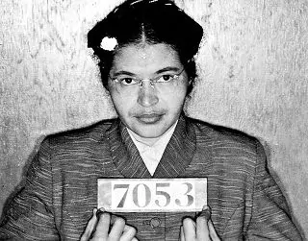
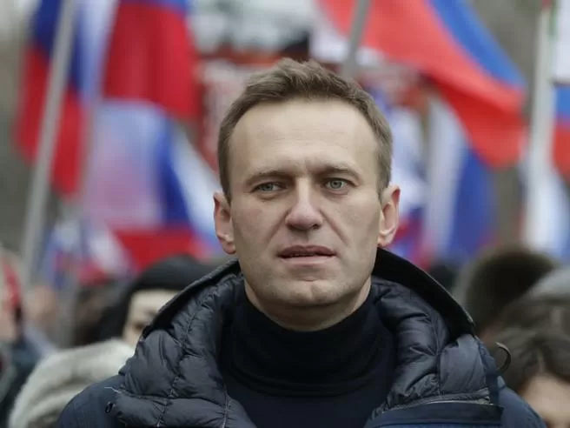
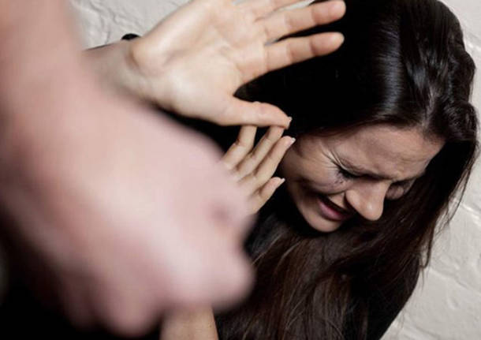
How is the article abused nowadays?
Decriminalization of domestic violence, Russia, 2017
Rosa Parks, USA, 1955
Alexei Navalny, Russia, 2021

Slide 5
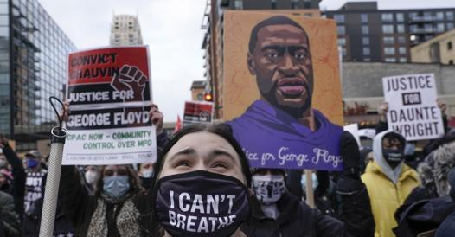
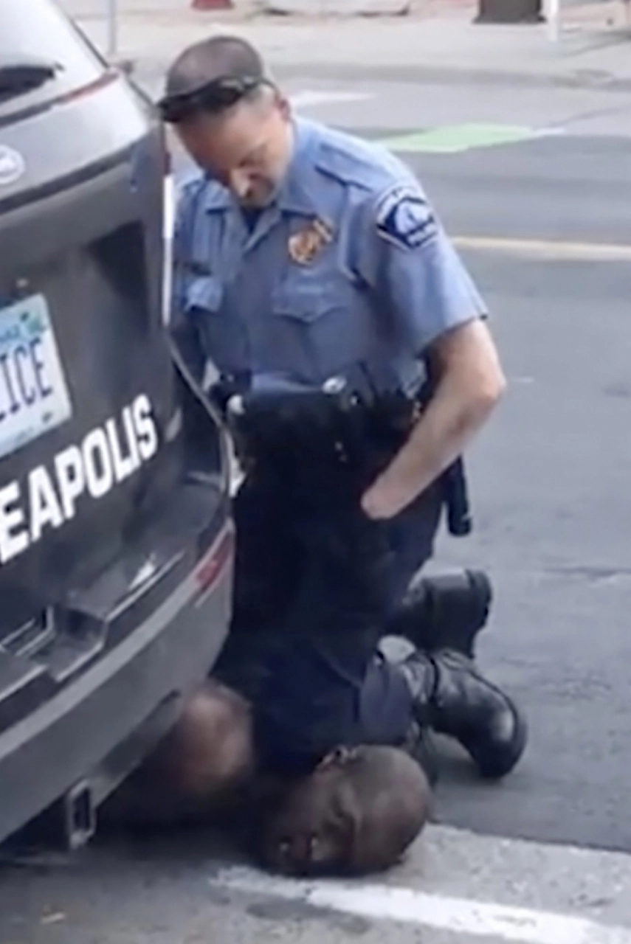
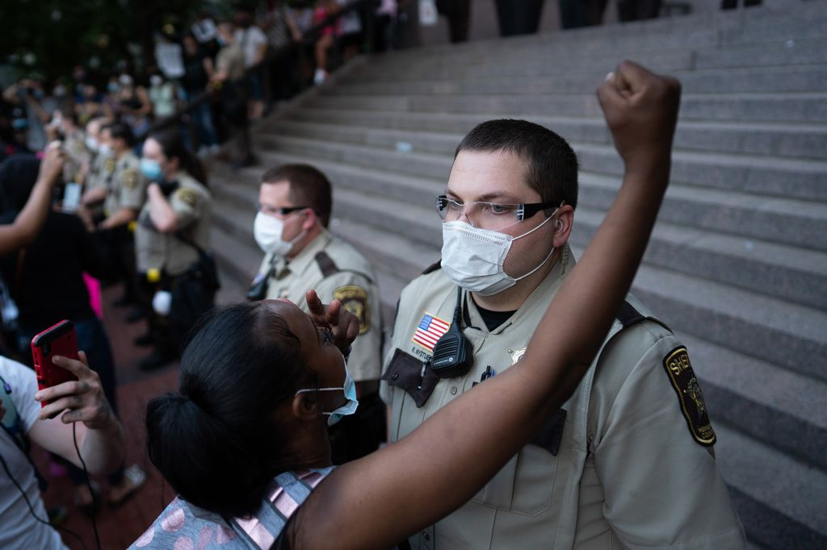
An example from history George Floyd
He was denied the right to a fair trial in court because of his skin’s colour
After a year of protestations, the responsible of his dead has been condemned for homicide
He suffered an abuse of power

Slide 6
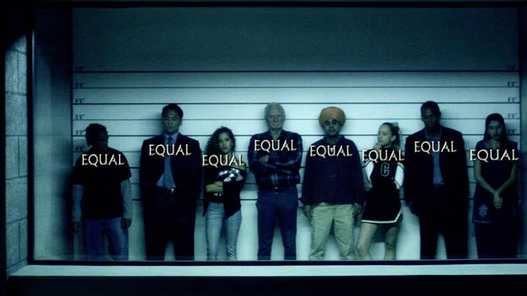
Relations to us
We believe article 7 is fundamental
Its existence should be taken for granted
Same duties → same rights
Nowadays, human rights are not always respected

Slide 7
Webliography
https://www.globalist.it/world/2017/01/30/io-non-sto-zitta-le-donne-russe-contro-la-depenalizzazione-delle-violenze-in-casa-211092.html
https://www.ispionline.it/it/pubblicazione/russia-navalny-processato-e-condannato-28947
https://www.ilfattoquotidiano.it/2021/04/21/george-floyd-lex-poliziotto-chauvin-condannato-per-omicidio-la-lettura-della-sentenza-in-tribunale-video/6173052/
https://www.un.org/en/about-us/universal-declaration-of-human-rights
https://it.wikipedia.org/wiki/Rosa_Parks
https://www.nytimes.com/2020/05/31/us/george-floyd-investigation.html

