Slide 1
The Canterbury Tales
Detail by Ezra Winter
by BAGGIO MATTEO & BOLZAN MARIO

Slide 2
Index
The Canterbury Tales
Geoffrey Chaucer
The Physician
The Physician’s personality
The Physician as a symbol
The Physician in the middle ages
The Physician nowadays
Emmet L. Doc Brown

Slide 3
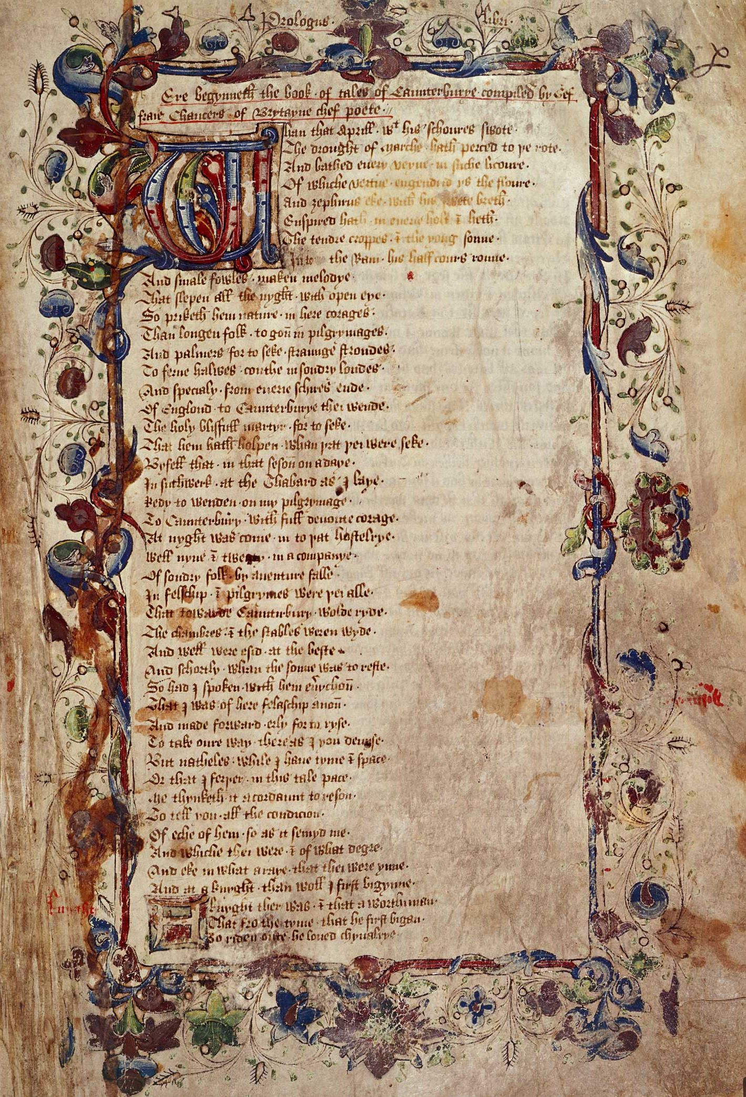
The Canterbury Tales
24 stories collection by Geoffrey Chaucer in Middle English
Written between 1387 and 1400
The most frequently used technique is the frame story
24 pilgrims, who travel from London to Canterbury
Each character of the poem wants to represent a specific social class
A page from the original text of the Canterbury Tales

Slide 4
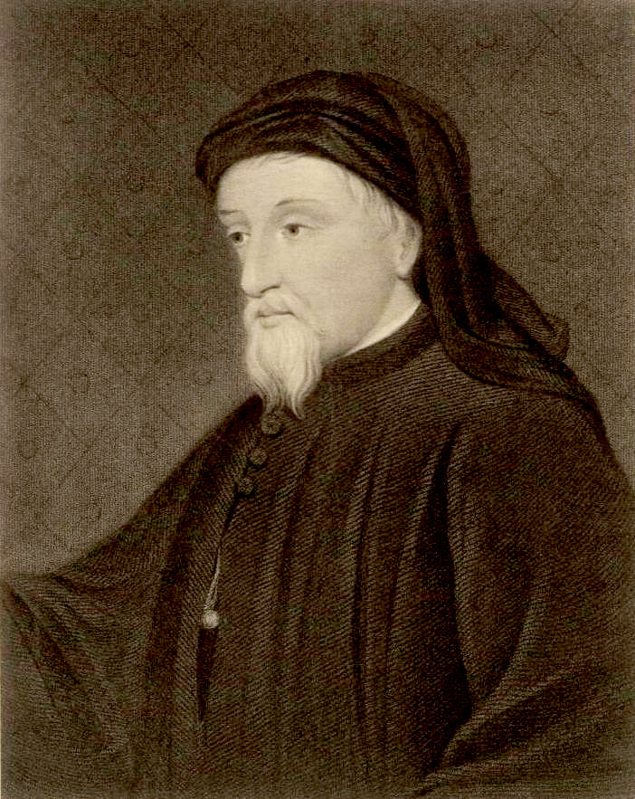
About Geoffrey Chaucer
When was Chaucer born, and when did he die?
What were his links to royalty?
What roles did he fulfil in life?
The first that employs Middle English for literature
Portrait of Chaucer

Slide 5
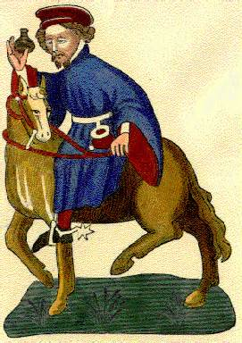
The Physician
Illustration of the
Physician
Presented with the telling technique
Strategies:
His job → “With us there was a doctor in physic"
His fields of expertise → "For talk of medicine and surgery; /… grounded in astronomy"
His diet → "he was measured as could be, … / But nourishing and easy to digest"
His dressing-style → "In blue and scarlet he went clad"
His relationship with money → "loved he gold exceeding all"

Slide 6
The Physician as a symbol
This value isn’t associated to Middle Ages, but it’s quoted in Physician's prologue
What is empathy?
The Physician is very empathic:
"He knew the cause of every malady, Were it of hot or cold, of moist or dry, And where engendered, and of what humour;"
The symbol for empathy

Slide 7
The Physician in the Middle Ages
The Physician represents the growing classes which enriched after the plague
As everyone during Middle Ages, he was quite stingy
However, he was a doctor willing to help other people
The Physician’s work is one of the first jobs to admit a form of rationality which doesn’t correspond to religion

Slide 8
The Physician nowadays
The contemporary reader may interpret the physician as a person who is really in his job,. However, he was very attached to money.
Nowadays everyone is tied to money → he is an actual character

Slide 9
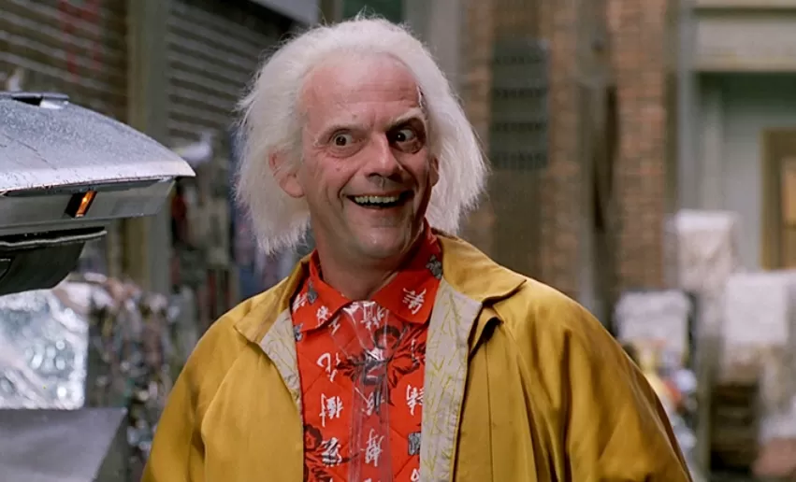
Emmett L. “Doc” Brown
Similarities:
They both wear eccentric clothes
They are nice and helpful people, moreover emphatic
They are both excellent scientists and technologists
Differences:
Doc is quite poor and he’s not as stingy as the Physician

Slide 10
Webliography and Bibliography
The Physician’s introductory paragraph
The Physician’s introductory paragraph translated
A. Martelli, I. Bruschi, I. Nigra, It’s Literature 1, Rizzoli Languages (2019)
End

