Slide 1
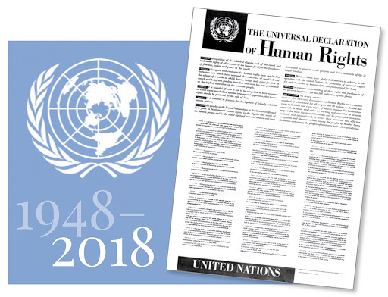
WEB QUEST
GROUP: 2
MEMBERS: Bosich Simone
Bozza Luigi Dotteschini Giulia
CLASS: 3lsca
OBJECT: “Universal Declaration of Human Rights”
ARTICLE NUMBER: 19

Slide 2
ARTICLE 19
“Everyone has the right to freedom of opinion and expression; this right includes freedom to hold opinions without interference and to seek, receive and impart information and ideas through any media and regardless of frontiers.”
Why did the UN General Assembly consider it necessary to include this article in the UDHR?
It has been violated several times in the past
Nowadays it is still abused in many states.

Slide 3
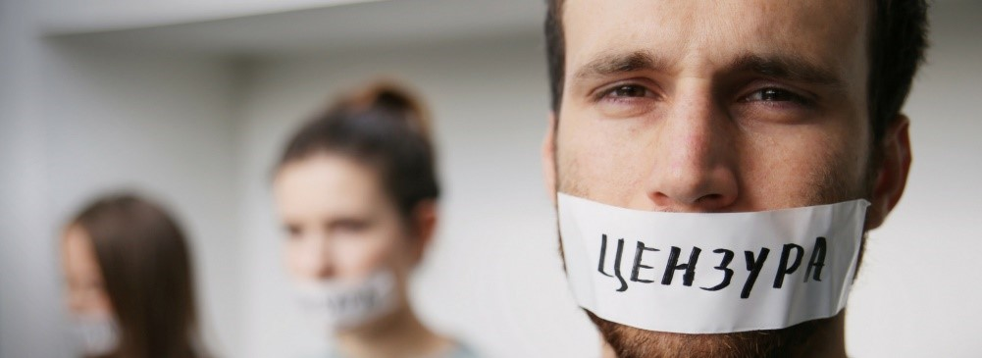
THE ARTICLE’S INFRINGEMENTS TODAY
Russia repressed political dissent with force and pressured independent media and human rights defenders
In the Democratic Republic of the Congo, the government attacked human rights defenders and restricted freedom of expression censoring newspapers
In Egypt a human rights researcher ,Patrick George Zaki, was beaten and tortured because he was accused of publication of fake news and incitement to protest.

Slide 4
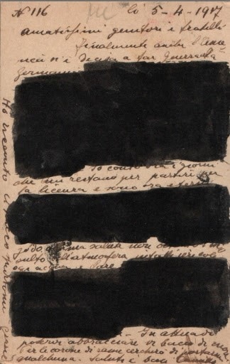
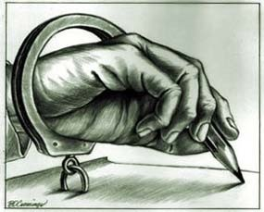
THE ARTICLE’S INFRINGEMENTS IN THE PAST
From 1925 to 1929, Fascism became entrenched in power and repressed all forms of freedom of expression:
Opposition deputies were denied access to parliament
Censorship was introduced in December 1925.
The political police exercised a strict control over the citizens’ lives.
Fascist Censorship’s main goals were:
Control over the public appearance of the regime
Check of the public opinion as a measure of consensus

Slide 5
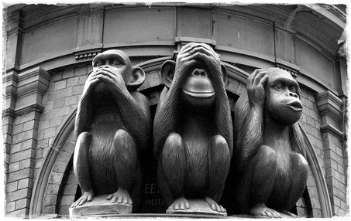
THE ARTICLE’S IMPORTANCE
The UDHR’s 19th article is one of the most significant since it guarantees equality, necessary to reach the peace in the world.
All opinions have the same value and must be respected
Nobody has the right to impose his own viewpoint to the others.
WHAT CAN WE DO IN OUR DAILY LIFE?
Do not remain indifferent and fight against injustices
Get informed on what’s happening in the world
Remove prejudices

Slide 6
WEBLIOGRAPGHY
http://www.un.org/en/documents/udhr/index.shtml
http://www.humanrights.com/what-are-human-rights/violations-of-human-rights/article-3.html
https://en.wikipedia.org/wiki/Censorship_in_Italy
https://www.amnesty.it/appelli/liberta-per-patrick/
https://en.wikipedia.org

