Slide 1
The pardoner GROUP 5 – WEB QUEST ACTIVITY
Serena giorgia – tecla stabile

Slide 2
INDEX
GENERAL KNOWLEDGE
CHARACTER - THE PARDONER
THE PARDONER - CHARACTERIZATION
The pardoner - celebrity relationship
The pardoner - symbol
The pardoner in the middle age
The pardoner today

Slide 3
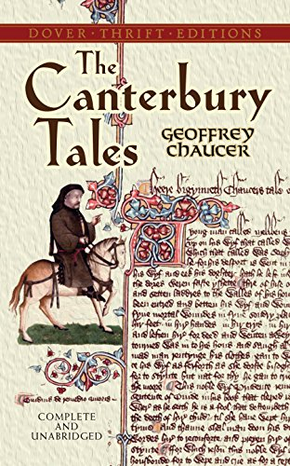
General knowledge
The pardoner is a character of the Geoffre Chauser’s work “The Canterbury Tales”;
“The Canterbury Tales” was wrote between 1387 and 1400;
The work is a frame story;
The work tells about some pilgrims going to Canterbury, along the way they tell some stories.

Slide 4
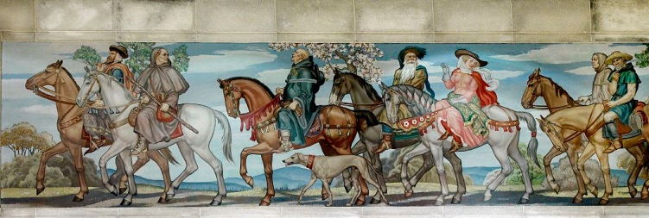
Character – The Pardoner
Each character presents in the pilgrims stories represents a different social class of the Middle Ages
The Pardoner is introduced in the General prologue
His tale is present in Fragment VI.

Slide 5
THE PARDONER - Characterization
Most important strategy: irony (“Was no such pardoner of equal grace”)
Additional strategies:
Physical description (“hair as yellow as wax”; “shiny eyes he had as has a hare”, “no beard he has”)
His voice (“A voice he had that sounded like a goat”)
His riding style (“It seemed to him he rode in latest style”)
His action
His position in the Church

Slide 6
The pardoner celebrity relationship
Celebrity that looks like the pardoners: Owen Wilson in the role of Hansel McDonald, in the film "Zoolander“.
They both:
Wear long blonde hair;
Have no beard;
Have bright eyes;
Show excessive care for their image;
Have a feminine voice, movements and facial expressions.

Slide 7
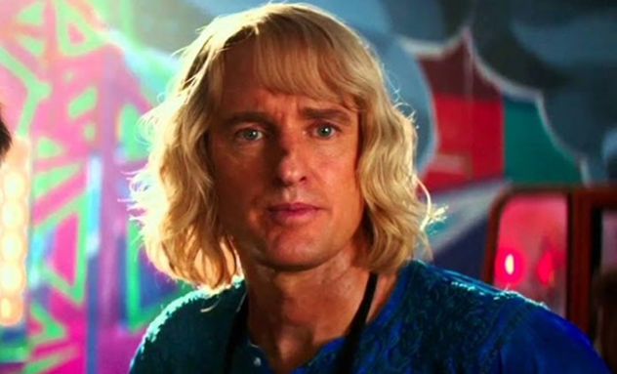
The pardoner celebrity relationship
The characters are both placed in an ironic context
The watcher doubts their virility, there is a suspicion of a possible homosexuality

Slide 8
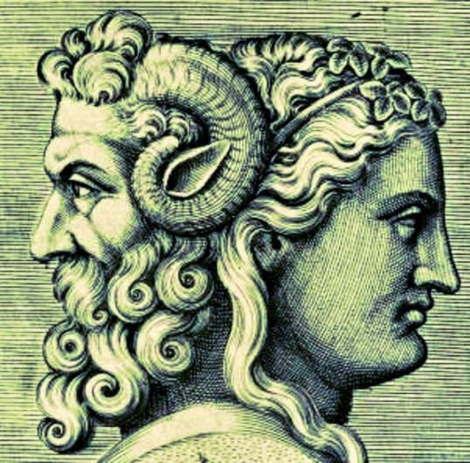
The pardoner-symbol
We chose Janus because he represents the current saying "having a double face“.
Similarity between the god and the pardoner:
deviations of attitude;

Slide 9
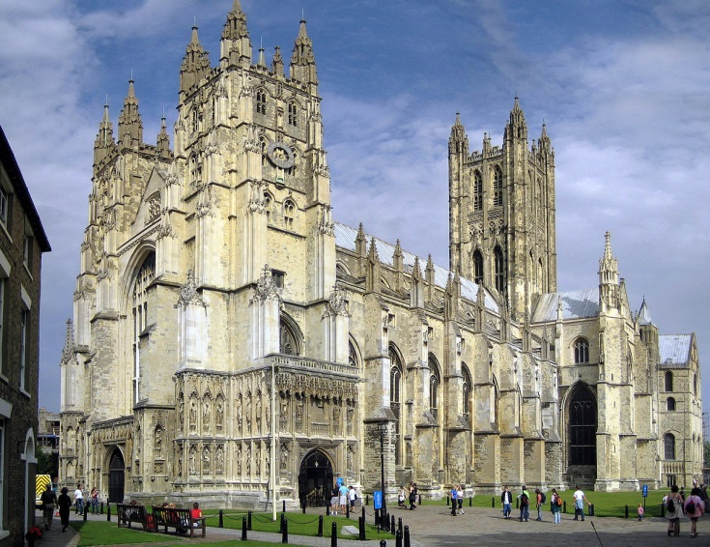
The pardoner in the middle age
HISTORICAL BACKGROUND
The Investiture Controversy: the war between the Church and the Emperor;
The trip to Canterbury is significant: there was the remains of Thomas Becket, a martyr of the war.

Slide 10
The pardoner in the middle age
MEDIEVAL SOCIETY
The pardoner is an example of religious man in the Middle Age
He travels a lot and spread the Christianity values
The pardoner is an accuse to the Church and his corrupted proponents

Slide 11
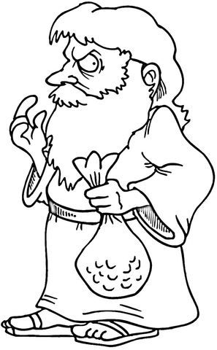
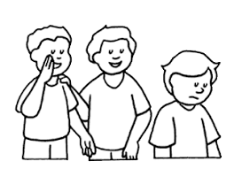
The pardoner today
A modern reader may associate the pardoner to:
Judas, a man of faith that betrayed Jesus to earn a sum in money
Politicians
Friends who later do not turn out to be such
Unscrupulous salesmen and flatterers

Slide 12
Thanks for the attention
Serena giorgia, stabile tecla

