Slide 1
Publishing Houses
in Sardinia
Editoria in Sardegna Group 1
Battiston Matteo
Cleber Alice
Mazzolin Silvia
Savorgnan Enrico

Slide 6
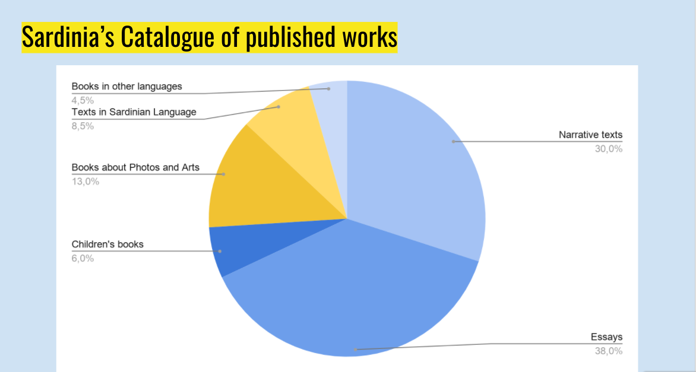

Slide 7
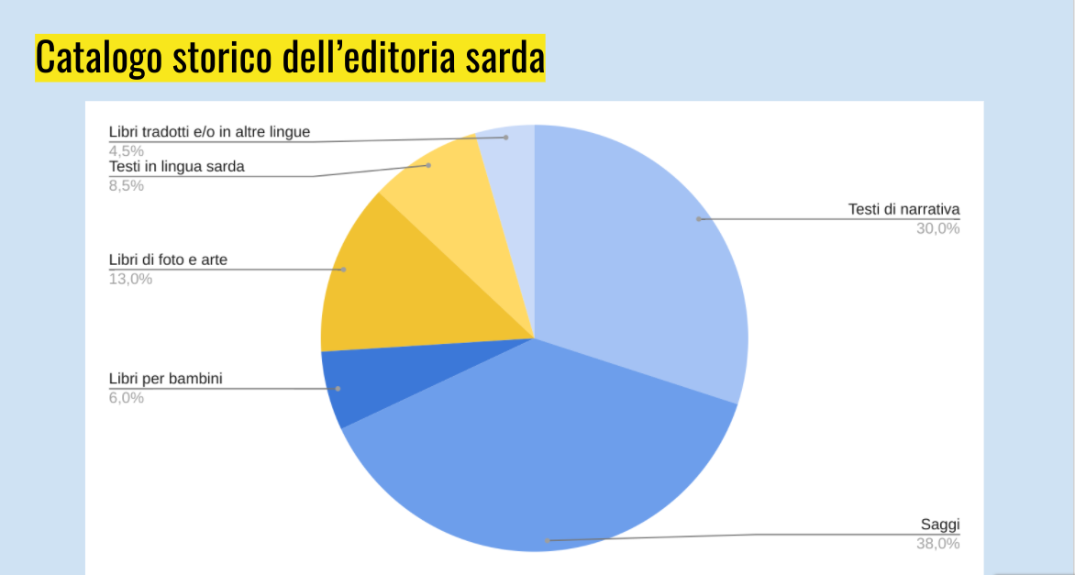

Slide 8
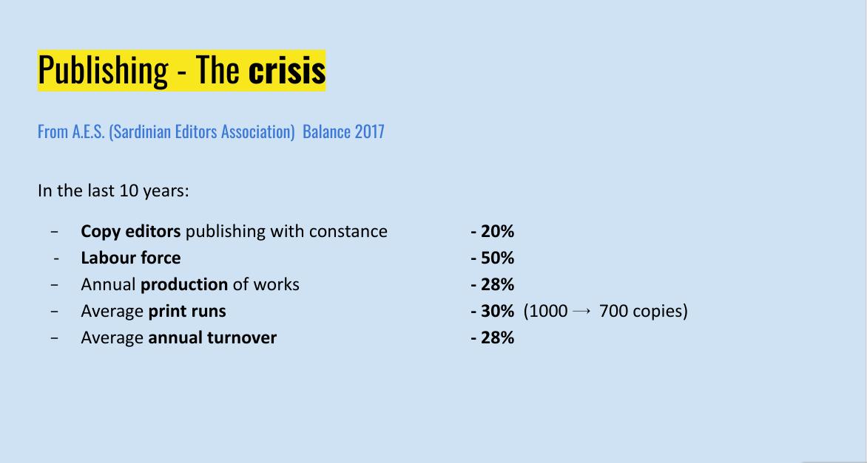

Slide 9
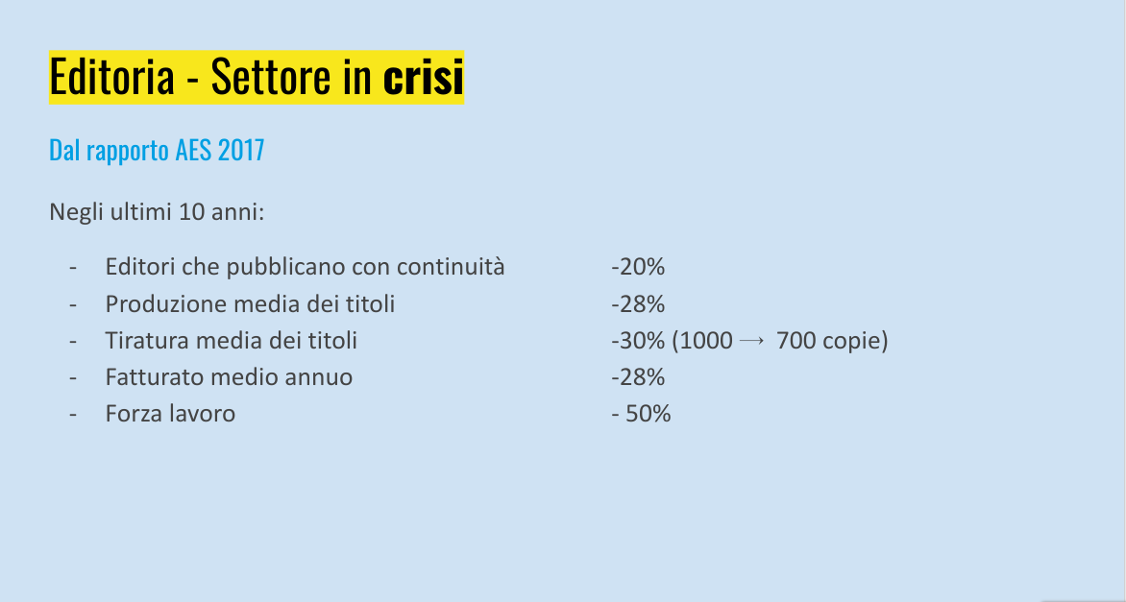

Slide 11
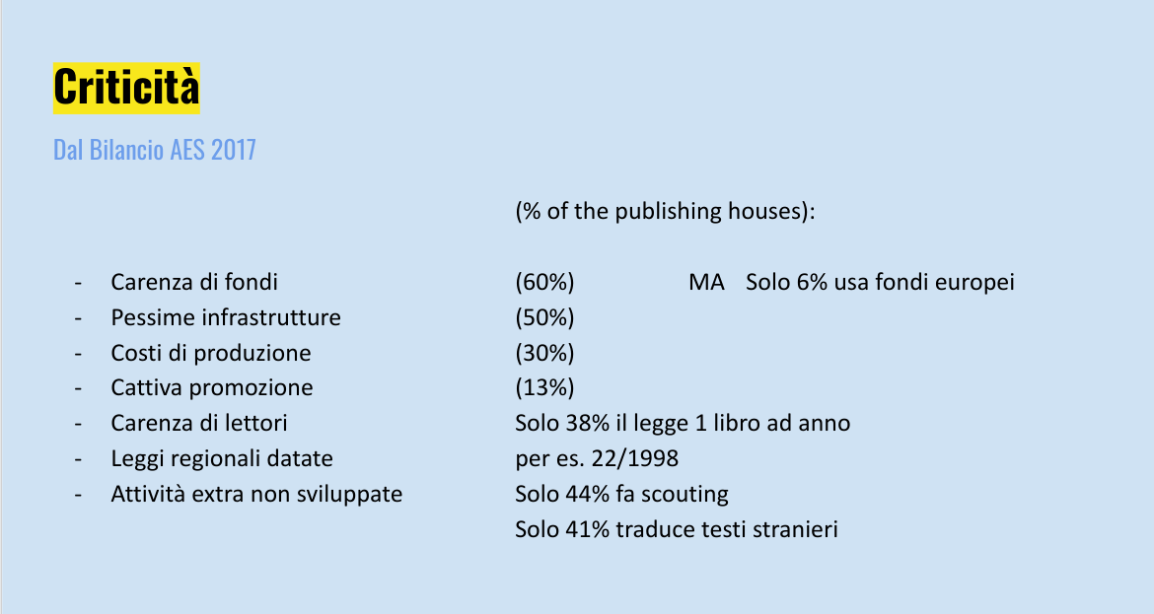

Slide 12
Sitegraphy - Sitografia
www.nationalia.info
https://www.sardegnaricerche.it/attivita/parcotecnologico/
https://www.statista.com/statistics/531010/unemployment-rate-italy/
https://fred.stlouisfed.org/series/LRIN64TTITQ156N
https://ec.europa.eu/eures/main.jsp?countryId=IT&acro=lmi&showRegion=true&lang=en&mode=text&regionId=IT0&nuts2Code=%20&nuts3Code=null&catId=403
https://ec.europa.eu/eures/main.jsp?catId=403&lmi=Y&acro=lmi&lang=en&recordLang=en&parentId=&countryId=IT&regionId=IT0&nuts2Code=%20&nuts3Code=null&mode=shortages&regionName=Sardegna
https://www.laleggepertutti.it/411158_quali-sono-le-regioni-a-statuto-speciale#:~:text=Anche%20dopo%20la%20riforma%20del,cui%20esercitano%20la%20potest%C3%A0%20legislativa
https://www.regione.sardegna.it
https://www.sardegnacultura.it/
SardegnaTurismo - Sito ufficiale del turismo della Regione Sardegna

Slide 13
https://www.sardegnareporter.it/2020/08/la-crisi-delleditoria-libraria-sarda-e-il-silenzio-dellassessore-biancareddu/340767/
http://search.regione.sardegna.it/cgi-bin/RSsearch.pl?key=editoria&categ=11&type=&funz=and&stop=30&submit=vai
https://knoema.com/atlas/Italy/Sardinia
https://www.giornaledellalibreria.it/news-mercato-leditoria-sarda-dimensioni-e-criticita-3338.html
https://www.aie.it/Portals/_default/Skede/Allegati/Skeda10-291-2021.1.27/Sardegna_2015_2019.pdf?IDUNI=bg5lv4lu32twcucwnwzlwl1b671
https://www.regione.sardegna.it/j/v/2568?s=10516&v=2&c=212&t=1
https://www.filmitalia.org/it/filmcommission/33739/
https://www.istat.it/it/files//2021/01/Report-Editoria-Lettura-Tavole-statistiche-2019.xlsx
http://dati.regione.sardegna.it/dataset?organization=ras-sardegna-statistiche
https://www.istat.it/it/files//2020/05/20_Sardegna_Scheda_DEF.pdf
http://www.regione.sardegna.it/documenti/44_944_20210105181333.pdf
https://www.sardegnaimpresa.it/coronavirus-ecommerce/
https://www.sardiniapost.it/cronaca/infrastrutture-tecnologiche-per-imprese-nuovi-investimenti-per-il-crs4-di-pula/

