Slide 1
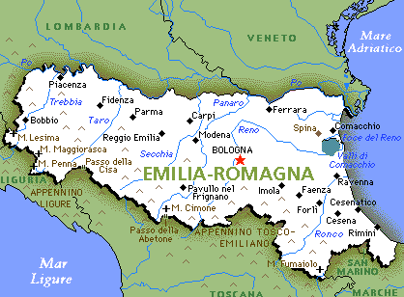
BRIEFING OF EMILIA ROMAGNA

Slide 2
LABOUR MARKET OVERVIEW
People active in the labour market 2.2 milion
50 % of the populatioon ( 4.4 milion )
the highest percentage among the Italian regions.

Slide 3
Increase of employment 7,4% (2019)
higher than the value of EU 28 (69.3%)
includes those aged 15 – 34
Covid 19 consequences:
Employment fixed-term and temporary work
Activities services
Business
Tourism sector (important role in the region)

Slide 4
Reduction of jobs affected mostly women because they are(due to health emergency) the majority of workers in tertiary
activities
lower level Unemployment rate 5,5% (2020)
Bologna
Parma 7% women 4,3% men
Reggio Emilia
Ravenna Lower than the National average

Slide 5
The economic system: the main production chains
Machinery
Automobiles
Agriculture machinery
Food-processing machinery
Construction
Fashion
Health
Culture
Creativity

Slide 6
Temporary contracts 17% of workers
Trade
Tourism
Agricultural activities
High labour mobility service activities
education and training mathematical sciences and IT and specialized professions engineering

