Slide 1
ARTICLE 18
GROUP 3
BLASI GIULIA
KUMAR ANPURNA
REGENI CELESTE

Slide 2
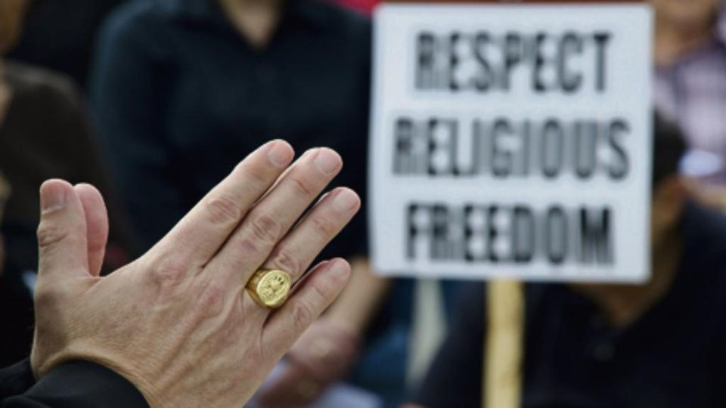
Article 18
Everyone has the right to freedom of thought, conscience and religion; this right includes freedom to change his religion or belief, and freedom, either alone or in community with others and in public or private, to manifest his religion or belief in teaching, practice, worship and observance.
This article states that eveybody is free to have their own thoughts, to confess the religion in which they reflect themselves the most and it also includes freedom of conscience. In this right we can also find the freedom to change religion or belief, in community or either alone and it affirms that everyboby has the right to manifest their religion by teaching, practicing, worshipping and even by just giving opinion on it.
The UN General Assembly might have thought it necessary to include this article because freedom of religion is one of the most precious rights since it protects the freedom of an individual to hold identity-shaping, profound convictions about the deeper meaning of life and to engage in conviction-based practices either alone or in community with others, and in public or private.

Slide 3
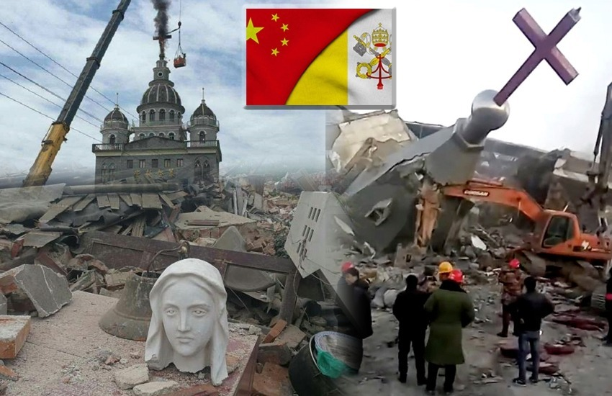
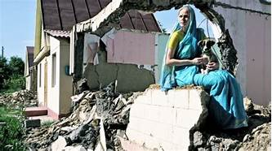
Uighur minority's genocide in China.
Christians’ persecution in China.
Hare Krishna community's homes' destruction in Kazakhstan

Slide 4
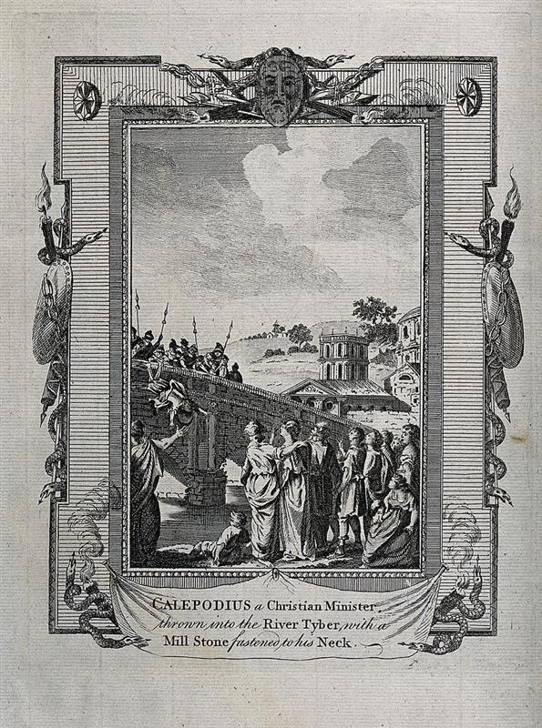
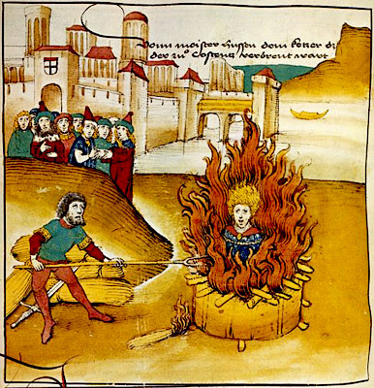
The reasons of Christians’ persecution were various:
they were accused of being;
they were considered deserters;
they were recognized as the cause of natural disasters;
As an aftermath Christians were arrested and killed; afterwards 3 edicts were emanated:
Edict of Tolerance in 311 AD;
Edict of Milan in 313 AD;
Edict of Thessaly in 380 AD;
These Edicts, step by step, gave Christians the absolute freedom to profess their religion.
This article has been abused throughout history and especially during the Roman Empire and it was violated by:
Nero in 64 AD;
Domitian in 89 AD;
Decius in 250 AD;
Diocletian in 303 AD.

Slide 5
How can we help to ensure that this article won’t be violated again:
Through education;
Through internet;
Through new generation.
Despite what has happened in history, we keep making the same mistakes even though we are living in a world that has changed and evolved a lot. We can see how a lot of people are still getting persecuted for their religion belief and some of them are Christians that are getting crucified or beheaded in Iraq by ISIS extremists. In our opinion it’s not normal for an article like this to exist because we believe that freedom of religion and thought should be indisputable choices. What makes us sad is that, even if we are living in the 21st century, the article 18 is still getting violated by many people and countries. We also strongly consider that only the young generation can change this dull society.

Slide 6
Resources:
https://www.un.org ;
https://www.bbc.co.uk ;
https://www.humanrights.com ;
https://www.thesun.co.uk ;
https://en.wikipedia.org ;
https://www.storiain.net ;
http://www.santangela.info/wp-content/uploads/2013/12/Le-persecuzioni-romane-e-gli-editti-della-libertà-2.pdf ;
https://appgfreedomofreligionorbelief.org/article-18-violated-universally-house-lords-debate/ .
Thanks for your kind attention!

