Slide 1
The english reinassance and the puritan age
Historical and social background

Slide 2
The reinassance
PERIOD: This period covers the whole of the 16th century and part of the 17th. It is devided into shorter periods: Elizabethan Age, Jacobean Age and the Age of Milton. There is no exact date at which the Middle Ages can be said to end and the Renaissance to begin. As always happens, the old and the new learning mixed together for several decades.
CONTRASTS: The English Renaissance was an age of great changes and great contrasts: king vs Parliament; Anglicanism vs Puritanism; aristocracy vs rich middle class. Life was hard for the lower classes and unemployment was high. The slave trade, the witch hunt, the religious persecutions, the massacres in Ireland demonstrated that not everything was good in the Golden Age. To contrast poverty a Poor Law was passed under Elizabeth. England began to change from an agricultural into a commercial and industrial country.
SCIENCE: The development of the new science and of philosophy changed the picture of the world as seen before. The studies of Nicolaus Copernicus, Galileo Galilei and Johannes Kepler revolutionized astronomy providing a new model of the Universe. The Ptolemaic system was shattered: the earth was not the fixed centre of the universe. Philosophers as Thomas Hobbes and Francis Bacon gave another blow to the traditional beliefs. They rejected the old deductive method in favour of the inductive method
RELIGION: These ideas affected religion, too: the reformation rejected the central church authority in favour of individual conscience. The individual reading of the Bible was encouraged. Many religious movements provided their own correct text of the Bible. In 1611 the King James’ Bible, Known also as the Authorised Version, was adopted in the Anglican Church.

Slide 3
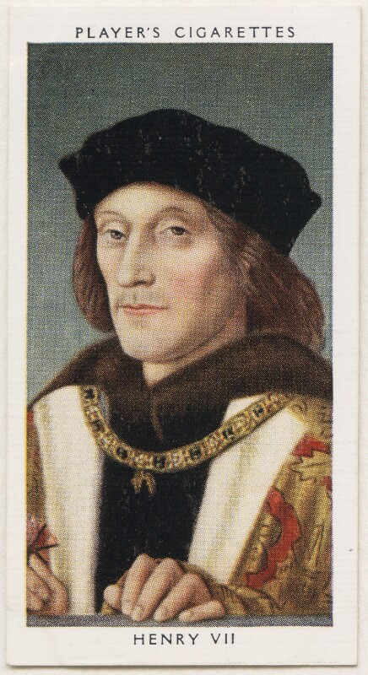
The renaissance
TUDOR DINASTY
In 1485 the Civil war between the families of York and Lancaster ended and Henry VII started the Tudor dynasty. He enforced law and order, encouraged commerce, restored to the Crown much of its former prestige and never summoned Parliament. He followed imperialistic dreams. In this era new classes began to emerge: the gentry, the yeomen and the merchants.
ENGLISH REFORMATION
Henry did not like the spread of Lutheranism in England and defended the Catholic Church against Luther. Nevertheless, he decided to break with Rome, not for theological reasons but for money to cover the cost of his court and of the wars. In order to do this he confiscated gold, silver, jewelry and estates from the Church. The occasion to the break was given by Henry’s decision to divorce his wife Catherine of Aragon. He wanted to marry Anne Boleyn and asked the Pope to declare his marriage null but he refused his request. Henry decided to divorce all the same and in 1534 he summoned Parliament and made it pass the “Act of Supremacy” by which the King was confirmed Supreme Head of the Church of England and Protestantism was recognized as the State Religion. All Englishmen were required to take an oath to accept the rejection of Pope’s authority and recognized the marriage to Anne Boleyn as lawful.

Slide 4
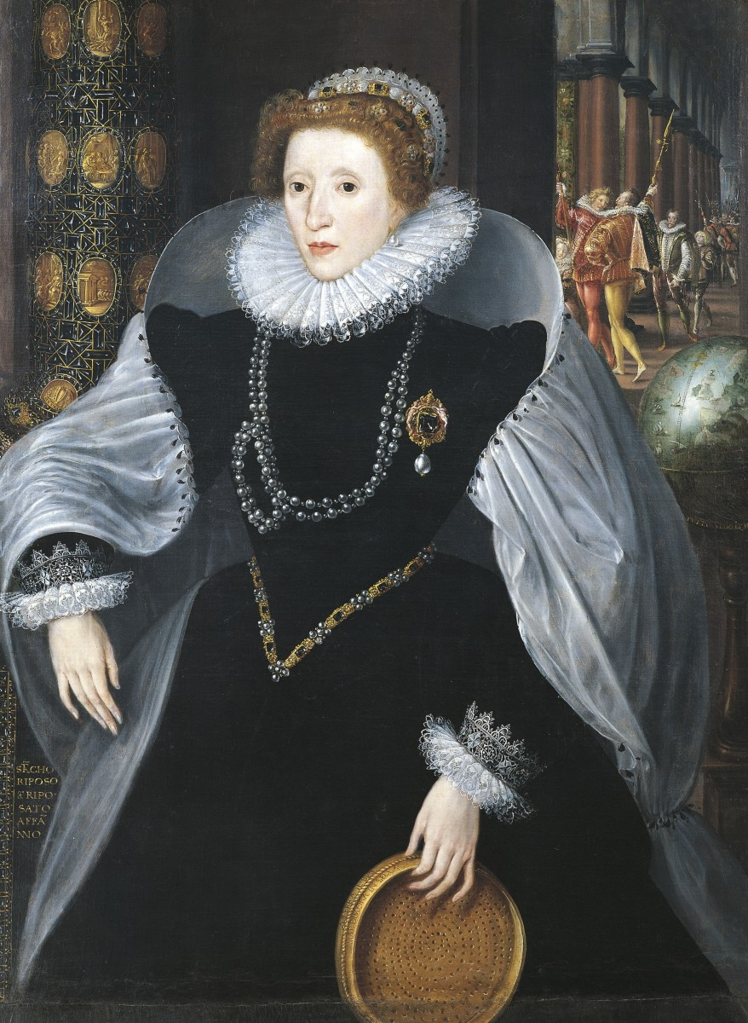
ELIZABETH I
When Mary Tudor died she left behind her a country without religious unity but internal peace and stability was achieved when Elizabeth I came to the throne and re-established the Anglican Church with the “Second Act of Supremacy”. Thanks to this policy of compromise in the religious field, Elizabeth ensured England internal peace and increased wealth and commercial power. After the discovery of America, Elizabeth supported the new explorations thanks to the creation of a powerful fleet. She encouraged the growth of the Royal Navy and the birth of the East India Company.
CONFLICT BETWEEN SPAIN AND ENGLAND
There was a Protestant revolt in the Catholic Scotland, so Mary Stuart, Queen of Scotland and cousin of Queen Elizabeth, had to take refuge in England. The English Catholics, who wanted to restore Catholicism, tried to make her Queen of England but Elizabeth I kept her virtually prisoner for nineteen years. When the latest plot was discovered, Elizabeth consented to Mary’s execution. After Mary’s execution things went worse between Spain and England. The frictions brought to open war in 1588 when Philip II of Spain tried to invade England. The Spanish “Invincible Armada”, was defeated in the English Channel and England’s victory saved her independence.

Slide 5
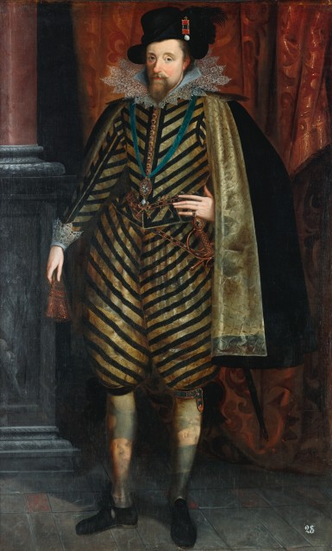
JAMES VI
When Elizabeth died, the throne went to James VI of Scotland. He was the son of Mary Stuart and ruled both England and Scotland as James VI of Scotland and James I of England, the first King of the Dynasty of the Stuarts. The two counties remained separate, with separate Parliaments until 1707 when, under the terms of “The Treaty of Union”, England and Scotland became a single state, the United Kingdom of Great Britain, and the parliaments at Westminster and Edinburgh were replaced by a single Parliament of Great Britain.
THE CALVINIST
The Calvinists, called Puritans in England, wanted to purify the Anglican Church. Unlike the Tudors, who had always realized that their strength came from Parliament and from the people, James believed in the “Divine Right” of the Kings: a king answered for his actions to God alone because he received authority from God. He believed that the powers of Parliament were a concession of the King. In the religious field he discontented both the Puritans and the Catholics. There was a strong reaction of the Catholics and Puritans who tried to blow up the king and Parliament, the first one were sent to death and the Puritans persecuted. A group of them, known as “The Pilgrim Fathers”, sailed on board the “Mayflower” and landed in North America. There they founded New Plymouth, starting the beginning of the future United States.

Slide 6
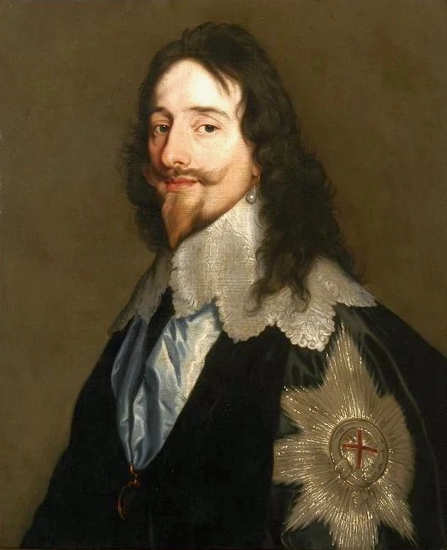
THE PURITAN AGE
CHARLES I
Charles I tried to rule as an absolute king. He was in need of money to support a series of military expeditions against France to help the Huguenots. The House of Commons refused to grant it so he dissolved Parliament trying to obtain money by illegal means and forced loans. As money was not sufficient he called a Parliament again in 1628. The Commons agreed to support the military expenses but asked the king to accept the Petition of Rights. The king refused and didn’t call another Parliament until 1640 when he had to face religious troubles in Scotland. Parliament was summoned again in the same year because Charles needed money. Parliament did not grant the money and asked Charles I to give up control of the country. In 1641, a rebellion in Catholic Ireland was militarily repressed.
The first Civil war broke out in 1642. On one side there were the Royalists or Cavaliers, supported by the Crown and The Anglican Church while on the other side there were the Parliamentarians supported by the Puritan dissenters lead by Oliver Cromwell. The war ended in the victory of the Puritans. Charles I was charged with high treason and was beheaded. England became a Parliamentary Republic, the Commonwealth, and was ruled for some years by the Commons. In 1653 Parliament was dissolved, Cromwell became Lord Protector and the country was under his direct rule. It only lasted until 1660 when a newly summoned Parliament recalled King Charles II, the legitimate heir of the Stuart Dynasty from his exile. Charles restored the Church of England and granted freedom of religion to Puritans and Catholics, even if he his own assent to the Act of Uniformity of 1662 which stated that those who did not conform to the Prayer Book had to be driven out of the Church. In 1672 however he issued a Declaration of Indulgence which suspended all penal laws against Protestants and Catholic non-conformists.

