Slide 1
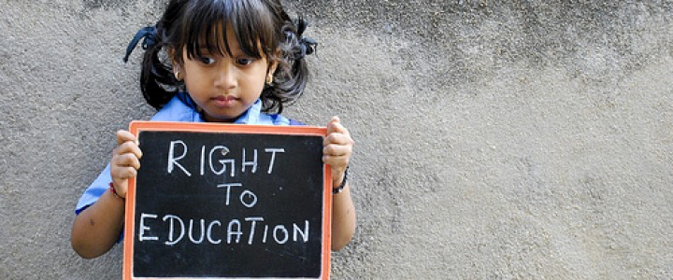
Article 26 : “Right to education” Group composed by Jodie Fabbro, Sara Buiatti, Luna Corbatto e Sonia Di Feola.

Slide 2
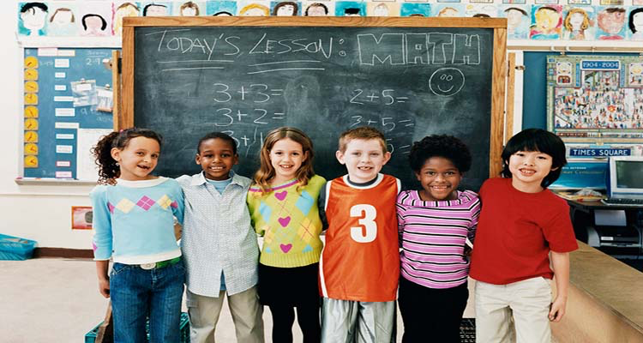
We chose to analyze 26th Article of Universal Declaration of Human Rights.
The article explains how education should be open to everyone.
The UN might have taken the choice to add this right because ‘till now many children aren’t allowed to go to school.

Slide 3
The ways in which the article is violated
Gender differences: often within gender differences there are countries where girls do not have the opportunity to receive an education and are obligated to learn to perform domestic functions and to care for family members.
War and poverty: some children cannot go to school and learn because they live in a country where there are war and poverty and therefore they are forced to fight.
Child labour: often in many countries we are faced with child exploitation. Families who are forced to face poverty alone, because they do not receive any help from the State, they must ask for help from every family member, even the youngest.

Slide 4
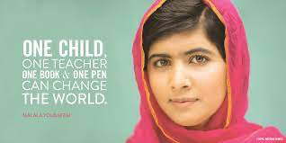
Malala
Malala is a 23 year old Pakistani activist for the right to education. She was born in the North of Pakistan where the Taliban forbade the right to education and civil rights in general to all the women. She became a victim of a Taliban’s attack, because of the blog that she created on the Internet where she reported all the injustices and all her experiences that she lived. After she emigrated in Europe she was able to study and she started to talk about all the experiences she has lived to all the world. For all her commitment she has been rewarded with the Nobel prize for peace in 2014 and Sakharov Prize for the freedom of thought in 2013.

Slide 5
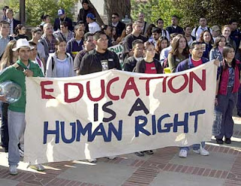
How we can ensure that the article is not violated here and worldwide
In the world there might be a teenager like me who can’t go to school, who has dreams like mine, and the thought that a girl or boy is forced to fight or work instead of studying and creating a future for themselves is crazy.
Because of that, we, who are the future
generation, should share their stories,
just like Malala did, to support those
children, teenagers, families who aren’t
lucky as we are.

Slide 6
Links that helped us to write our presentation:
http://www.amnesty.org/en
http://www.humanrights.com/
http://www.hrw.org/
http://www.un.org/en/
https://it.wikipedia.org/wiki/

