Slide 1
UNIVERSAL DECLARATION OF HUMAN RIGHTS
Article 18
A WEBQUEST
GROUP 3
Members: Di Tomaso – Fain – Robino Form: 1LSAB
Lingua e cultura inglese – Ed. Civica
Prof.ssa M. Beltramini

Slide 2
ARTICLE 18
Everyone has the right to freedom of thought, conscience and religion; this right includes freedom to change his religion or belief, and freedom, either alone or in community with others and in public or private, to manifest his religion
or belief in teaching, practice, worship and observance.
Everybody has the right of thinking what he thinks is correct and practise the religion he wants.
Everyone can manifest his belief in many moods (teaching, practice,
worship and observance), alone or in community, change religion or
thought.

Slide 3
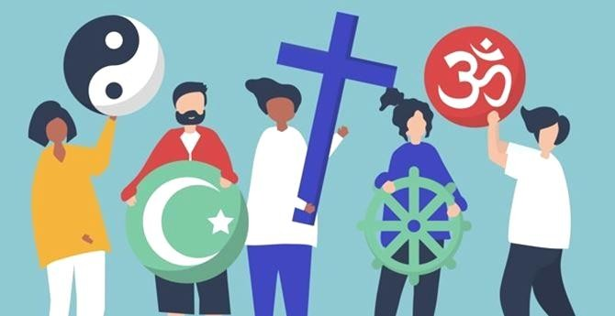
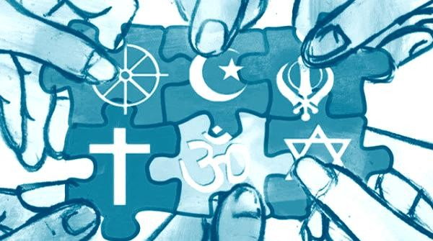
ARTICLE 18. VIOLATIONS
In the next three slides we will show three examples of violations:
Religious restrictions in the world
Freedom of religion in Arab countries.
North Korea’s situation

Slide 4
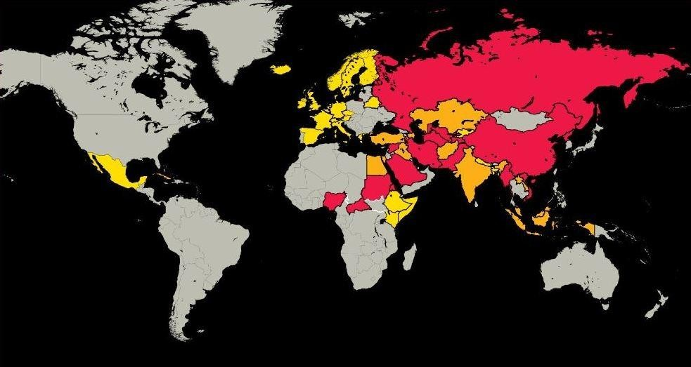
RELIGIOUS RESTRICTIONS IN THE WORLD
Sometimes the article is not respected.
In some countries there is no freedom of religion, for example in :
China
Eritrea
Iran
Russia
North Korea
In the mentioned countries there is a lot of discrimination and religious restrictions.
They are countries with serious situations, but there are also many other countries where the situation is being resolved.

Slide 5
R E L I G I O N I N A R A B I C C O U N T R I E S
What we know about Muslim majority countries is that religious freedom remains a right hanging by a thread.
Let us consider three of those countries: Iran, Egypt and Pakistan.
In Egypt, the road to secularism is still long and the Constitution states 'the principles of Sharia are the main source of legislation'.
In Pakistan, the judicial system is split between the 'ordinary' courts and the ones applying the Islamic law. In recent years dozens of citizens have been punished with the death penalty for offending Mohammed.
In Iran, freedom of opinion is also limited by 'observance of Islamic criteria', while the civil code prohibits marriages between Muslims and citizens of other faiths.

Slide 6
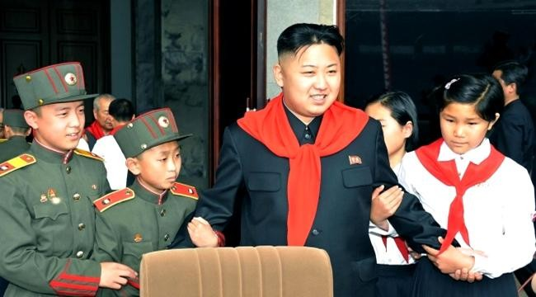
NORTH KOREA
North Korea is a totalitarian regime.
The dictator is Kim Jong-un
The population is influenced by the regime (state religion,violation of press and freedom of demonstration).
Citizens are forced into a state of ignorance and constantly threatened.
For foreign journalists, entering Korea is difficult: controls are very tight
Teachers are controlled by the state, and biographies of politicians and Kim Jong-un himself are also studied at school.

Slide 7
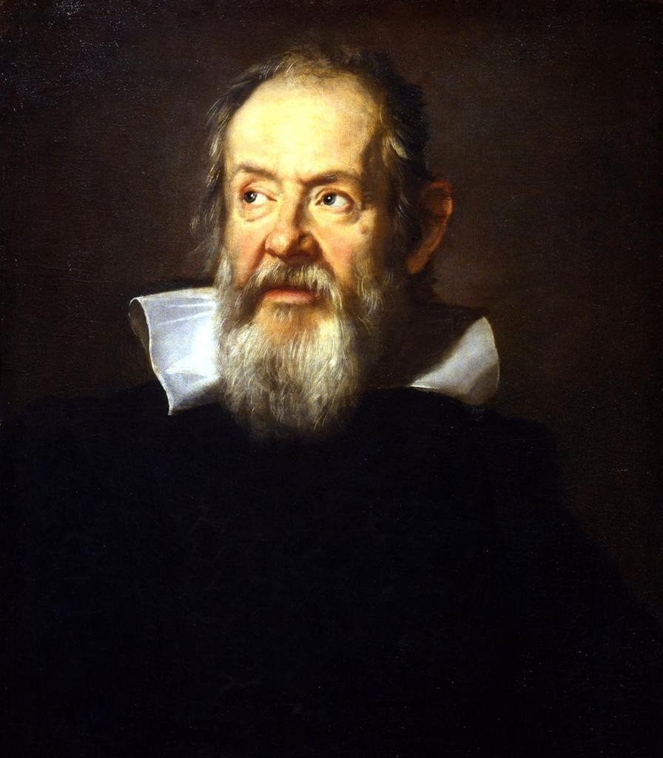
GALILEO GALILEI AND THE CHURCH
Galileo Galilei was a famous Italian scientist.
He lived in Tuscany in XVI century.
He is well-known for his experimental method.
The method consists in:
posing a hypothesis,
finding a thesis
confirming it with some experiments.

Slide 8
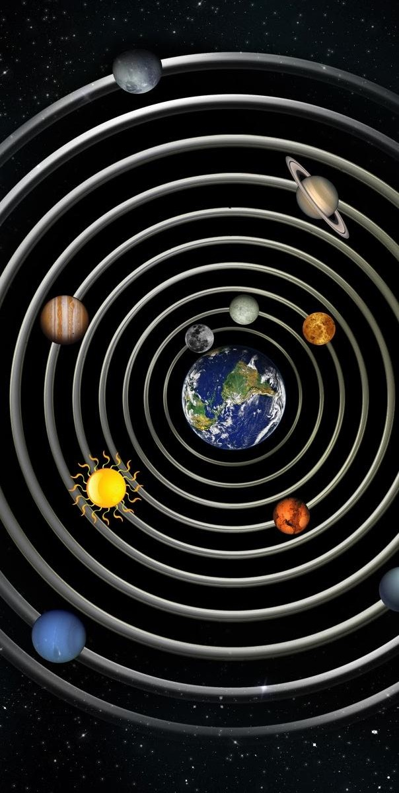
HIIS THEORY
He discovered not all heavenly bodies turn around the earth: he discovered Jupiter has some moons.
The theory, called heliocentric theory was opposite to the geocentric theory, supported by the Church.
For this reason he was sentenced and in 1633 he had to take back
all his theories.
He died before his theory
was recognized.
This event braked the improving of this period’s scientific progress.

Slide 9
OUR THOUGHT ABOUT ARTICLE 18
W e think Article 18 tells about the human beings’ freedoms that cannot be destroyed.
People can deprive us of our religion, but they cannot destroy our thoughts and ideals.
We think everybody should be allowed to express her/himself freely.
Everyone can change his ideas and beliefs.

Slide 10
OUR THOUGHT ABOUT ARTICLE 18
We must remember the mistakes we made in the past and we must make sure they will never happen again.
That is why we have to respect each other , everybody’s culture, religion and thoughts because a world without diversity would be boring. Having different ideals and thoughts is really important.
We can improve the situation in our city or Nation with simple gestures helping someone or a group treated differently or in an unfair way.
Therefore we must celebrate different religions to erase all discrimination.

Slide 11
WEBLIOGRAPHY
https://www.un.org/en/about-us/universal-declaration-of- human-rights
https://www.avvenire.it/mondo/pagine/rapporto-usa-su- liberta-religiosa-aumentano-le-violazioni
http://www.salvisjuribus.it/liberta-religiosa-del-minore-e- responsabilita-genitoriale-nella-dialettica-del-rapporto- educativo-familiare/
http://cistampa.com/story/qual-e-la-situazione-della-liberta- religiosa-nei-paesi-islamici-16282
https://lindro.it/la-corea-del-nord-uno-dei-paesi-piu-isolati-al- mondo/
https://www.studenti.it/galileo-galilei-biografia-scoperte.html

