Slide 1
WEB QUEST Article 22 Group 4: PITARRESI - MAROCCO - FORT class: 1LsaB
"THE RIGHT TO SECURITY"

Slide 2
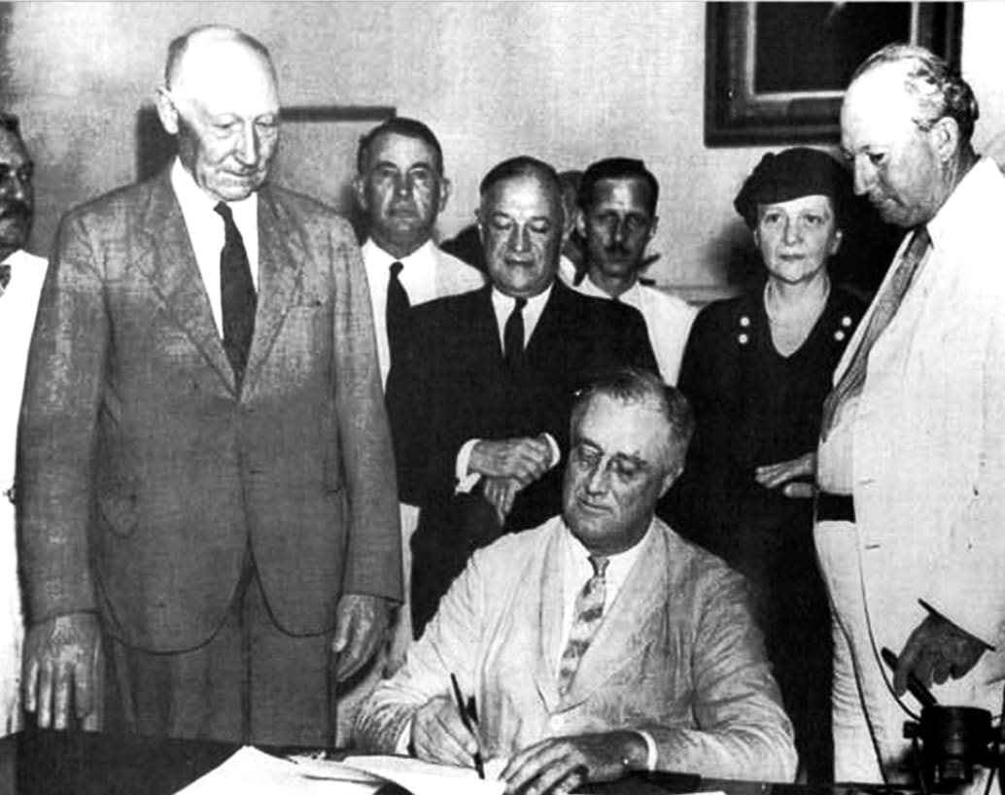
We chose article 22 which states that: everyone, as a member of society, has the right to Social Security and is entitled to it through national effort and international cooperation. We think that the UN General Assembly might have thought that it was necessary to include it on a basis of fairness and respect to people.
Nnnnnnnnnnnn
INTRODUCTION TO ARTICLE 22
The Social Security Act,(U.S.A.) signed into law by President Franklin D. Roosevelt in 1935 ======>

Slide 3
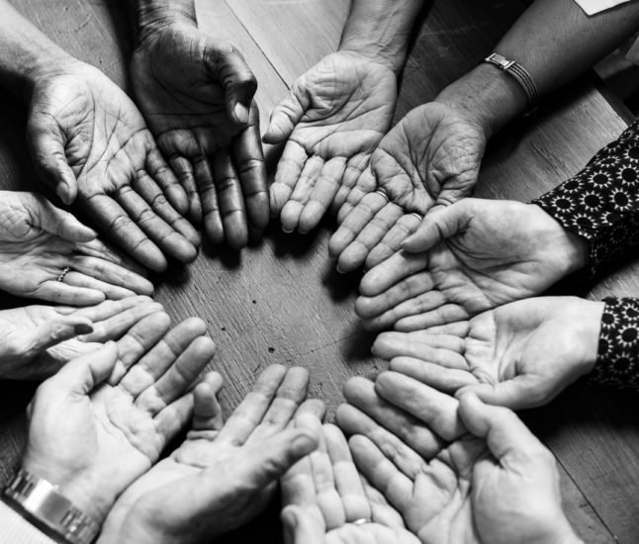
When the right is violated
In America, care and support in times of need cost a lot.
During the Shoah Mussolini deprived Jews of access to health, deprived them of their crops and of all their commercial rights.
“Re-education" camps in China to help Muslims convert.

Slide 4
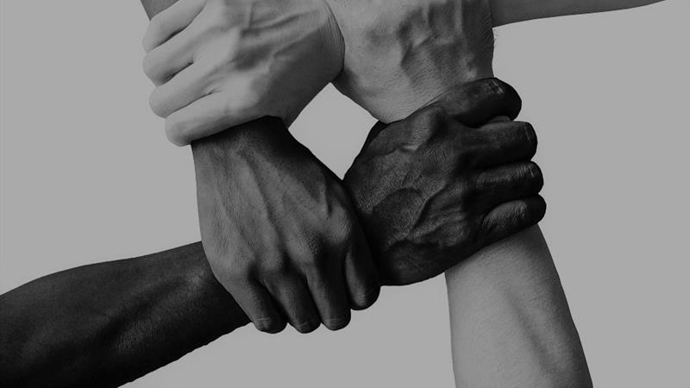
The violation of human dignity
In some countries many people live in hunger and poverty. Many live in poor housing and without basic amenities, such as water and sanitation.
Many children grow up even without a worthy education. This climate of degradation is not only the result of an extreme lack of resources, but also of their governments that are not prepared to do anything about it.
The people who live in extreme conditions very often find themselves
marginalised by society,
denied the right to speak and
threatened with violence and
without any security.
Many people living in slums or informal settlements are not protected from harassment such as forced evictions because their right to live there is not legally recognised.
Forced evictions mean people are removed from their homes and lands without advance notice, consultation and compensation.
They are illegal and violate the right to housing. Often, forced evictions are violent, destroy livelihoods and make people homeless.

Slide 5
A bit of help
Every human being has rights. The rights must be guaranteed for by the government. Many times the rights are violated, and one of them is the person’s dignity.
The right can be protected not only by laws and regulations but also with mutual respect and a understanding of one's security and privacy.

Slide 6
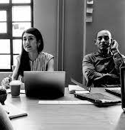
Sources and links:
1 photo of F.D.Roosevelt
2 parts: 1, 2, 3
3 background photo
4 UN logo

