Slide 1
ARTICLE 4
Group 1: Budai Daniele, Cicogna Riccardo, Cignola Emma
Lingua e cultura inglese
Ed. Civica
Prof.ssa M. Beltramini

Slide 2
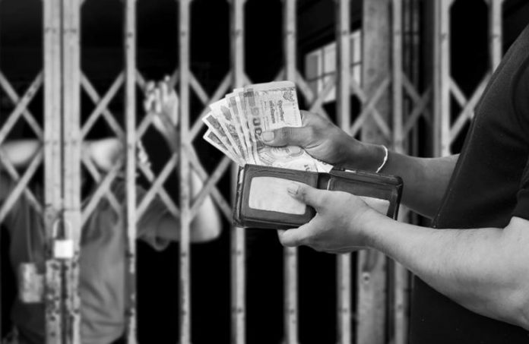
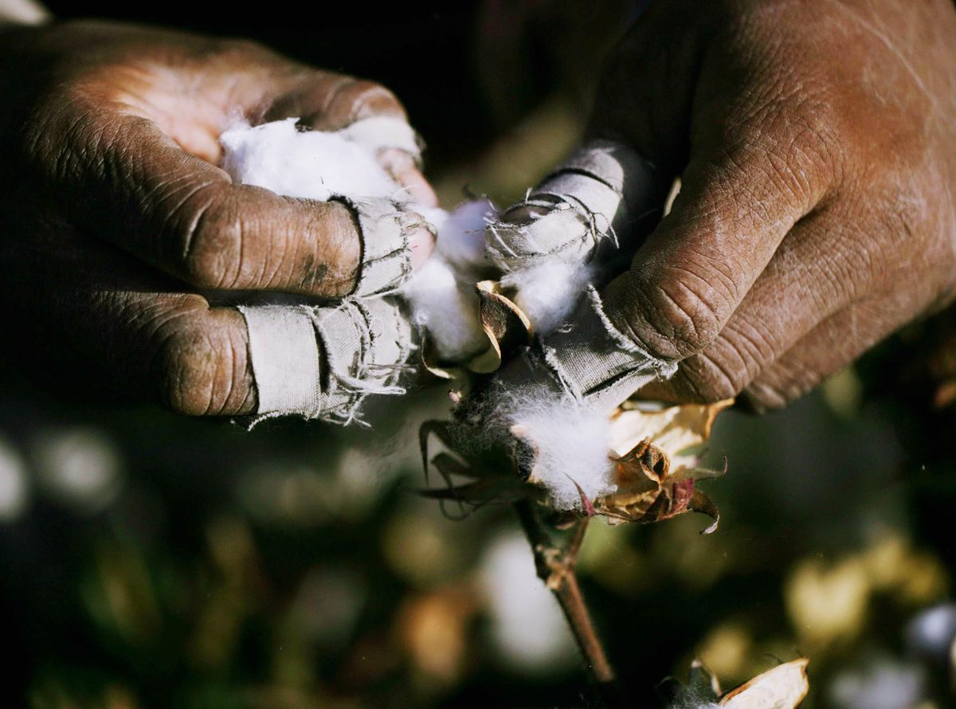
"No one shall be held in slavery or servitude; slavery and the slave trade shall be prohibited in all their forms"
The article is necessary because every life has the same value, and it is not right for people to be exploited without being properly paid

Slide 3
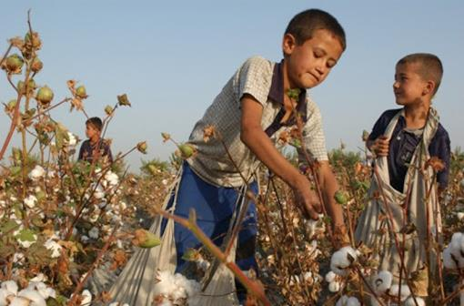
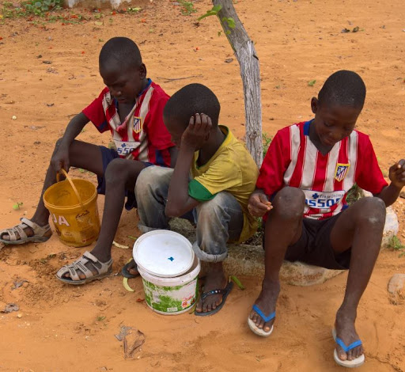
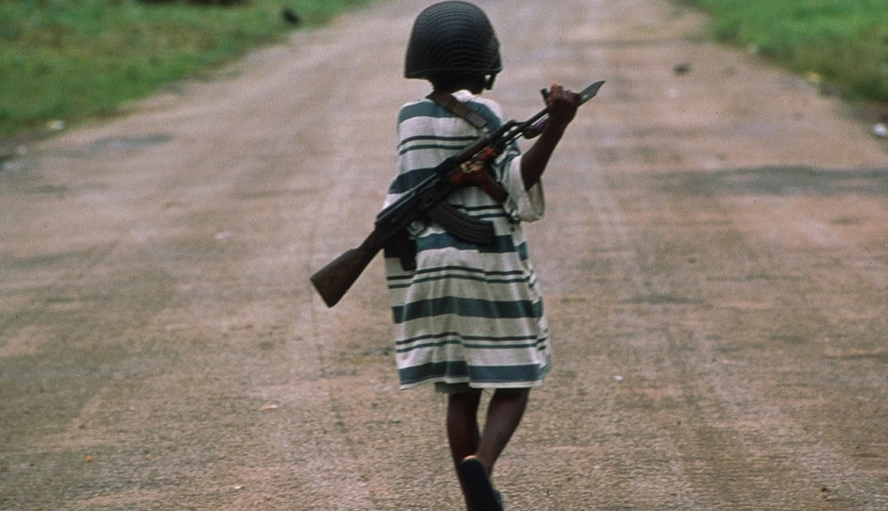
Abuses and violations of Article 4
In Senegal there are children, descendants of slaves, who are discriminated for their origins and because of this they do not have the right to education
In Kenya children are kidnapped and enrolled in criminal gangs or in the army, against their will
There is still slavery in Uzbekistan. Women and children are obliged to forced labor such as picking cotton or fruit.

Slide 4
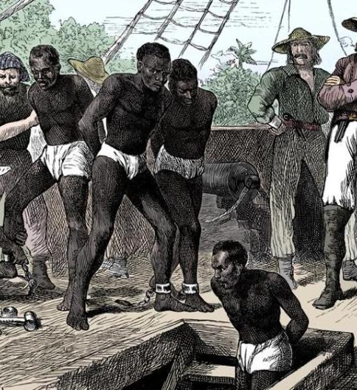
Slavery in North America
Africans were deported to become servants
Servitude was not convenient for landowners and they changed it into slavery
Slave codes were introduced
To ensure the stability of the slave organization, the rights of slaves were restricted
When the war between North and South America ended slavery was abolished

Slide 5
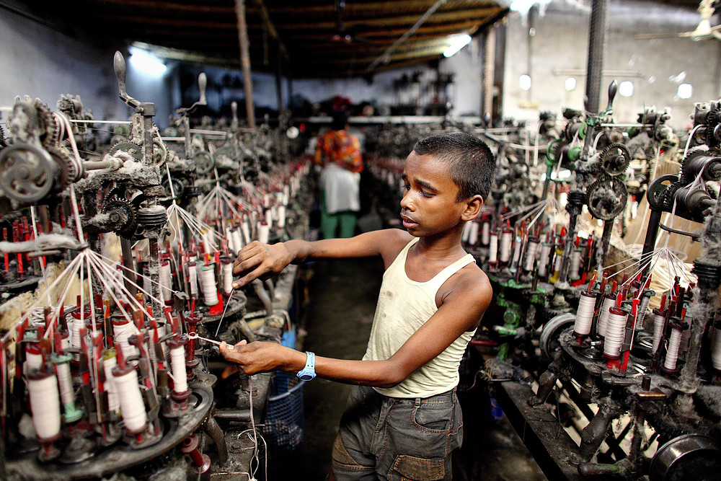
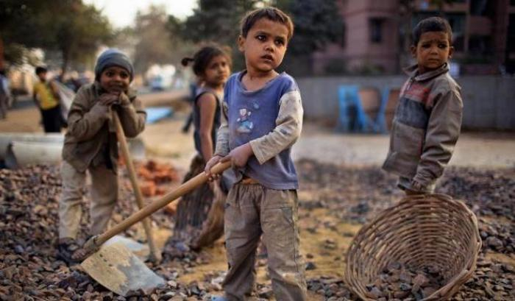
Even if article 4 is not close to us it is important because it is not acceptable that even today there are people who are badly treated including children.
One thing that we all can do is informing people about the problem because even if article 4 prohibits slavery and servitude, in the world a lot of people are treated as slaves or as if they owed servitude.

Slide 6
URLS:
https://www.focus.it/cultura/storia/usa-stati-uniti-400-anni-fa-nasceva-la-schiavitu
https://www.humanrights.com/what-are-human-rights/violations-of-human-rights/slavery-and-torture.html
https://www.hrw.org/

