Slide 1
Members:
- Tanieli
- Titton
- Zamparo
Lingua e cultura inglese-ED.CIVICA
Fom: 1LSCA
Prof.ssa MBeltramini
GROUP 2

Slide 2
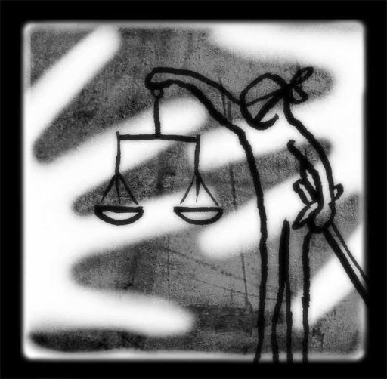
NO ONE SHALL BE SUBJECTED TO ARBITRARY ARREST, DETENTION OR EXILE.
The article states that no one can be subjected to unjustified arrests by law.
In our opinion the General Assembly of the United Nations considered it necessary to include the article because all people are equal.
Everyone must be considered in the same way in front of the law and must have a fair trail to be convicted.

Slide 3
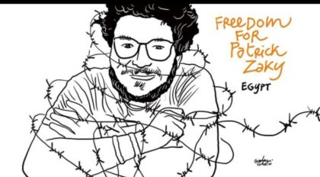
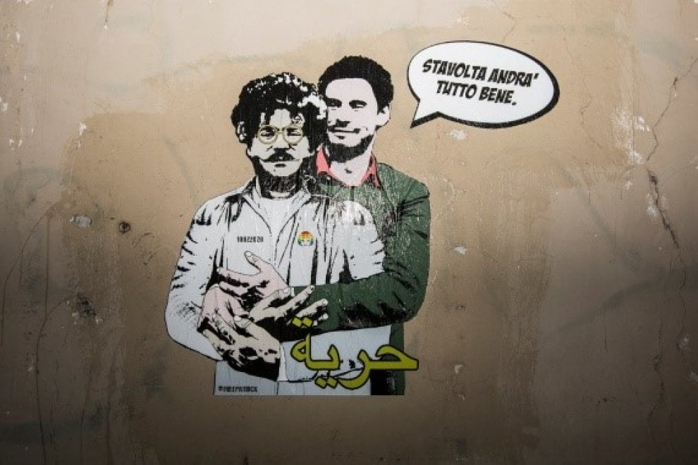
On the 7th of February 2020 Patrick Zaki, a young Egyptian human rights researcher, was captured by the secret services. Accused of attempting to overthrow the ruling regime and for his master's thesis on homosexuality, once arrested, Patrick Zaki will be tortured for 17 consecutive hours with blows to the stomach, back, and electric shocks inflicted by Egyptian security forces, as well as being questioned about his stay in Italy and his alleged link with Giulio Regeni's family . After a brief detention in Talkha’s prison, he was transferred to Tora prison. His preventive, arbitrary, illegal, unjustified and cruel detention will be sometimes extended for successive periods of 45 days. After a year, Patrick Zaki is still in in AN Egyptian prison.
EXAMPLE OF ARTICLE 9 VIOLATION

Slide 4
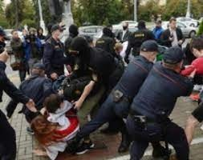
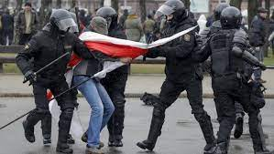
EXAMPLE OF ARTICLE 9 VIOLATION
Even today the cultural scene in Belarus is stifled by the government brutal repression of dissent following protests against the re-election of President Aleksandr Lukashenko.
Belarusian authorities arbitrarily detain and torture artists, musicians, writers and actors for expressing criticism of law enforcement by creative and artistic means. While others force them to leave their jobs.
Despite the complaints against the law enforcement criminal investigation have not been launched, conversely hundreds have been opened against peaceful protesters; many of which are victims of torture and ill-treatment.
At the beginning of December 2020, there were already 27,000 people illegally detained in Belarus.

Slide 5
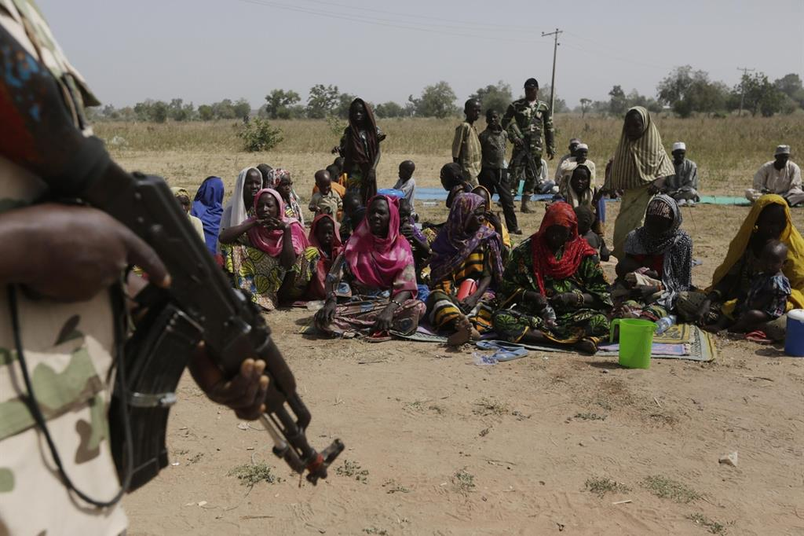
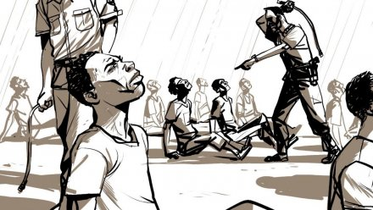
EXAMPLE OF ARTICLE 9 VIOLATION
Thousands of people are arbitrarily detained and subjected to "torture, abuse and other human rights violations in prisons run by armed groups in Libya, including those affiliated with the current government.
This was denounced by a United Nations report, published today and produced the UN mission in Libya.
"Men, women and children throughout Libya are arbitrarily detained and deprived of their freedoms on the basis of their tribal or family ties or political affiliations", denounces the UN human rights office:
"The victims have little or no access to judicial remedies or reparations, while members of armed groups operate in total unity ”. There are also many accusations of people who died during detention: "The bodies of hundreds of people captured by armed groups were found in the streets, in hospitals and in landfills, many with amputated limbs, with sigs of torture and gunshot wounds.”

Slide 6
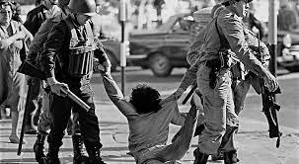
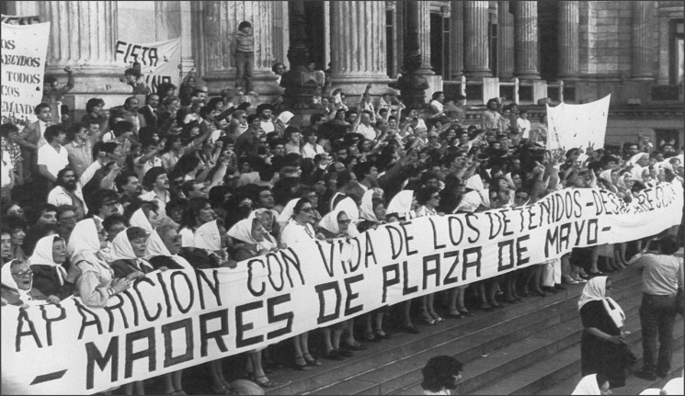
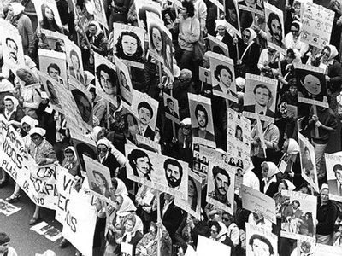
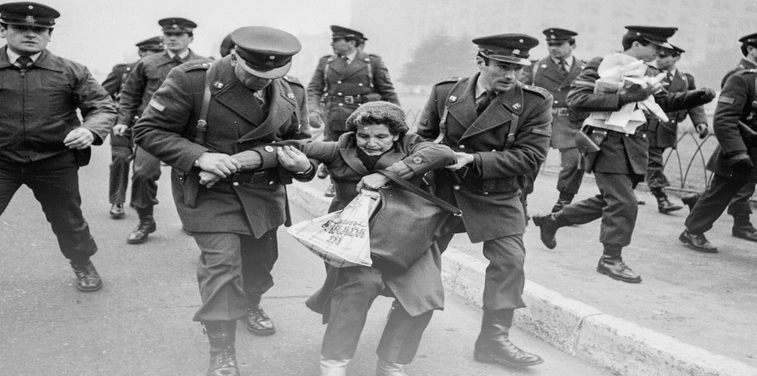
DESAPARECIDOS
Desaparecidos in Spanish means "missing people " and refers to all those who, men and women, the elderly and children, in various Latin American countries, were kidnapped by military regimes, tortured, killed and finally thrown into nothingness.
In 1973 Augusto Pinochet Ugarte come to power, one of the most inhuman dictators of the twentieth century, sadly famous for the barbaric elimination of his opponents.
He then set up a repressive police body which, during its ferocious dictatorship, from 1973 to 1990, kidnapped, tortured and made disappear thousands of people, most of them left-wing political opponents, academics, professionals, religious, students and workers.
The victims of that Holocaust locked up in secret places, prisons and concentration camps, tortured even for months, often drugged, loaded onto military aircraft and thrown to drown in the ocean during the now infamous "death flights".
Hundreds of children, along with their parents, were kidnapped, or were given birth in detention centers where pregnant girls were brought, who gave birth during the days of imprisonment.
Amnesty International and other organizations demanded his arrest for human rights violations but he died in Santiago in 2006 without the crimes he had committed being punished.

Slide 7
CONSIDERATIONS
The example of the desaparecidos teaches us that dictatorships oppress people's rights and free thinking.
WHAT CAN WE DO IN OUR OWN SMALL WAY?
In our own small way we can avoid discriminating against other people of different ethnicities, cultures and religion.
We must also defend the democratic ideas of freedom and the government should guarantee fair trials for all people regardless of their place of origin, without arbitrarily condemning them.

Slide 8
List of websites
http://www.un.org/en/documents/udhr/index.shtml
http://www.amnesty.org/en
https://www.agensir.it/quotidiano
https://sites.google.com/site/esamevirgi/dittatura-di-pinochet-desaparecidos

