Slide 1
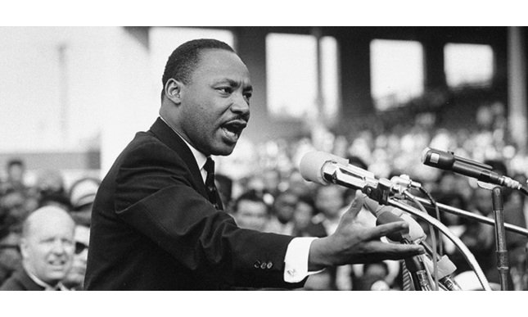
---- DR. MARTIN LUTHER KING JR. ----
In the 60s, President Lyndon Johnson signed the Civil Rights Act and the Voting Rights Act, outlawing discrimination based on race, national background and gender and giving everyone the right to vote. Even if segregation and discrimination were not legally allowed, many southern states continued to treat African-Americans as second class citizens.
MAIN EVENTS
December 1955
M. L. King was elected President of the Montgomery Improvement Association.
January 1957
M. L. King was elected President of the Southern Christian Leadership Conference.
August 1963
M. L. King gave his I Have a Dream speech during the March on Washington for Jobs and Freedom, in Washington, D.C.
QUOTATIONS
«There comes a time when one must take a position that is neither safe, nor politic, nor popular, but he must take it because conscience tell him it is right.»
«I have a dream that my four little children will one day live in a nation where they will not be judged by the colour of their skin, but by the content of their character.»
«Our lives begin to end the day we become silent about things that matter.»
SPEECHES
Martin Luther King received a letter from a 9th grade student in which she wrote about what she had heard about the man and particularly focused on one part:
"I read that if you had sneezed, you would've died. I'm simply writing you to say that I'm so happy that you didn't sneeze".
He then proceeded talk about how this simple letter changed him.
During the "Drum Major Instinct” sermon, M. L. King gave the definition of greatness, one related to service and love.
He believed that black people have nothing to be ashamed of and during one of his speeches he yelled with the crowd:
“YES! I’M BLACK. I’M PROUD OF IT. I’M BLACK AND BEAUTIFUL!”
2LSCA
Budai Isabella
Delcuratolo Sebastiano
Vicenzin Anna

