Slide 1
Article 26 in the Universal Declaration of Human Rights
Group n° 5
Credits: Serena Giorgia - Sponza Odilla - Stabile Tecla
Typology: WebQuest

Slide 2
INDEX
Article
Three different ways the article has been abused/violated or might be abused/violated by a person, group, or country:
The Story of Malala
The North Korea Government
Education during Covid-19
Three examples from history when this article has been violated or abused
Education in the 70’s
Fascist regime
Eritrea: education system
How does this article and the examples from history relate to you?

Slide 3
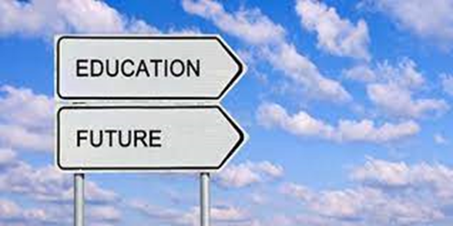
Everyone has the right to education. Education shall be free, above all the fundamental stages, which must be compulsory. Any kind of education shall be freely available. In order to choose who can attend higher education merit must be consider.
Development of the human personality reinforce respect of human rights and fundamental freedoms are education goals. In order to help United Nations in the preservation of peace, education should encourage to flourish understanding, tolerance and friendship among all nations, racial or religious group.
Parents are the leading voice in the choice education’s kind that shall be given to their children.
Source:
https://www.youtube.com/watch?v=WzAO8k9K11c

Slide 4
Three different ways the article has been abused/violated or might be abused/violated by a person, group, or country.

Slide 5
THE STORY OF MALALA
Why her story is an example?
Example of fight against denial of girl’s education
1997 -> Birth
2009 -> She began blogging for the BBC
2011 -> Nomination for the International Children's Peace Prize
2012 -> Gunman shot
2013 -> Speech at United Nation
2013 -> She published her first book “I am Malala”

Slide 6
“One child, one teacher, one book, one pen can change the world.”

Slide 7
THE NORTH KOREA GOVERNAMENT
Why is the North Korea Educational system an example?
Example of the violation of the article’s second point.
Goals of North Korean education:
Teach about the greatness of the Kim family
Teach children to hate Japanese and American people
Teach the superiority of North Korea

Slide 8
EDUCATION DURING COVID-19
Schools shut all across the world
Education has changed dramatically:
- e-learning
- digital platforms
What does Covid-19 mean for the future of learning?
Negatively impact
Literacy slowly
Human interaction
The challenges of online learning:
People without reliable internet access

Slide 9
Three examples from history when the article has been violated or abused

Slide 10
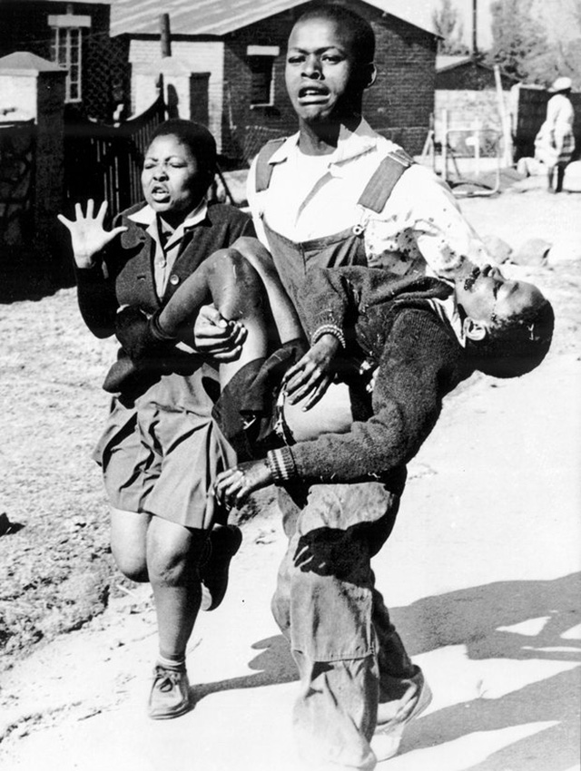
Education in the 70’s
For the song, touch it
«Another Brick in the Wall»
Second part of the song
Protest against strict education
Hymn of black students during a Elie’s River revolt
-> Decree of 1974: English as language of instruction
-> English = The language of the oppressor
-> 30 April 1976: strike of students

Slide 11
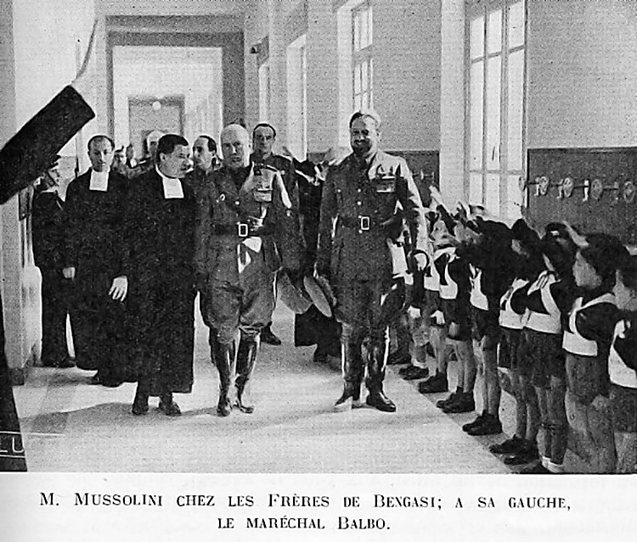
FASCIST REGIME
1922: DICTATORSHIP IN ITALY
Totalitarian society: seizing control of Italy = focus on education
Fascist ideology: superiority of Aryan race
School books: used to instill their ideology among young people
Classroom posters: touched on a range of Fascist issues
Effectiveness of Fascist Indoctrination: create a martial spirit to motivate Italian soldiers to institute a new Italian empire.

Slide 12
ERITREA: EDUCATION SYSTEM
Ethiopian rule in Eritrea (1962-91)
Consequences:
Deny educational freedoms to Eritreans
Suppress freedom of thought
Suppress manifestation of Eritrean dissent or nationalism
Keep the educational system in quiescent conformity with the government.

Slide 13
How does the article and the examples from history relate to you?

Slide 14
Source:
https://en.wikipedia.org/wiki/Impact_of_the_COVID-19_pandemic_on_education#Consequences_of_school_closures
https://www.unicef.org/laos/education-during-corona-virus-outbreak
https://en.wikipedia.org/wiki/Another_Brick_in_the_Wall
https://www.hrw.org/report/1993/01/12/eritrea-freedom-expression-and-ethnic-discrimination-educational-system/past-and
https://www.durihanamission.org/2018/08/an-education-of-hatred/
http://en.unesco.org/
http://hrlibrary.umn.edu/
http://www.globalpartnership.org/

