Slide 1
ARTICLE 23 GROUP 4: COSTANTINI SOFIA, DE ODORICO DAVIDE, MACOR ELISA E MIAN ELISA

Slide 2
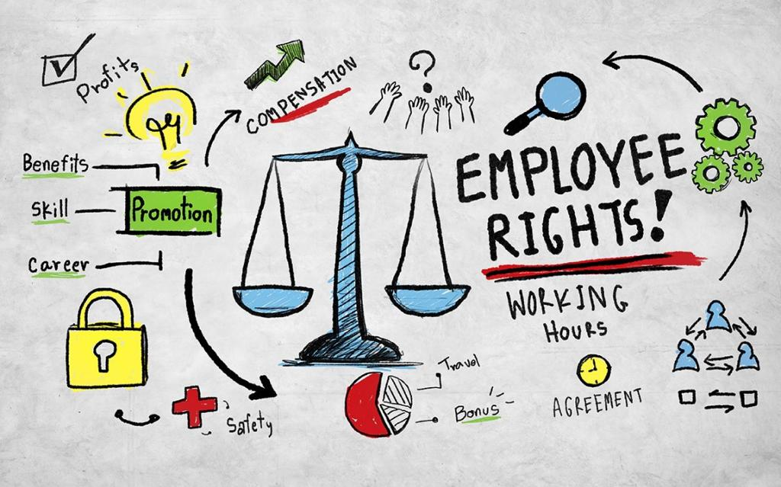
ARTICLE 23
1. Everyone has the right to work, to free choice of employment, to just and favourable conditions of work and to protection against unemployment.
2. Everyone, without any discrimination, has the right to equal pay for equal work.
3. Everyone who works has the right to just and favourable remuneration ensuring for himself and his family an existence worthy of human dignity, and supplemented, if necessary, by other means of social protection.
4. Everyone has the right to form and to join trade unions for the protection of his interests.
Article 23 tells about human rights respected in the world place of work.
The General Assembly of the United Nations might have thought it necessary to include this article in the Declaration of Human Rights to guarantee the right to work to everyone and put an end to any form of discrimination and abuse that affected the world of work.

Slide 3
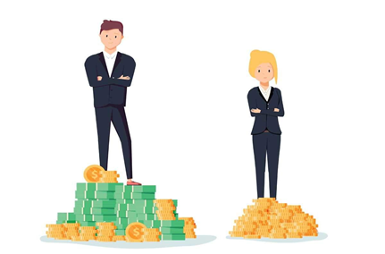
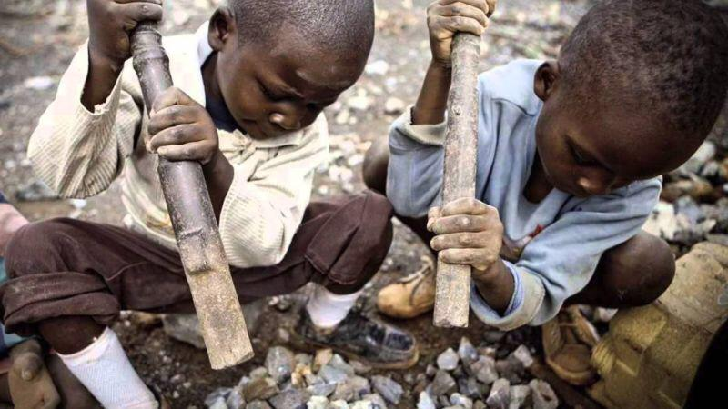
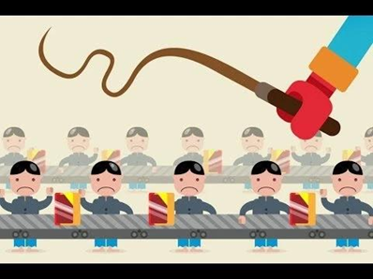
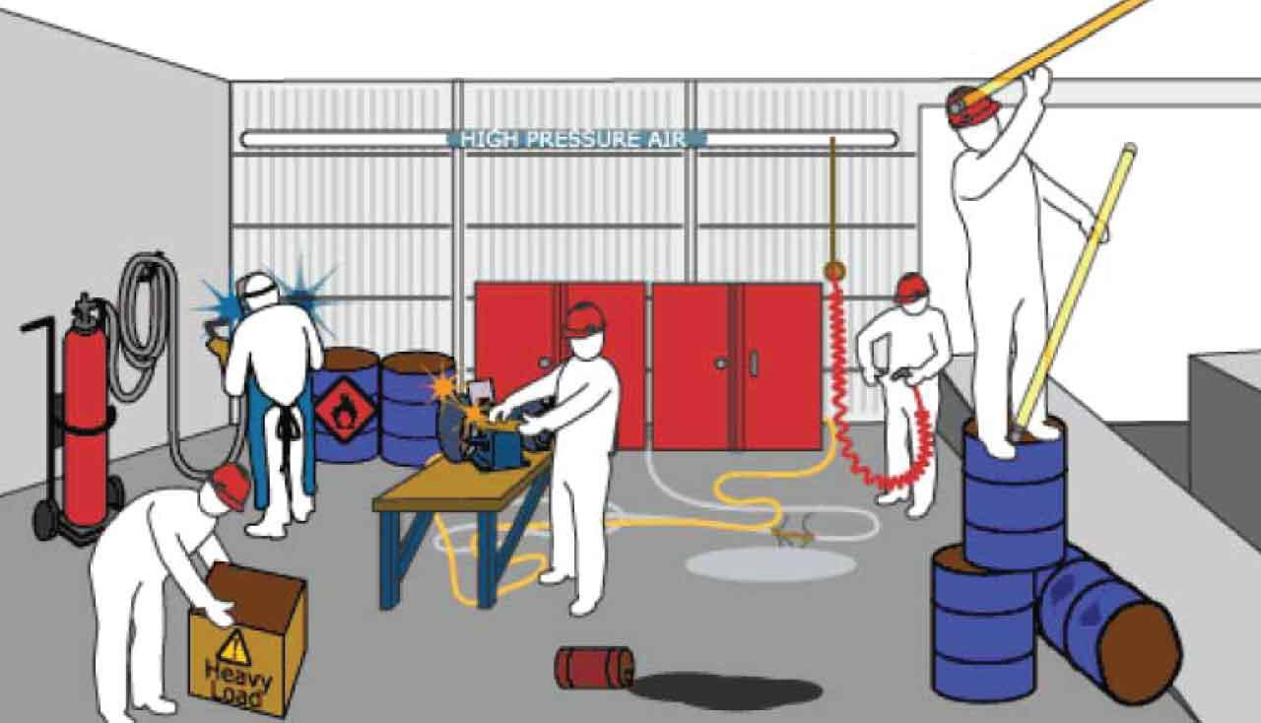
FORMS OF VIOLATION
DISCRIMINATION
(Sex, race, sexual orientation,
gender identity)
CHILD
LABOUR
(Coltan mines)
EXPLOITATION
OF LABOUR
(Low freedom of choice, low
wage workers)
HAZARDS
IN THE
WORKPLACE
(Safety issues:
biological, chemical...)

Slide 4
CASES
A recent report established that LGBTQ+ workers in the United States had seen high rates of discrimination and harassment in the workplace, including the loss of jobs, slurs, threats, and physical violence.
In general, the report said, homosexual men tended to earn less than heterosexual men, and bisexuals tended to earn less than gay or straight people.
Other studies of earnings of transgender individuals have consistently reported lower income, high rates of discrimination and harassment, and high rates of unemployment.
When the mentioned studies were conducted, LGBTQ+ people had no protections against employment discrimination due to sexual orientation and gender identity, many of which had mostly fallen through legislative gaps in civil rights protections.
- Obama administration;
- Trump administration;
- Biden administration.
Everyone has to acknowledge the
importance of Supreme Court rulings and
federal laws when it comes to protections
for LGBTQ+ people, in order to ensure
respect and equality.

Slide 5
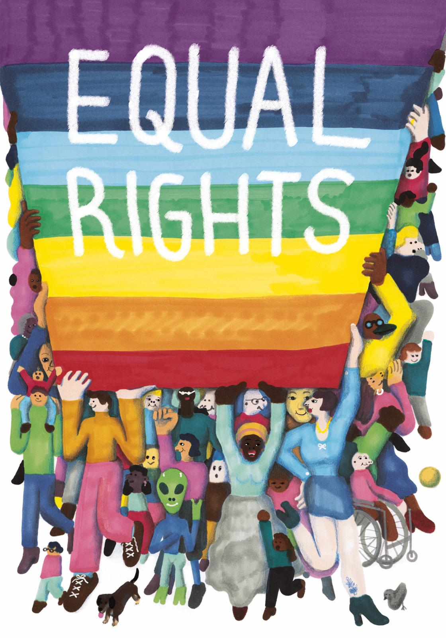
WHAT ONE CAN DO
We often hear people talk about discrimination in the workplace, but it seems like no one is interested in solving the problem. It is necessary to find a way to extend workers rights to every person and in every part of the world. At the same time it is fundamental to give children the “right to grow up”, without having to work in awful conditions to provide for themselves and their families.
Our generation in particular is very sensitive to discrimination of any kind, whether it is based on gender, sexuality or race, and we feel compelled to put an end to all kinds of intolerance and inequality, even in the workplace.
Some ways to ensure that this article is not violated here and around the world are:- Identify the problem;- Raise awareness and educate;- Guarantee safety and equality to all workers through laws.

Slide 6
SLIDE FIVE
http://www.claiminghumanrights.org/udhr_article_23.html
https://www.un.org/en/about-us/universal-declaration-of-human-rights
https://www.createwebquest.com/debalex/human-rights-webquest-0

