Slide 1
ARTICLE 18
GROUP 3
BLASI GIULIA KUMAR ANPURNA REGENI CELESTE
Lingua e cultura inglese – ED. CIVICA
Form: 4LSUB
Prof.ssa MBeltramini

Slide 2
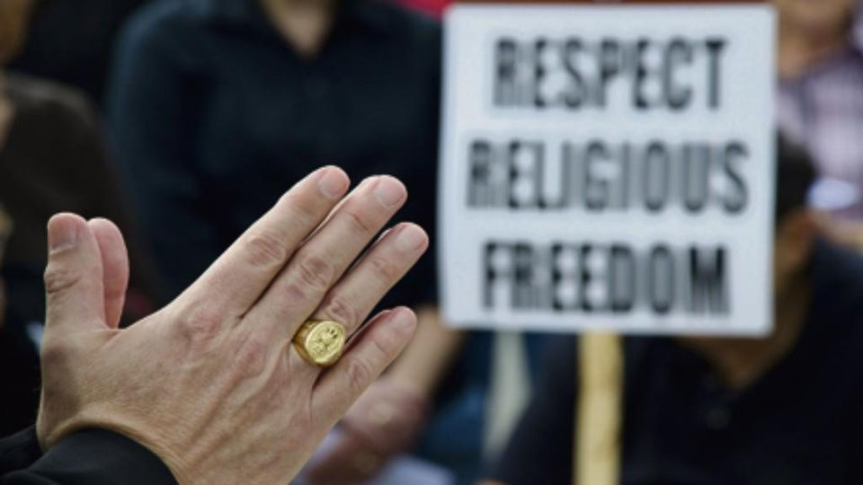
Article 18
Everyone has the right to freedom of thought, conscience and religion; this right includes freedom to change his religion or belief, and freedom, either alone or in community with others and in public or private, to manifest his religion or belief in teaching, practice, worship and observance.
The article states that eveybody is free to have their own thoughts, to profess the religion in which they reflect themselves the most.It also includes freedom of conscience.
The right guarantees freedom to change religion or belief, in community or either alone.
It affirms that everyboby has the right to manifest their religion by teaching, practicing, worshipping and even by just expressing her/his own opinion about it.
The UN General Assembly might have thought it necessary to include article 18 because freedom of religion is one of the most precious rights.
It protects individual freedom to
hold identity-shaping, profound convictions about the deeper meaning of life
engage in conviction-based practices either alone or in community with others, and in public or private.

Slide 3
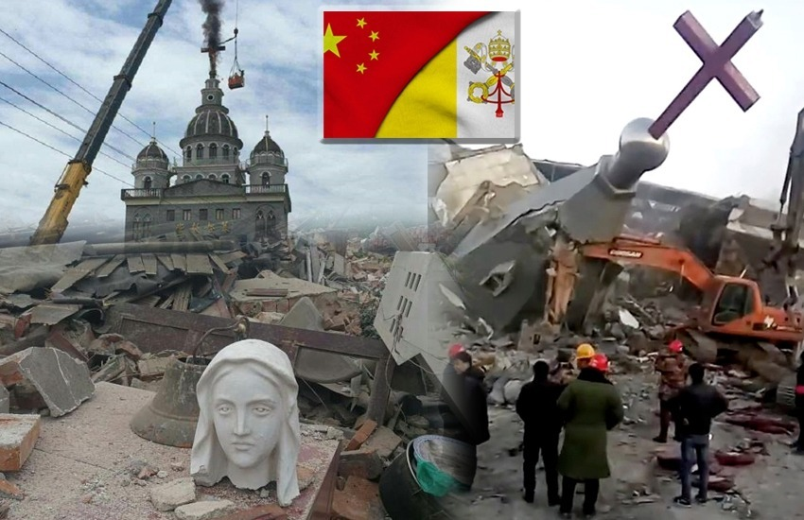
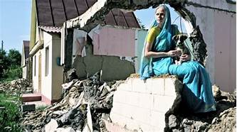
Uighur minority's genocide in China.
Christians’ persecution in China.
Hare Krishna community's homes' destruction in Kazakhstan

Slide 4
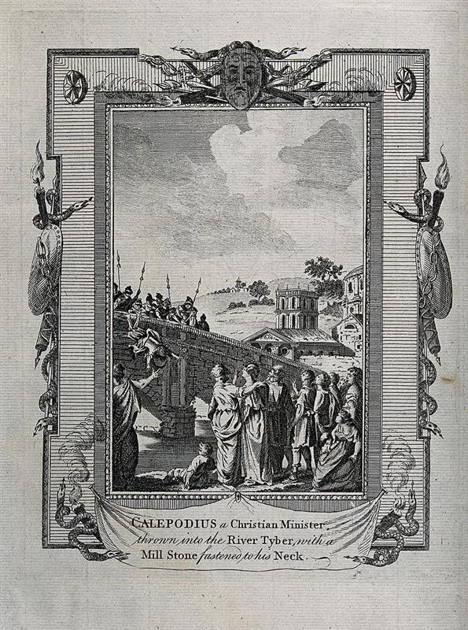
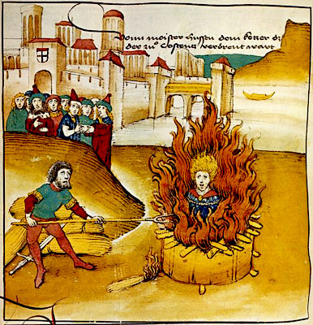
The reasons for the persecution of Christian citizens were various:
they were accused of being enemies of the state
they were considered deserters
they were recognized as the cause of natural disasters
As an aftermath Christians were arrested and killed; afterwards 3 edicts were emanated:
Edict of Tolerance in 311 AD;
Edict of Milan in 313 AD;
Edict of Thessaly in 380 AD;
The Edicts gradually gave Christians absolute freedom to profess their religion.
The article has been abused throughout history and especially during the Roman Empire and it was violated by:
Nero in 64 AD;
Domitian in 89 AD;
Decius in 250 AD;
Diocletian in 303 AD.

Slide 5
How can we help to ensure that the article will not be violated again:
Through education
Through the Internet access
Through new generations.
Despite what happened in history, people keep on making the same mistakes even though we are living in a world that has changed and developed a lot.
You can see lots of people are still persecuted for their religious belief. Some of them are Christians that are getting crucified or beheaded in Iraq by ISIS extremists.
In our opinion the article should not even exist because we believe that freedom of religion and thought should be indisputable choices.
What makes us sad is that, even if we are living in the 21st century, Article 18 is still getting violated by many people and countries.
We also strongly consider that only the young generation can change the present society.

Slide 6
Resources:
https://www.un.org ;
https://www.bbc.co.uk ;
https://www.humanrights.com ;
https://www.thesun.co.uk ;
https://en.wikipedia.org ;
https://www.storiain.net ;
http://www.santangela.info/wp-content/uploads/2013/12/Le-persecuzioni-romane-e-gli-editti-della-libertà-2.pdf ;
https://appgfreedomofreligionorbelief.org/article-18-violated-universally-house-lords-debate/ .
Thanks for your kind attention!

