Slide 1
UDHR - ARTICLE 7 GROUP 2
Bean Erica, Nicola Erica, Puntin Noemi Annamaria
and Taccarelli Andrea Serena
FORM: 4LSUB Lingua e cultura inglese – ED. CIVICA
Prof.ssa MBeltramini

Slide 2
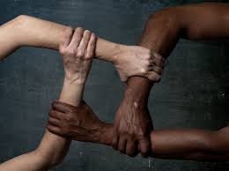
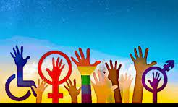
ARTICLE 7
The article declares that all people are equal before the law and are entitled, without any discrimination, to equal protection of the law.
Everyone has the right to equal protection against all discrimination and against any kind of incitement to it.
In our opinion, the UN General Assembly decided to include Article 7 to strive for equality and fight all kinds of discrimination before the law.

Slide 3
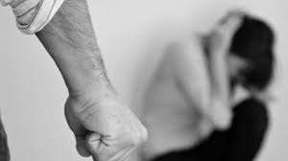
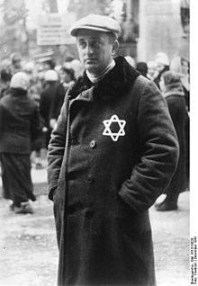
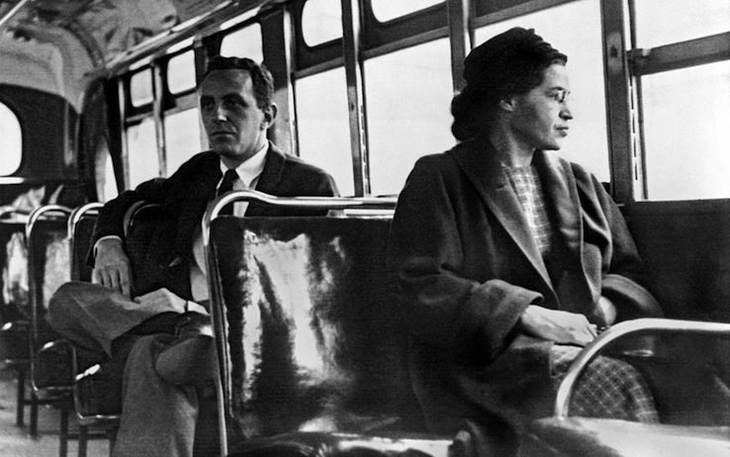
ARTICLE 7 MAY BE VIOLATED IN DIFFERENT WAYS
By one person: femicide, all kinds of gender-based violence
By a group: mafia, which requires payment of protection money, or when it blackmails, or even when it kills those who rebel
By a country: when in the United States, until the mid-1960s, there were racial laws against black people (example: Rosa Parks), or the persecution of Jews

Slide 4
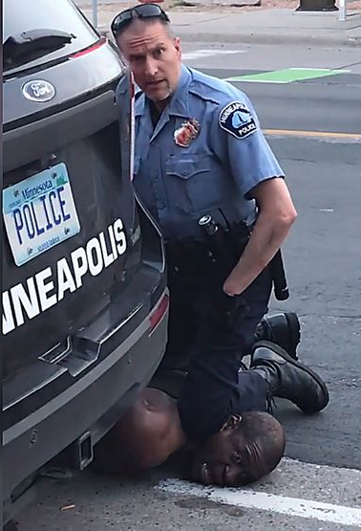
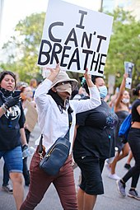
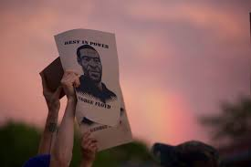
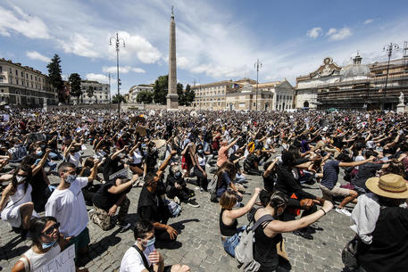
THE CASE: GEORGE FLOYD
The tragedy gave rise to a series of protests in favor of the rights of people of colour. The estimated time the policeman kept his knee on Floyd's neck, choking him, was about 8 minutes and became a symbol. During the protests, people kneel for the same length of time.
On May 25, 2020, Minneapolis police officers arrested George Floyd, a 46-year-old black man, after a convenience store employee called 911 and told the police that Mr. Floyd had bought cigarettes with a counterfeit $20 bill. Seventeen minutes after the first squad car arrived at the scene, Mr. Floyd was unconscious and pinned beneath three police officers, showing no signs of life.
The officers took a series of actions that violated the policies of the Minneapolis Police Department and turned fatal, leaving Mr. Floyd unable to breathe, even as he and onlookers called out for help.

Slide 5
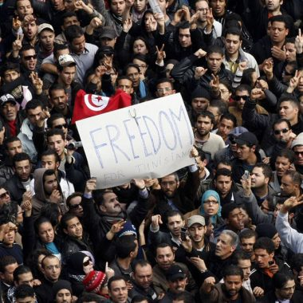
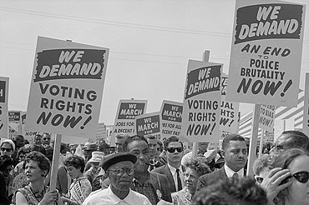
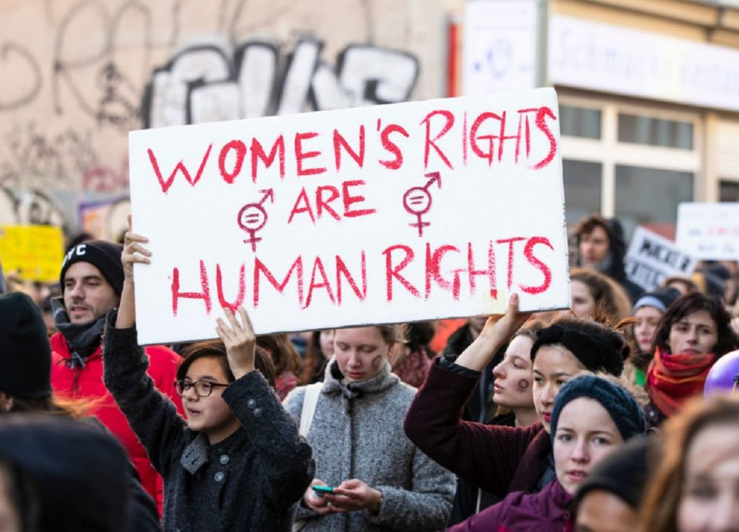
WHAT WE CAN DO TO PROTECT ARTICLE 7
Despite all the protests, even today, rights continue to be violated.
We, the young generation, believe it is important to fight to convey the idea of this serious problem, denouncing any abuse or law violation.

Slide 6
WEBLIOGRAPHY
https://www.nytimes.com/2020/05/31/us/george-floyd-investigation.html
Universal Declaration of Human Rights | United Nations
United for Human Rights: Right to Exist, Humanitarian Groups, Universal UN Declaration
https://www.nytimes.com/interactive/projects/cp/national/unpublished-black-history

