Slide 1
Publishing Houses
in Sardinia
L’editoria in Sardegna

Slide 2
Introduction – Professional Profiles
Publishing: The activity of making contents available to the public
by
the distribution of printed and digital works (books, magazines, ebooks, websites,..)
Profiles in publishing houses:
Copy Editors = revise literary works
Literary Agents = find publishers for their writers
Literary Scouts = read a lot and look for excellent works
Production Editors = control publication process
Marketers and/or Copy Writers = create advertisements for promotion

Slide 3
Introduzione all’editoria e le sue figure professionali
Editoria: crea contenuti disponibili al pubblico, usando lavori scritti e digitali (libri, ebook, riviste,..)
Figure professionali in una casa editrice:
Redattori = Revisionano i lavori
Literary Agents = Trovano pubblicatori
Literary Scouts = Cercano materiale e scrittori da pubblicare
Production Editors = Responsabili del processo di pubblicazione
Marketers and/or Copy Writer = Creano pubblicità e marketing

Slide 4
Publishing In Sardinia
33 Small - and micro - Publishing Houses
Employees 300
Works published per year 220
Works in catalogue 6000
Yearly income € 5.4 million
Main genres:
Essay writings
Fiction
Texts in Sardinian language

Slide 5
Editoria in Sardegna
33 Case editrici (micro e piccole dimensioni)
Addetti 300
Opere stampate per anno 220
Titoli in catalogo 6000
Fatturato annuo €5,4 mln
Generi principali:
Saggistica
Narrativa per adulti
Testi in lingua sarda

Slide 6
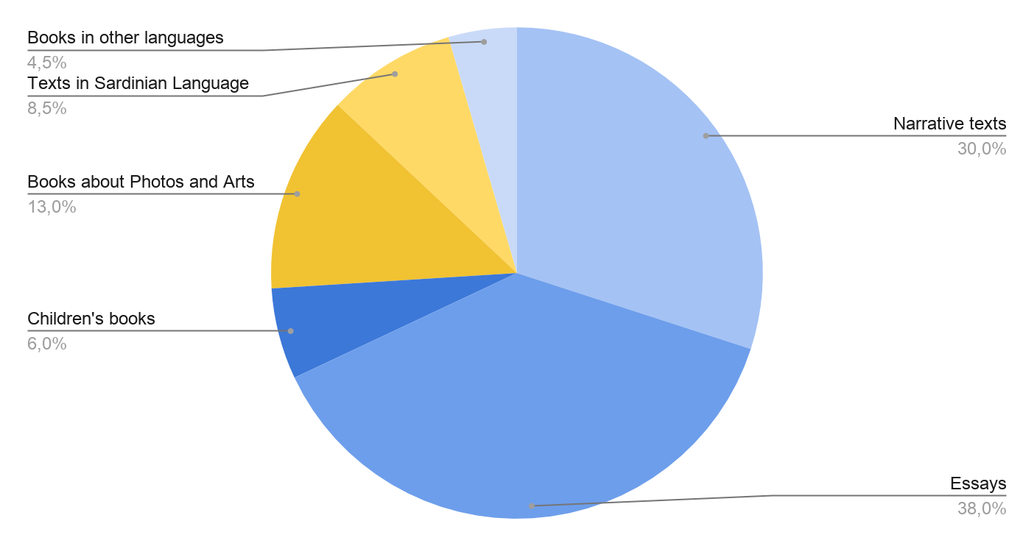
Sardinia. Catalogue of published works

Slide 7
Catalogo storico dell’editoria sarda

Slide 8
Publishing - The crisis
From AES Balance 2017 (Associazione Editori Sardi Survey)
In the last 10 years:
Copy editors publishing with constance decreased of 20%
Annual production of works decreased of 28%
Average print runs (1000 ⇨ 700 copies)
Average annual turnover decreased of 28%
Labour force decreased of 50%

Slide 9
Editoria - Settore in crisi
Dal rapporto AES 2017
Negli ultimi 10 anni:
Editori che pubblicano con continuità -20%
Produzione media dei titoli -28%
Tiratura media dei titoli -30% (1000 → 700 copie)
Fatturato medio annuo -28%
Forza lavoro - 50%

Slide 10
Weaknesses
From the 2017 AES Survey Data- latest survey
SURVEY percentage of publishing houses data
Lack of funds (60%) BUT ONLY 6% publishing uses European Funds
Bad transport infrastructures (50%)
High cost of production matters (30%)
Bad promotion and distribution (13%)
Lack of readers BUT ONLY 38% citizens read just1 book per year
Old Regional Law latest legislation 22/1998
---------------------------------------------------------------------
Additional activities that SHOULD be improved Only 44% publishing scouts new possibilities
Only 41% publishing translate foreign novels

Slide 11
Criticità
Dal Bilancio AES 2017
Problematiche riscontrate (% of the publishing houses):
Carenza di fondi (60%) BUT Just 6% uses European Founds
Pessime infrastrutture (50%)
Costi di produzione (30%)
Cattiva promozione (13%)
Carenza di lettori Solo 38% il legge almeno un libro ad anno
Leggi regionali datate 22/1998
Attività extra non sviluppate Solo 44% fa scouting
Only 41% Translate foreign novels

Slide 12
SITOGRAFIA
www.nationalia.info
https://www.sardegnaricerche.it/attivita/parcotecnologico/
https://www.statista.com/statistics/531010/unemployment-rate-italy/
https://fred.stlouisfed.org/series/LRIN64TTITQ156N
https://ec.europa.eu/eures/main.jsp?countryId=IT&acro=lmi&showRegion=true&lang=en&mode=text&regionId=IT0&nuts2Code=%20&nuts3Code=null&catId=403
https://ec.europa.eu/eures/main.jsp?catId=403&lmi=Y&acro=lmi&lang=en&recordLang=en&parentId=&countryId=IT&regionId=IT0&nuts2Code=%20&nuts3Code=null&mode=shortages&regionName=Sardegna
https://www.laleggepertutti.it/411158_quali-sono-le-regioni-a-statuto-speciale#:~:text=Anche%20dopo%20la%20riforma%20del,cui%20esercitano%20la%20potest%C3%A0%20legislativa
https://www.regione.sardegna.it
https://www.sardegnacultura.it/
SardegnaTurismo - Sito ufficiale del turismo della Regione Sardegna

Slide 13
https://www.sardegnareporter.it/2020/08/la-crisi-delleditoria-libraria-sarda-e-il-silenzio-dellassessore-biancareddu/340767/
http://search.regione.sardegna.it/cgi-bin/RSsearch.pl?key=editoria&categ=11&type=&funz=and&stop=30&submit=vai
https://knoema.com/atlas/Italy/Sardinia
https://www.giornaledellalibreria.it/news-mercato-leditoria-sarda-dimensioni-e-criticita-3338.html
https://www.aie.it/Portals/_default/Skede/Allegati/Skeda10-291-2021.1.27/Sardegna_2015_2019.pdf?IDUNI=bg5lv4lu32twcucwnwzlwl1b671
https://www.regione.sardegna.it/j/v/2568?s=10516&v=2&c=212&t=1
https://www.filmitalia.org/it/filmcommission/33739/
https://www.istat.it/it/files//2021/01/Report-Editoria-Lettura-Tavole-statistiche-2019.xlsx
http://dati.regione.sardegna.it/dataset?organization=ras-sardegna-statistiche
https://www.istat.it/it/files//2020/05/20_Sardegna_Scheda_DEF.pdf
http://www.regione.sardegna.it/documenti/44_944_20210105181333.pdf
https://www.sardegnaimpresa.it/coronavirus-ecommerce/
https://www.sardiniapost.it/cronaca/infrastrutture-tecnologiche-per-imprese-nuovi-investimenti-per-il-crs4-di-pula/

