Slide 1
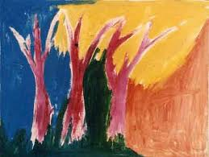
Postmodernism

Slide 2
Since Postmodernism is still alive, it is not yet possible to define it in retrospect.
The Postmodern would be that which in the
Modern invokes the unpresentable in
presentation itself, that which refuses the
consolation of correct forms, refuses the
consensus of taste permitting a common
experience of nostalgia for the impossible,
and inquires into new presentations--not to
take pleasure in them, but to better produce the feeling that there is something
unpresentable. (Jean-Francois Lyotard)
A piece of knowledge is never false or true - but only more or less biologically and evolutionary useful. All dogmatic creeds are approximations: these approximations form a humus from which better approximations grow. ... We know only one source which directly reveals scientific facts - our senses. (Ernst Mach)

Slide 3
• Modernity and postmodernity
– Historical periods characterised by political and cultural events, technological change and intellectual and ideological movements
– Not the movements themselves
• Modernism and postmodernism
– Genres/styles/movements of thought and expression associated to these periods

Slide 4
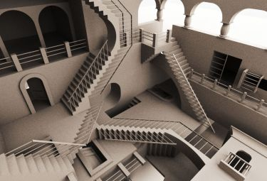
Modernity
• Industrialisation
– Capitalism (Fascism, Marxism)
– Division of labour
– Rise of institutions
– Rapid urbanisation
• Enlightenment
– Supremacy of reason
– Critique of realism
– Individualism
• Nation‐state
– Colonialism
– The “West”
– Division of culture
Late modernity
• Rejection of Truth as universalizing force
– Multiculturalism
– Feminism
– Media culture
– Liberation theology
• Rejection “West” as the end of history
– WWII, then Asian wars
– Decline of manufacturing distinction industry
– Stagflation

Slide 5
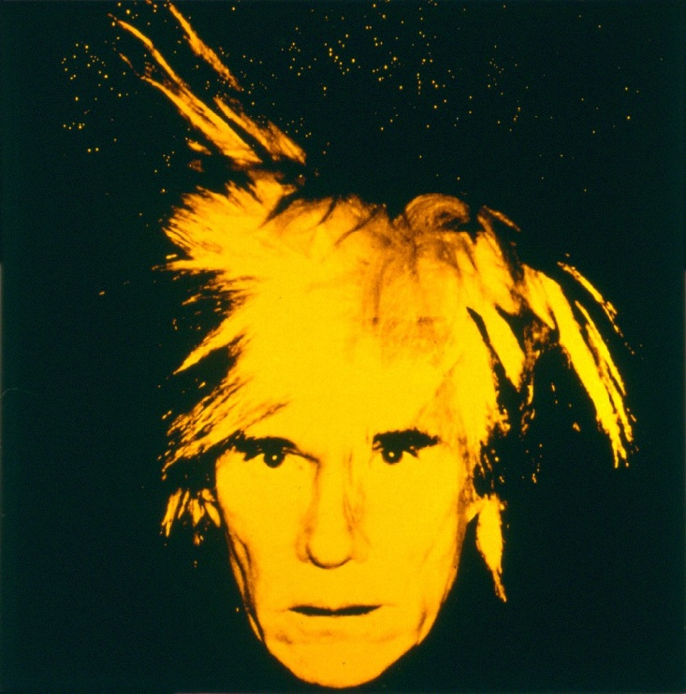
Modernism
• Search for truth
• Division of high & low culture
• Valuing the aesthetic
• Rejection of realism
Postmodernism
• Aesthetic of everyday life
• Pastiche
• Involvement of spectator in spectacle
• Self‐parody
• Solidarity
• High and low culture

Slide 6
Postmodernism is the belief that:
Most theoretical concepts are defined by their role in the conjectured theoretical network. (A subset are 'operationally' defined by a fairly direct tie to observations.)
The theoretical network is incomplete.
It follows that theoretical concepts are 'open', or what logicians call 'partially interpreted'. Research continues precisely because they are open; the research task is to 'close' them, although never completely.
http://psycprints.ecs.soton.ac.uk/archive/00000088/

Slide 7
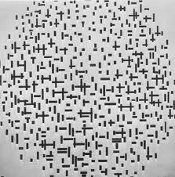
Most Important Points:
Suspicion and rejection of Master Narratives; local narratives, ironic deconstruction of master narratives: counter-myths of origin
Rejection of totalizing theories; pursuit of localizing and contingent theories
Social and cultural pluralism, disunity, unclear bases for social/national/ethnic unity.

Slide 8
Skepticism of progress, anti-technology reactions, neo-Luddism; new age religions
Sense of fragmentation and decentered self; multiple, conflicting identities.
Alternative family units, alternatives to middle-class marriage model, multiple identities for couplings and childraising.
Subverted order, loss of centralized control, fragmentation.
Trust and investment in micro- politics, identity politics, local politics, institutional power struggles.
Hyper-reality, image saturation, simulacra seem more powerful than the "real"; images and texts with no prior "original". "As seen on TV" and "as seen on MTV" are more powerful than unmediated experience.

Slide 9
Postmodernists of repute
• Italo Calvino
Six Lessons for the New Millennium
• Andy Warhol
Blood for Dracula
•Robert Altman
Ferris Bueller’s Day Off
• Wes Craven
Eat Drink Man Woman
• Quentin Tarantino
Pulp Fiction
• Robert Rodriguez
Once Upon a Time in Mexico
• Madonna
Hung Up /give it 2 me

Slide 10
Postmodernism
• Aesthetic of everyday life
• Pastiche
• Involvement of spectator in spectacle
• Self‐parody
• Solidarity
• High and low culture
Late modernity
• Rejection of Truth as universalizing force
– Multiculturalism
– Feminism
– Media culture
– Liberation theology
• Rejection “West” as the end of history
– WWII, then Asian wars
– Decline of manufacturing distinction industry
– Stagflation

