Slide 1
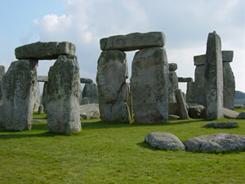
BRITISH PREHISTORY

Slide 2
OVERVIEW
Human beings have been living in the part of northern Europe that is today called Britain for about 750,000 years.
THE LATEST ICE AGE :
Britain became separated from the European before 6000 BC.
HOMO SAPIENS :
The people living on the new islands of Britain were descendants of the first modern humans, they arrived in northern Europe, 40,000 years ago.

Slide 3
NEOLITHIC: FARMING
The introduction of farming is widely regarded as one of the biggest changes in human history.
MIGRATION OR FOLK-MOVEMENT :
The introduction of farming into Britain was the result of a migration across the Channel.
DOMESTICATED LIVESTOCK :
Neolithic farmers also kept domesticated dogs, which were bred from wolves.

Slide 4
THE BRONZE AGE
The first bronzes appear in Britain in the centuries just before 2500 BC, which is the usually accepted start date for the Bronze Age.
APPEARANCE OF METAL MARKS :
Although the an important technological development, especially in the control of fire.
MIDDLE BRONZE AGE (1500-1250 BC) :
increasing number of metalwork hoards, where dozens, sometimes hundreds of spearheads, axes and daggers were placed in the ground.

Slide 5
THE IRON AGE
The Iron Age of the British Isles covers the period from about 800 BC to the Roman invasion of 43 AD, and follows on from the Bronze Age.
THE POPULATION of exceeded one million.
FARMING TECHNIQUES IMPROVED :
the introduction of the iron-tipped ploughshare made the cultivation of heavy clay soils possible.

Slide 6
THE IRON AGE: HILL FORTS
The function and form of these monuments varied greatly over time.
EARLY IRON AGE: seasonal gatherings, perhaps for trade, exchange and religious activities, with a further function as a storage centre for the broader community.
450 BC : many of these early hill forts were going out of use.
Beyond the hill forts, most Iron Age settlements were small, and probably housed single extended families.

Slide 7
ROMAN INFLUENCE
Towards the end of the second century BC, Roman influence began to extend into the southern France.
CONTACT : Britain and Roman world across the English Channel.
EXCHANGE : wine, slaves, minerals and grain.
DIPLOMATIC RELATIONS Rome appears to have established good relations with a number of tribes.
HADRIAN’S WALL

Slide 8
STONEHENGE
Stonehenge was a huge, long-term construction project.
Most of southern Britain may have been involved in the huge construction project that was Stonehenge.
“WHY ?” : nobody is really sure what it was built for.
Timothy Darvill and Geoff Wainwright : “Stonehenge was a holy place or a secular tool for calculating dates.”

Slide 9
STONEHENGE
PILGRIMAGE FOR POPLE:
Darvill: “This was a place of pilgrimage for people...coming to get healed.”
Wainwright : “Herbal remedies would probably have been well known, and their secrets passed from generation to generation.”
ACCURATE DATING allowed for more efficient and successful agriculture, as well as the marking of important religious and social events.

Slide 10
TRIBES
The island has consisted of multiple cultural groups and identities
FIRST POPLE: great regional diversity of culture
conflict with neighbours
THE CELTS: 'Celtic' identity was born in the 18th century
'CELTIC' LANGUAGE
'CELTIC' ICONS : such as hill-forts and art, weapons and jewellery

Slide 11
TRIBES
BRITAIN AND THE ROMANS:
  AD 300, almost everyone in 'Britannia' was Roman
  Roman rule saw profound cultural change
  Rome conquered half the island
  Scotland remained beyond Roman government
THE DARK AGE:
  End of Roman power saw the reassertion of ancient patterns
  Sixth century: most of Britannia was taken over by 'Germanic' kingdoms

Slide 12
DEATH AND BURIAL
The features were indeed graves that were over 2,500 years older than the Roman graves
THE AMESBURY ARCHER : the most well-furnished grave
  THE BURIAL : symbol of status
  GRAVE CONTENTS : Beaker pot and metal
  THE ARCHER’S COMPANION

Slide 13
DEATH AND BURIAL
LIFE AND DEATH IN PREHISTORIC BRITAIN:
the discovery of Britain's first mummies should start to redefine key aspects of life and death in prehistoric Britain.
BODY PRESERVATION:
The bodies had been smoked to preserve them
Mummification

Slide 14
SITES AND ARTEFACTS
SKARA BRAE GALLERY
  Exterior: Europe's most complete Neolithic community
  Wall: These walls are solidly built
  Living area: a stone bed and dresser
  Heart: centre-piece of the living area
  Bed: stone bed
  Work top
  Dresser : the family may well have displayed their luxury items
  Bone necklace: carved bone necklace
  Carved objects

Slide 15
SITES AND ARTEFACTS
There are Iron Age sites, reconstructions and museums across England, Wales and Scotland.
Others are accessible by public footpaths, but several are on private land.

Slide 16
LIVING THE IRON AGE
ROUNDHOUSES: hill forts began to be built;
interior of the house was an ideal place for the drying and preservation of food;
LEISURE TIME: drinking freshly brewed beer from a drinking horn made of antler and talking to the other members of the house;
RELIGION AND RITUAL: based on the agricultural year.

Slide 17
LIVING THE IRON AGE
THE RAOUNDHOUSES:
  WALL CONSTRUCTIONS: The walls were plastered with daub, which dries to a very hard and durable surface.
  ROOFS: The roofs were conical
  MATERIALS: The building materials required for Iron Age roundhouses called for the careful management of natural resources.

Slide 18
LIVING THE IRON AGE
ARCHEOLOGICAL EVIDENCE:
  THE BUILDINGS: build palaces, cities, major tombs or ceremonial sites such as stone circles;
  Buildings were made out of timber and thatch.
  REFUSE DISPOSAL: people were relatively poor in material terms;
  great importance of recycling and reusing of broken items.
  DELIBERATE BURIALS: rubbish from feasts and sacrifices

Slide 19
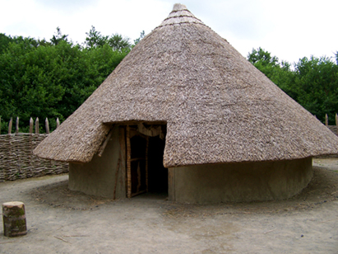
THE END

