Slide 1
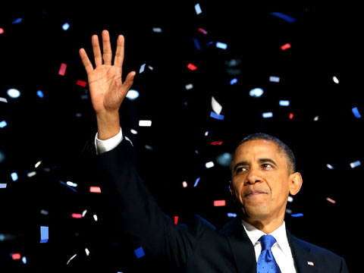
CLASSICAL CULTURE IN THE ENGLISH LANGUAGE
Influence of Latin Culture in the Obama’s Acceptance Speech
By
Girardi Gioia and Santini Leonardo

Slide 2
OBAMA’S SPEECH
GENRE :
Argumentative text → to persuade the interlocutor with some thesis
STRUCTURE :
Introduction → say thank you, values, career
Body → crisis, army, society, politic, future
Conclusion → new project, improve the economy situation

Slide 3
OBAMA’S SPEECH
OBJECTIVE:
Discover how and if the Latin language is still living in today’s english language
METHOD:
Look for the words inside the text
Find their origin in the dictionary
Count the latin words
Percentage
Identify noun, verb, adjective
Semantic field
Conclusion

Slide 4
OBAMA’S SPEECH
FIRST PAGE: 79 Latin words in 768 total words → 10,3%
56 Nouns → 44,2%
12 Verbs → 9,5%
11 Adjectives → 9%
SEMANTIC FIELDS :
ECONOMY : deficit, taxes, debt, surplus
POLITIC: nomination, candidates, president
VALOUR: optimism, promise, family,
ARMY: peace soliders, to defend
DIFFICULTY: tragedy of innocent, disctraction,
JOB: factory, office, product
EDUCATION: college, education, tuition

Slide 5
OBAMA’S SPEECH
SECOND PAGE: 65 latin words in 819 total words → 8%
43 Nouns → 66,2%
14 Verbs → 21,5%
7 Adjective → 10,7%
1 Preposition → 1,5%
SEMANTIC FIELDS:
ECONOMY : tax, export, industry, products
POLITIC : corporations, states, government, strategy
ENERGY : renewable, carbon, solar, batteries
FUTURE : remedied, problems, responsibility

Slide 6
OBAMA’S SPEECH
THIRD PAGE: 32 latin words in 1196 total words → 2,7%
21 Nouns → 65,7%
7 Verbs → 21,9%
4 Adjective → 12,5%
SEMANTIC FIELDS:
ENERGY : natural, renewable, batteries, oil
EDUCATION : student, inspire, cience, math
SOCIETY : path, time, recent, person
ECONOMY : imports
POLITIC : administrations, companies

Slide 7
OBAMA’S SPEECH
FOURTH PAGE: 73 Latin words in 862 total words → 8,5%
52 Nouns → 71,2%
11 Verbs → 15%
10 Adjectives → 14 %
SEMANTIC FIELDS:
POLITIC: president, democracy, congress, governor
ECONOMY: tax, rate, debt, deficit
VALOUR: success, honor, family, dignity, principles
SOCIETY: person, initiative, imigrants, patriotism
EDUCATION: student, college, math

Slide 8
OBAMA’S SPEECH
FIVETH PAGE: 52 Latin words in 814 total words → 6,4%
39 Nouns → 75%
8 verbs → 15,4%
4 Adjective → 7,7%
1 Adverb → 2%
SEMANTIC FIELDS:
ECONOMY: recession, control
POLITIC : convention, vote, candidate
SCIENCE : science, plant, scripture
ARMY : attack ,amputated, heroes, victories, battle
FUTURE: voice, horizon, possible

Slide 9
OBAMA’S SPEECH
SIXTH PAGE: 8 latin words in 171 total words → 4,7%
6 Nouns → 75%
2 Adjective → 25%
SEMANTIC FIELDS:
ENERGY: energy, oil, plants, batteries
POLITIC: vote, candidate
FUTURE: place, horizon, problem

Slide 10
CONCLUSION
4320 words VS 309 Latin words → 7,2%
These words are about: economy, politic, valour, army, job, future, education, difficulty, science,
In conclusion the influence of the classical culture in the today English language is very low:
WHY?
Anglo Saxon is the native tongue of English languages
In the ancient time the Latin culture didn’t exceed the Anglo Saxon ones
The Anglo Saxon language predominate the Latin ones in the English countries.

