Slide 1
FROM THE VICTORIAN AGE TO MODERNISM

Slide 2
WHY DID I CHOOSE THIS PATH?
To better understand the dynamics that allowed the passage from the Victorian Age to Modernism
To have a more complete panorama of the last part of the 19th century and the first two decades of the 20th

Slide 3
OBJECTIVE OF THE PATH
Which are the reasons that brought doubts, insecurity, sense of isolation and loneliness in the human being’s life?

Slide 4
FIRST PART OF THE THE VICTORIAN AGE (1837-1860)
Industrialization and the Britsih Empire brought:
Optimism
Moralism
Faith in progress
LITERATURE
The Major literary genre was the NOVEL
Omniscient intrusive third person narrator (Comments of the author)
Realistic novel
Happy end
To give a moral judgment
Linear chronological concept of time
Logical connections in a linear way
The reader is conditioned by the narrator’s filter

Slide 5
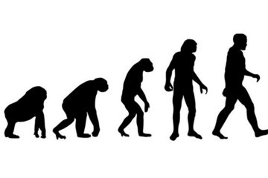
SECOND PART OF THE VICTORIA AGE (1860-1890)
RELIGIOUS CRISIS
AESTHETIC MOVEMENT (1880s)
Charles Darwin
The Origin of Species by Means of Natural Selection (1859)
Friedrich Nietzsche
Oscar Wilde
People have to find meaning by themselves, they can no longer refer to God
The Picture of Dorian Gray
Art should not have any moral, social or political purpose
God did not create Men
“God is dead”

Slide 6
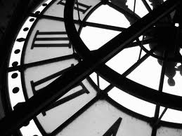
MODERNISM (1890-1920)
New theories
Henri Bergson
William James
Albert Einstein
Sigmund Freud
Carl Jung
Space and time do not exist as separate phenomena
People’s behaviour depends largely on the unconscious part of their minds
A basic element of man’s unconscious mind is formed by his racial memory
Past and future (as memory and expectation) exist together with the present in people’s mind
General Theory of Relativity (1905)
The Interpretations of Dreams (1899)
The Psychology of the Unconscious (1916)

Slide 7
MODERNISM
Rejected the old Victorian standards
The quest for truth.
Innovation in LITERATURE
Minimum plot
Poetical language
How to express reality (form)
The eclipse of the narrator
The shift of the point of view
The stream of consciousness technique
Focus on psychology
Simultaneous concept of time
The reader is free to make up her/his own point of view.

Slide 8
VIRGINIA WOOLF (1882-1941)
Developed a new way of expressing reality:
Interior monologue
Omniscient third person narrator (eclipse of narrator)
The shift of point of view (connectors)
Minimum plot
Chronological and simultaneous time
Poetical language
Mrs Dalloway (1925)

Slide 9
JAMES JOYCE (1882-1941)
The most important Modernist writer
Characteristics:
Ulysses (1922)
Importance of formal aspect
Eclipse of the narrator
Stream of consciousness
No logical connectors (association)
No punctuation
Simultaneous concept of time
Demands a lot to the reader
Setting:
Dublin, 16 June 1904 (a single day)
Characters: Leopold, Molly Bloom, Stephen
Structure:
18 chapters have titles derived from the episodes in the Odyssey by Homer
Leopold = Ulysses
Molly = Penelope

