Slide 1
Linguistics: Modernism and Postmodernism
A study of human language

Slide 2
Our Work
Task
Analyse linguistics during Modernism and Postmodernism.
Objectives
Comprehend the relationship between language and context;
Understand the changes introduced by philosophers;
Understand the importance of linguistics as a key to better comprehend the way human-beings think.

Slide 3
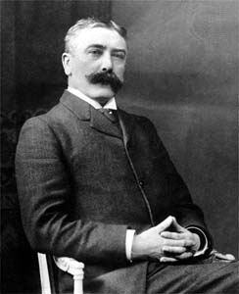
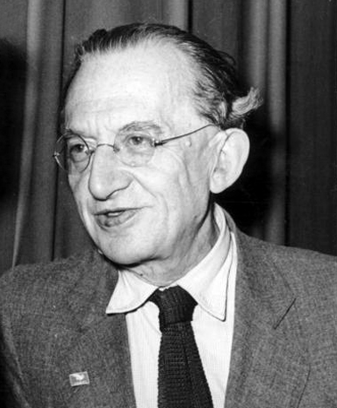
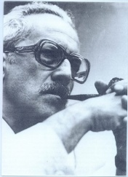
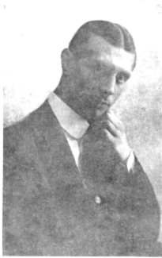
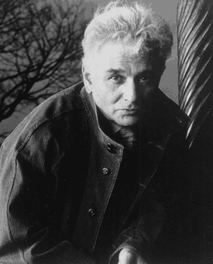
Time line
Modernism
Postmodernism
F. Saussure
G. Lukács
F. Rossi-Landi
V. Voloshinov
J.Derrida

Slide 4
What is Linguistics??
The scientific study of human language.
Three categories or subfields of study:
- language form,
- language meaning,
- language in context.
Holds other different disciplines such as Semiotics → science studying the role of signs as part of social life → social psychology which investigates the nature of signs and the laws governing them.

Slide 5
Why did Linguistics develop in this period?
Friedrich Nietzsche → “God is dead” (The Gay Science, 1882) → it underlines the fall of human’s certainties → spread of studies about human beings’ nature
Linguistics, studying human language, became one of the ways to study human beings’ nature.

Slide 6
Modernism
Movement in the arts, its set of cultural tendencies and associated cultural movements, originally arising in the late 19th and early 20th centuries.
Radical shift in aesthetic and cultural sensibilities evident in the art and literature.

Slide 7
Modernism and Literature
New narrative tecniques to create a different kind of novel → realist novel
Abolition of lineary plot →flashback, flash-forward, citations → lose of the classic concept of space
Themes previously considered taboo (sexuality..)
Work isn’t a subjective but an objective expression →Need of a specific and objective language
Notes:
7

Slide 8
Ferdinand de Saussure(1857-1913)
Theory of synchronic language: relationship signifier-signified is arbitrary → meaning produced by signs(signifier and signified union) relationship
Meaning built up on differences and binary pairs (eg. true/false)

Slide 9
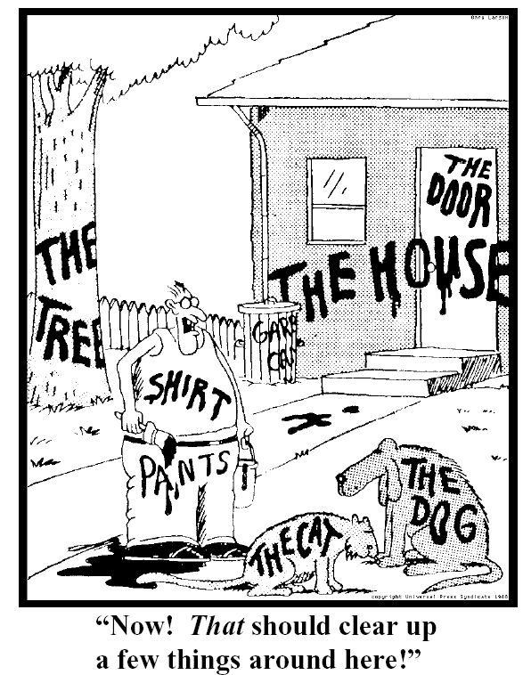
Semiotic Materialism
Inspired by Karl Marx’s materialism → analysis started from a realistic (not idealistic) element
Explicit the relationship text-context
A set of theoretical approaches to signs production and communication → study how socioeconomic and signs systems affect each other

Slide 10
Valentin Voloshinov (1895-1936)
Signs = intersection of subject( human psyche and consciousness) and object (social world)
sign connects the subject-object totality, the individual psyche and the social context
Language use not determined by class struggle→ same language used by different social classes
Ideology = how society enters people’s mind through signs

Slide 11
György Lukács (1885–1971)
Opposite approach to Voloshinov’s one: language as tool of class rule
Destruction of the subject-object totality of an humanized world by capitalism → people on the same level of material things
Alienation of low social class→ specific language in every social class

Slide 12
Postmodernism
Name given to the period of literary criticism that is now in full bloom.
Way of being, a sensibility, → difficult to decide in which period it started → post-World War II era (1950s).
Reaction of its practitioners to the rational, scientific and historical aspects of the modern age.

Slide 13
Postmodernism and Literature
Postmodernism is concerned with imprecision and unreliability of language and with epistemology (the study of what knowledge is)
The modernist philosophy believed in the truth | The postmodernist philosophic paradigm can be expressed in the following way: there is no identifiable truth.

Slide 14
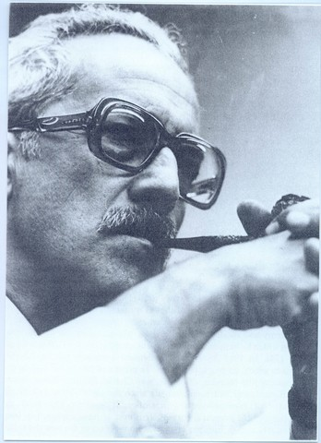
Ferruccio Rossi-Landi (1921–1985)
Humans are social beings →need to exchange ideas and thoughts through signs
Control of signs systems → control of people
Capitalism affects how and what people are able to communicate → linguistic alienation

Slide 15
Jacques Derrida(1930-2004)
Founder of “deconstruction”: communication is uncertain because of not definite link between signifier and signified
Meaning is unstable and
relative, not absolute
Concept of “differance”( to differ and to defer)to describe how meaning is produced

Slide 16
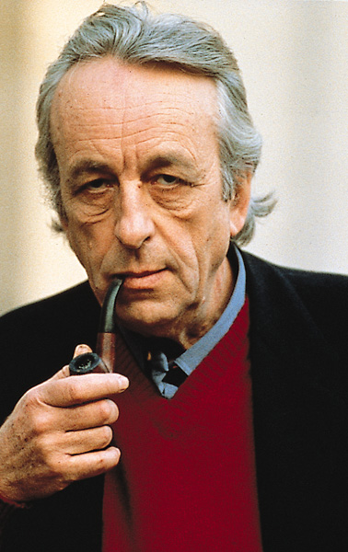
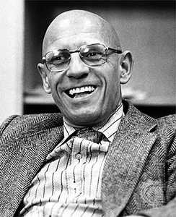
Other semioticians
Louis Althusser (1918-1990): no one on one relationship between class and language→ human thoughts formed independent of given economic conditions.
Michel Foucault (1926-1984): discourse regulated what can be said, what can be thought and what is considered true /false.

Slide 17
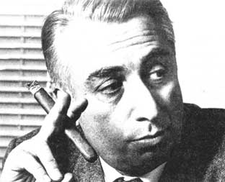
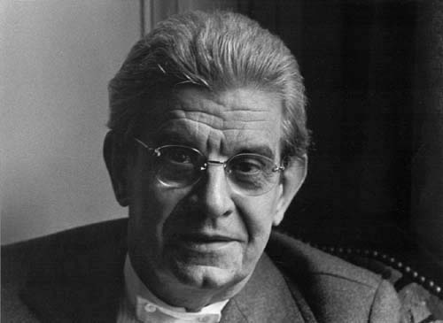
Other semioticians
Roland Barthes (1915-1980): the death of the author → the supremacy of the reader
Jacques Lacan (1901-1981): Saussurean ideas applied to psychoanalysis → unconscious is structured like a language

Slide 18
WORK BY
BALDIN Ruben
BUCCOLO Nicola
CHIESA Francesco
NOACCO Amedeo

