Slide 1
The Modern Age
From the crisys of values to a possible resolution of the problem

Slide 2
Aim of the path
To understand the processes that brought to the crisys of the society
To analize the reactions to this crisys
To recognize the new kinds of literature and art that developed as a consequence to the crisys
Try to understand if the crisys is resolved

Slide 3
The Modern Age
A period that goes from 1890 to 1930
An atmosphere of tension, caused by competition for raw material and the control of trade→it culminated with the First world war
U.S.A and Russia became the two most powerful countries of the world

Slide 4
Reasons of the crysis
Darwin → the Teory of selection →humans create themselves, God is outside human’s creation
Nietsche→conied the motto “God is dead” →there was no God
People felt lost

Slide 5
Consequences of the crisys
Doubt and insecurity in the human being
Sense of isolation
People in the end of the 19 th century and in the beginning of the 20 th, lived without a meaning
An atmosphere of pessimism

Slide 6
Reaction of the artists
Conrad→accepted what happened in one’s life as well as possible
T.S. Eliot and Ezra Pound →changed English poetry from a sentimental to a new form
Joyce and Woolf → focused their attention to the inner part of human being

Slide 7
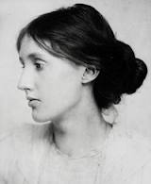
Woolf’s poetic
Interesting in giving voice to the interior world of feelings→ events lost their importance
Use of different narrative tecniques →inner monologue and the stream of consciousness (sequence of thoughts as they crop up in the character’s mind)

Slide 8
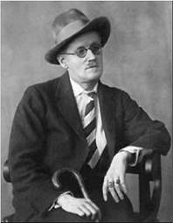
Joyce’s poetic
Use of the stream of consciousness
Use of simbols
Attention to the mytological world
Treatment of themes previously considered taboo (sexuality)
Substitution of the narrative method with the mytological metod

Slide 9
Aestethism: a reaction against the crysis
Artistic and literary movement of the 19 th century
It reflected the sense of frustation and uncertainty of artists
Aim of the aesthetic movement → redefine the role of art

Slide 10
The main theorist of aesthetism: Walter Pater
Excessive attention to the self
Rejected religious faith
Life should be lived as a work of art
Considered art as a means to stop time

Slide 11
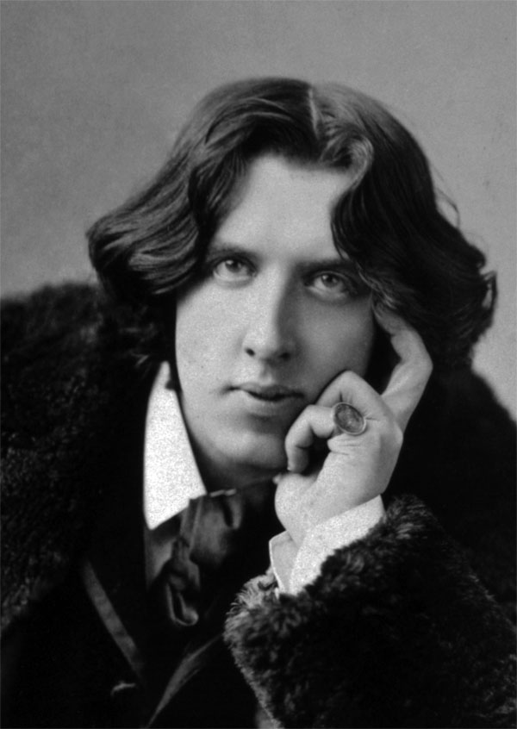
Oscar Wilde
One of the most important theorist of the Aesthetic movements
He didn’t accept the morality of the Middle Class during Victorian Age
Art only needed to be beutiful

Slide 12
A work by: Francesco Chiesa

