Slide 1
Why Did T.S. Eliot Use Hamlet’s Figure?

Slide 2
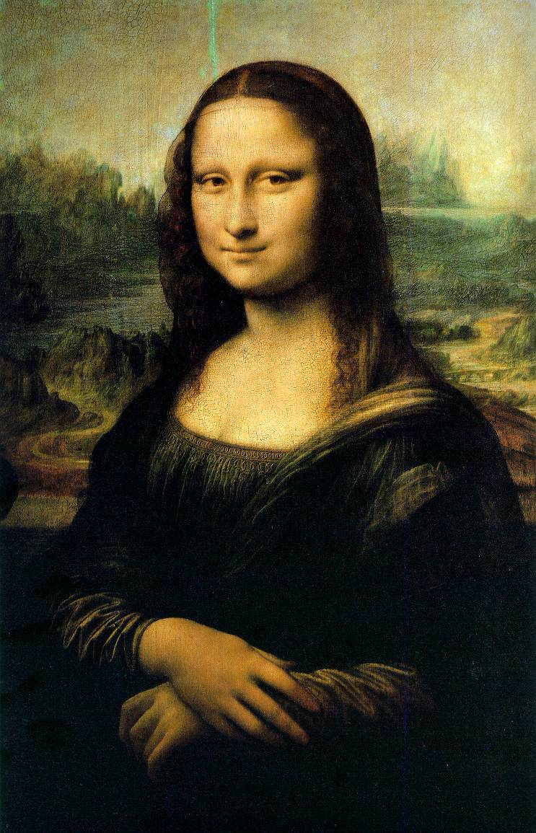
T.S. ELIOT about HAMLET’S FIGURE
It is the Mona Lisa of literature. (Hamlet)
ambiguity of Hamlet’s figure/Mona Lisa’s figure
According to Bernard Berenson, T.S. Eliot criticised the subjective interpretations and second-rate theories:
"the picture becomes more wonderful to us than it really is, and reveals to us a secret of which, in truth, it knows nothing”
(Oscar Wilde, The Critic as Artist, 1891)
Art has meaning in itself: art for art’s sake.
L. Da Vinci, Mona Lisa (1479-1528), Museè du Louvre, Paris

Slide 3
SHAKESPEARE’S HAMLET
The story
The prince of Denmark
Desire of revenging his father’s death
The true essence of the tragedy
Edipic complex
Reflection on existance
awareness of his condition
→ inaction: moral values VS ancient values
Io VS Super-Io
«to be or not to be», act or no act (procrastination/paralysis)
Hamlet is a modern anti-hero → human condition
Alfred Prufrock

Slide 4
PRUFROCK LIKE HAMLET «No! I am not Prince Hamlet, nor was meant to be» (l. 111) The Love Song of J. Alfred Prufrock
Prufrock is oppressed by an unknown “overwhelming question”
“To prepare a face to meet the faces that you meet”
“There will be time, there will be time”
Hamlet is oppressed by doubts and indecision
Hamlet makes believe to be mad
he has to appeare mad to others to prepare his plan
“Thus conscience does make cowards of us all”
existential questions
To prepare/appeare or to be ?
Appearence VS Reality (to be or not to be)
Procrastination/inaction
AND THE QUOTATION FROM THE LOVE SONG?

Slide 5
«No! I am not Prince Hamlet, nor was meant to be»
No! I am not Prince Hamlet, nor was meant to be;
…
Politic, cautious, and meticulous;
Full of high sentence, but a bit obtuse;
At times, indeed, almost ridiculous—
Almost, at times, the Fool.
A. Prufrok cannot compare himself to Hamlet (at the end he kills Claudio)
awareness of modern human condition: Like a patient etherized or a Fool
Human beings are ‘‘dead’’ like Dublin inhabitant of Joyce’s Dubliners
Every attempts of acting, of change their condition:
rigeneration (spring: april is the cruellest month) is useless

Slide 6
HUMAN CONDITION
T.S. Eliot’s choice of name:
Prufrock-Littau a furniture company’s name in Saint Louis
It does not refer to a specific person attempt to universalize his condition
His condition-modern human condition:
Impossibility of relating with others (alienation)
Everyday (When the evening) Prufrock executes and sees the same repetitive actions (bourgeois):
There will be time, In the room the women come and go, I have measured out my life with coffee spoons…
He asks to himself:
Do I dare..Disturb the universe?
to give answer to the overwhelming question
The answer is obviuosly negative:
And indeed there will be time
continuous inaction and he grow old ... he grow old...

Slide 7
CONCLUSION
The choice of Hamlet’s figure makes more clear the figure of anti-hero inability of acting and of relating with others
Hamlet’s figure makes the reader come to his/her mind classical figure of Oreste (parody of contemporaneous men) : there is an evident distance between classical hero (driven by values) and modern anti-hero (driven by his/her quest)
You can find similarity between yourself and Hamlet or Prufrock

Slide 8
Sitography:
http://www.arlindo-correia.com/020602.html
Giorgia Licata
classe 5A
A.s. 2012/2013

