Slide 1
LINGUISTICS: A WAY TO UNDERSTAND AND REPRESENT REALITY
From Modernism to Postmodernism

Slide 2
WHAT IS LINGUISTICS?
It is the science of language
The linguistic analysis can be arranged into four parts:
phonology
morphology
Research tools
Working method
Improvement
syntax
semantic

Slide 3
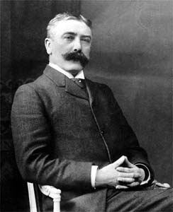
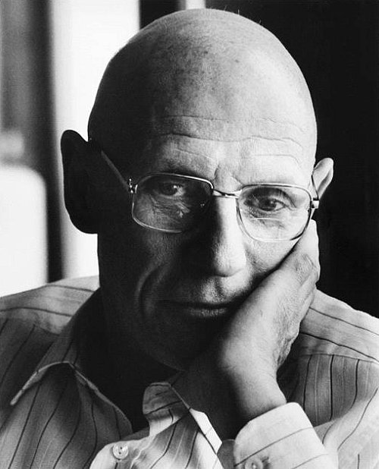
SOME PHILOSOPHERS
Ferdinand de Saussure (1857 – 1913)
Theory of synchronic language
Meaning built through difference and binary pairs
Concepts of langue and parole
Michel Foucault (1926 – 1984)
Analysis of the discourse’s function
Discourse as a power tool

Slide 4
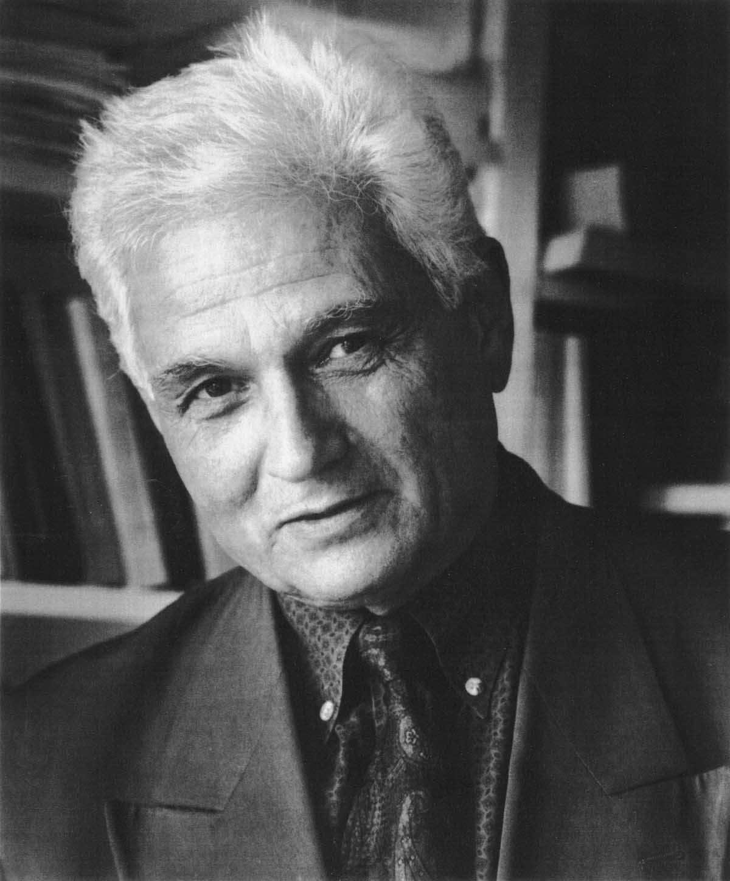
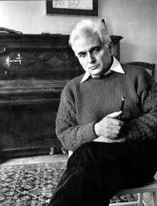
SOME PHILOSOPHERS
Jacques Derrida (1930 – 2004)
“Deconstruction”
No definitive link between signifier
and signified instability of meaning
Texts as products of intertextuality
Meaning built through difference and binary pairs

Slide 5
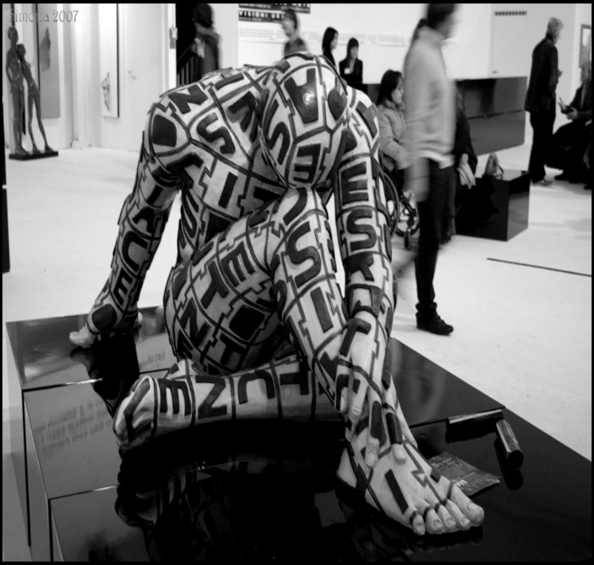
MATERIALISTIC SEMIOTICS
Theoretical approaches to signs production and communication
Studying of the influences between sign systems and socioeconomic systems
Inspired by Karl Marx’s philosophy
To make explicit
the relationship between
text and context

Slide 6
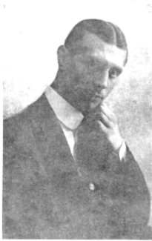
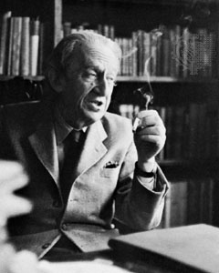
SEMIOTICIANS
Valentin Voloshinov (1895 – 1936)
Signs as the sites where subjects (psyche) and object (social word) intersect
Signs used to promote ideologies
No connection between language communities and class categories
György Lukács (1885 – 1971)
Language as mean of class rule
Connection between language communities and class categories
Destruction of the subject – object totality of an humanized word because of Capitalism
Alienation of the low class

Slide 7
WHY DID LINGUISTICS DEVELOP DURING MODERNISM AND POSTMODERNISM?
Because of:
The crisis of values during the Modern Age
Necessity of understanding and representing the world and reality in all their aspects

Slide 8
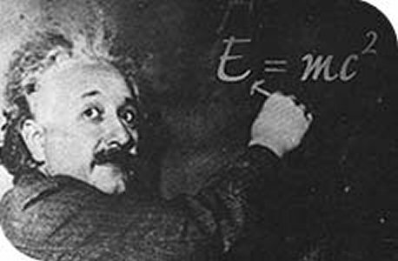
THE CRISIS OF VALUES
Theory of evolution by Charles Darwin (1809 – 1882)
Theory of relativity by Albert Einstein (1879 – 1955)

Slide 9
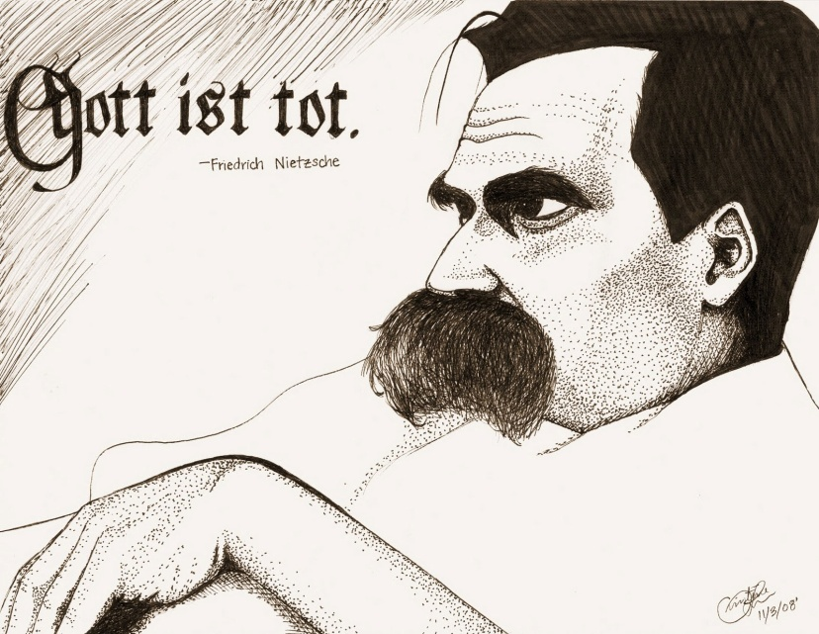
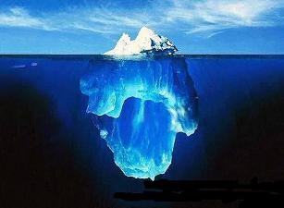
THE CRISIS OF VALUES
The death of metaphisysic: God is dead by Friedrich Nietzsche (1844 – 1900)
The concept of unconscious by Sigmund Freud (1856 – 1939)

Slide 10
TO UNDERSTAND AND REPRESENT REALITY
It is difficult to understand and represent all aspects’ reality
Linguistics is arranged into different fields:
synchronic linguistics
diachronic linguistics
theoretical linguistics
applied linguistics
historical linguistics
Every field explains a specific aspect of reality
comparative linguistics
psycholinguistics
sociolinguistics
stylistics

Slide 11
WORK BY:
Iaccarino Luca
Selvazzo Enrico
Class V A
School Year 2012 - 2013

