Slide 1
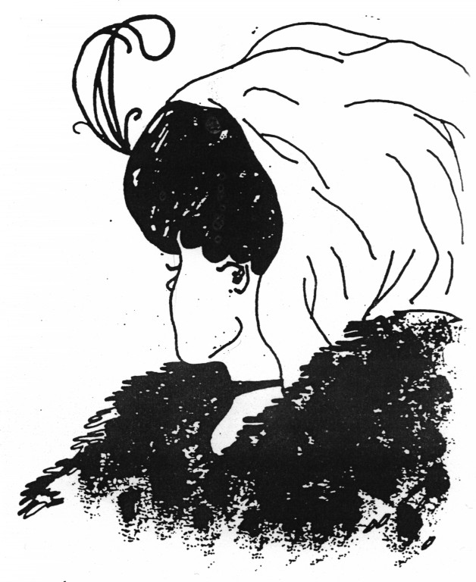
THE IMPORTANCE OF SUBJECTIVITY
THE SHIFT FROM EXTERNAL TO INNER REALITY DURING THE XIX CENTURY

Slide 2
REASON FOR CHOOSING THE PATH
To better understand the XIX century
To better understand the importance of subjectivity
To improve my skills in making intertextuality and connections between different subjects

Slide 3
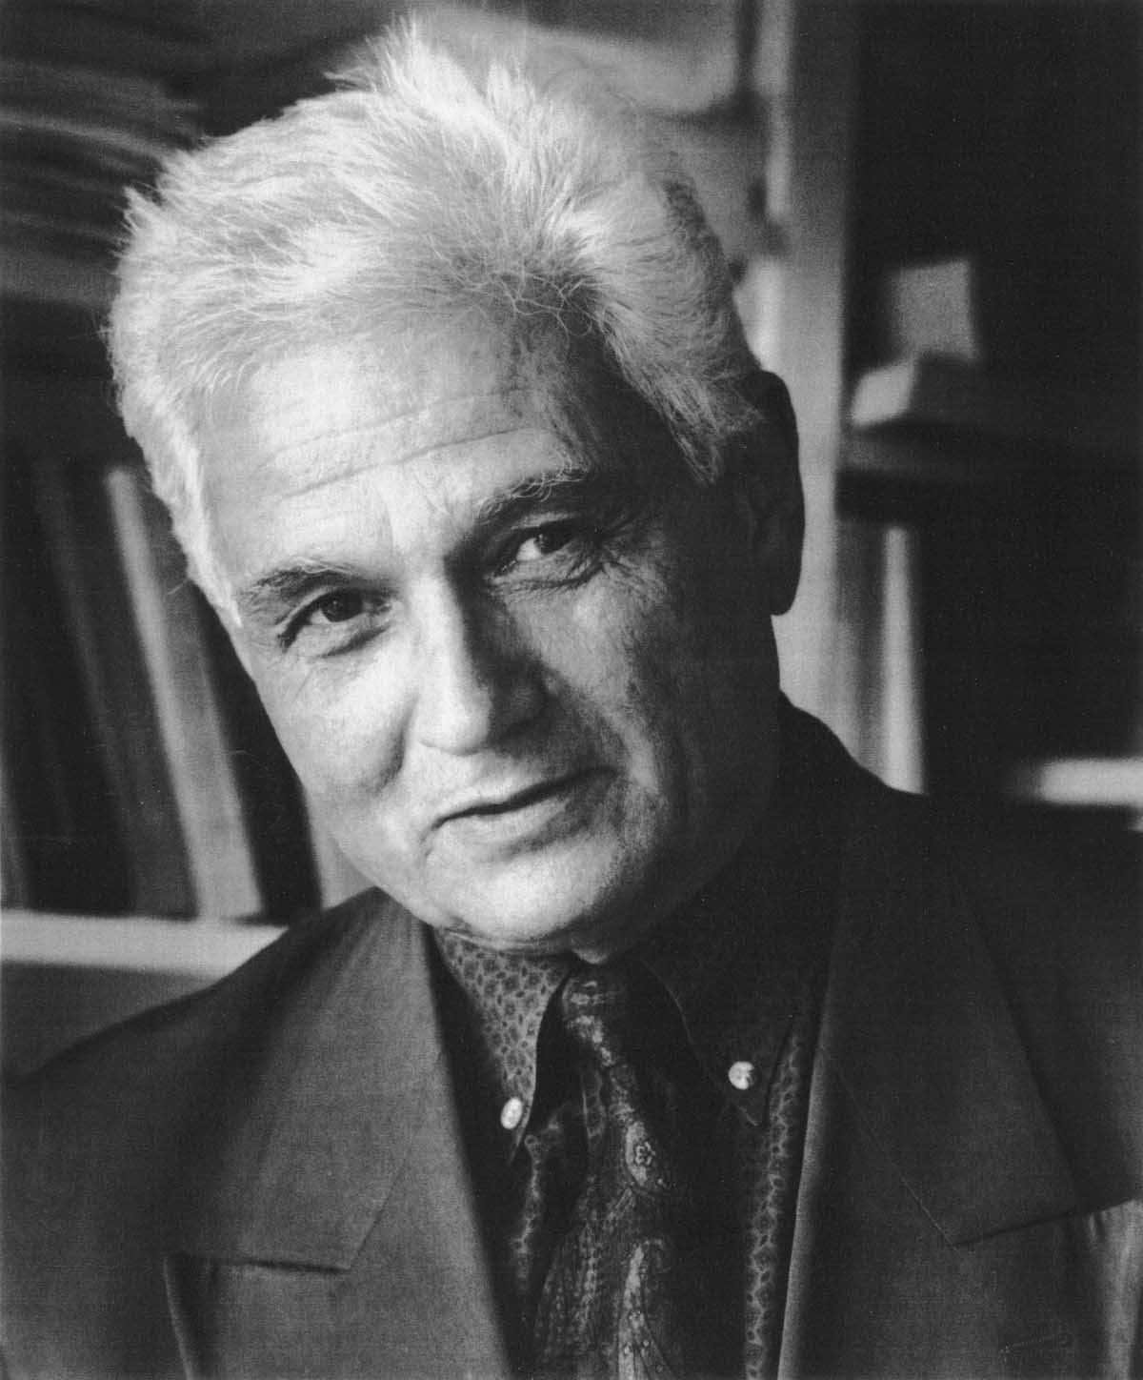
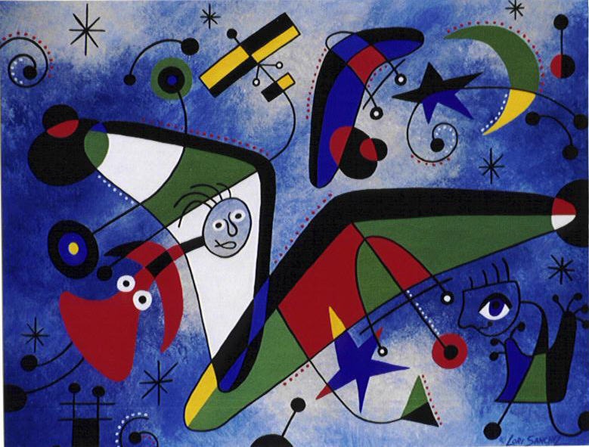
PROBLEM POSED OR OBJECTIVE OF THE PATH
THE IMPORTANCE OF SUBJECTIVITY
Why did subjectivity become important in the XIX century?
What were its responses in literature?
What were its responses in art?

Slide 4
MY PERSONAL PATH
LITERATURE:
James Joyce, Ulysses (1922), Penelope
Virginia Woolf, The Common Reader (1925)
Virginia Woolf, Mrs Dalloway (1925), First Chapter
ART:
Edvard Munch, Evening on Karl Johann (1892)
Edvard Munch, The Scream (1893)
Edvard Munch, Puberty (1893)

Slide 5
WHY DID SUBJECTIVITY BECOME IMPORTANT IN THE XIX CENTURY?
Because of:
The crisis of values during the Modern Age
Necessity of understanding and representing the world, the human being and reality in all their aspects

Slide 6
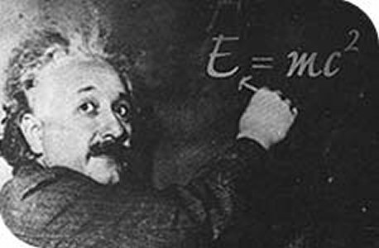
THE CRISIS OF VALUES
Charles Darwin’s (1809 – 1882) Theory of evolution
Albert Einstein’s (1879 – 1955) Theory of relativity

Slide 7
THE CRISIS OF VALUES
Max Planck’s (1858 – 1947) Quantum theory
Werner Karl Heisenberg’s (1901 – 1976) Uncertainty principle

Slide 8
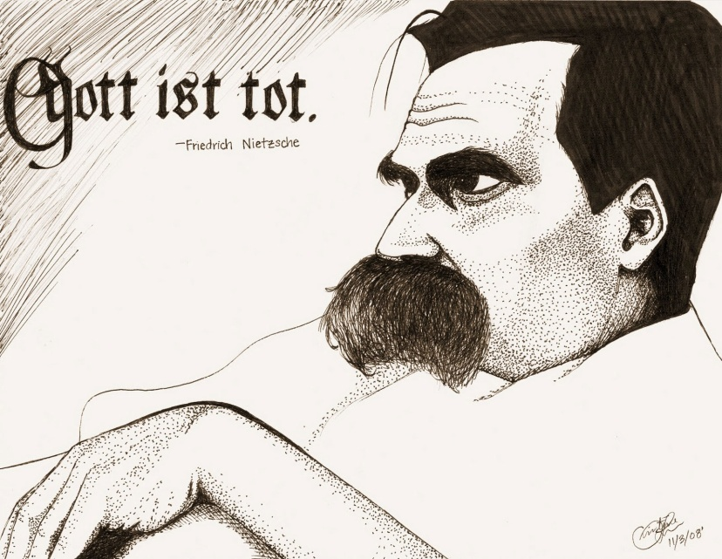
THE CRISIS OF VALUES
The death of metaphisysic: God is dead by Friedrich Nietzsche (1844 – 1900)
Sigmund Freud’s (1856 – 1939) The concept of unconscious

Slide 9
WHAT WERE THE RESPONSES OF SUBJECTIVITY IN LITERATURE?
The novelist disappeared and left the characters speak for themselves
Abesence of moral criticism and humorous observation
There is no plot or structure
Stream of consciousness, interior monologue and free in - direct and direct speech as privileged strategies

Slide 10
WHAT WERE THE RESPONSES OF SUBJECTIVITY IN LITERATURE? An example of stream of consciousness
what an unearthly hour I suppose theyre just getting up in China now combing out their pigtails for the
day well soon have the nuns ringing the angelus theyve nobody coming in to spoil their sleep except an
odd priest or two for his night office the alarmclock next door at cockshout clattering the brains out of
itself let me see if I can dose off 1 2 3 4 5 what kind of flowers are those they invented like the stars the
wallpaper in Lombard street was much nicer the apron he gave me was like that something only I only
wore it twice better lower this lamp and try again (…)
(James Joyce, Ulysses, Penelope)

Slide 11
WHAT WERE THE RESPONSES OF SUBJECTIVITY IN LITERATURE? An example of interior monologue
(…) “That is all,” she said, looking at the fishmonger’s. “That is all,” she repeated, pausing for a moment at the window of a glove shop where, before the War, you could buy almost perfect gloves. And her old Uncle William used to say a lady is known by her shoes and her gloves. He had turned on his bed one morning in the middle of the War. He had said, “I have had enough.” Gloves and shoes; she had a passion for gloves; but her own daughter, her Elizabeth, cared not a straw for either of them.
Not a straw, she thought, going on up Bond Street to a shop where they kept flowers for her when she gave a party. Elizabeth really cared for her dog most of all. The whole house this morning smelt of tar. Still, better poor Grizzle than Miss Kilman; better distemper and tar and all the rest of it than sitting mewed in a stuffy bedroom with a prayer book! (…)
(Virginia Woolf, Mrs Dalloway, First Chapter)

Slide 12
WHAT WERE THE RESPONSES OF SUBJECTIVITYIN ART?
EXPRESSIONISM (Edvard Munch)
It focuses its attention on character’s feelings
Simplification of the composition
Perspective distorsion
Deformation of the characters
Irregular lines
Constrast between colours

Slide 13
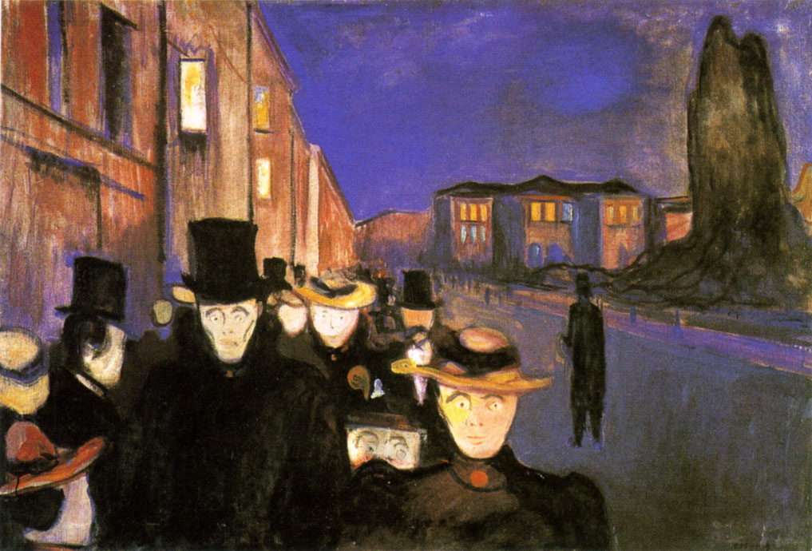
WHAT WERE THE RESPONSES OF SUBJECTIVITY IN ART?
Edvard Munch, Evening on Karl Johann (1892)

Slide 14
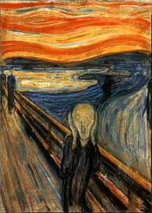
WHAT WERE THE RESPONSES OF SUBJECTIVITY IN ART?
Edvard Munch, The Scream (1893)

Slide 15
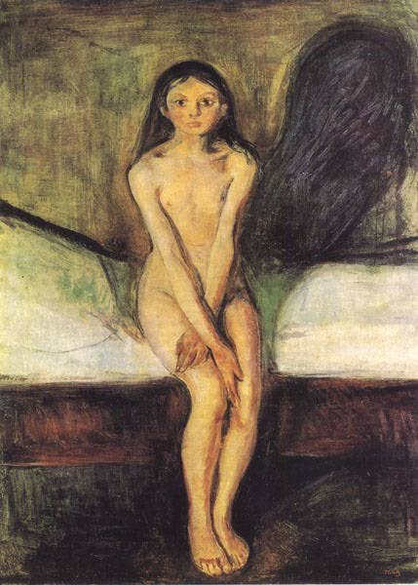
WHAT WERE THE RESPONSES OF SUBJECTIVITY IN ART?
Edvard Munch, Puberty (1893)

Slide 16
WORK BY:
Iaccarino Luca
Class V A
School Year 2012 - 2013

