Slide 1
The role of consciousness in the 20th Century
Migli Lisa 5^A A.S. 2012/2013

Slide 2
Reason for choosing the path
To analyze how the psychological sphere influenced literature, in particular during the 20th Century.

Slide 3
Aim of the path
To examine in depth some features of the Modern Age, in order to find out how consciousness works
To train in view of the final examination

Slide 4
The cultural background
Charles Darwin’s Evolution Theory (1859)
Friedrich Nietzsche’s Die fröhliche Wissenschaft (1882) → God is dead
Albert Einstein’s Theory of Relativity (1905-1913)
Sigmund Freud’s Interpretation of dreams (1899)
Mark Planck’s Postulate (1900)
The whole world undergoes a deep transformation

Slide 5
The discovery of the unconscious: Sigmund Freud
“The interpretation of dreams” (Die Traumdeutung), 1899
Dream interpretation UNCONSCIOUS Superego, Ego,
Es
The most intimate dimension: the unconscious reveals itself
Dream = A form of “wish fulfillment”
LITERATURE AND ART begin to investigate the unconscious
Break with Victorian tradition

Slide 6
The unconscious in literature: the importance of time
Virginia Woolf: Mrs Dalloway
Chronological time: Mrs Dalloway moves around London, disturbed by the strikes of the Big Ben
The handling of time
Interior time: travel in space and time, according to Mrs Dalloway’s flux of thoughts
Human mind’s complexity

Slide 7
The unconscious in literature: the importance of time
James Joyce: The Dubliners
Gabriel Conroy’s epiphany
A sudden spiritual manifestation: it shows mankind’s paralysis
Without following your emotions and private feelings, you cannot fully live

Slide 8
The unconscious in literature: the importance of time
James Joyce: Ulysses
The stream of consciousness
and the interior monologue
The mind does not follow a linear conception of time
The psychological sphere dominates mankind: the unconscious becomes predominant

Slide 9
The unconscious in literature: the importance of time
Italo Svevo: La Coscienza di Zeno
PSYCHOANALYSIS AND TIME
The story does not follow a chronological order
Memories
Feelings
Analysis of Zeno’s psychology
CLUMSINESS
SICKNESS AND WEAKNESS

Slide 10
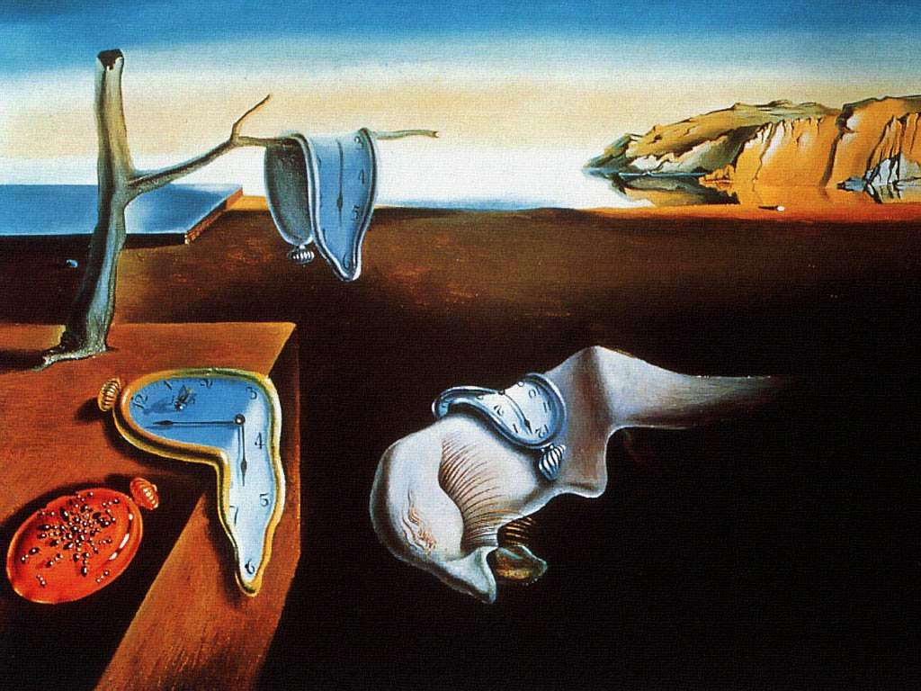
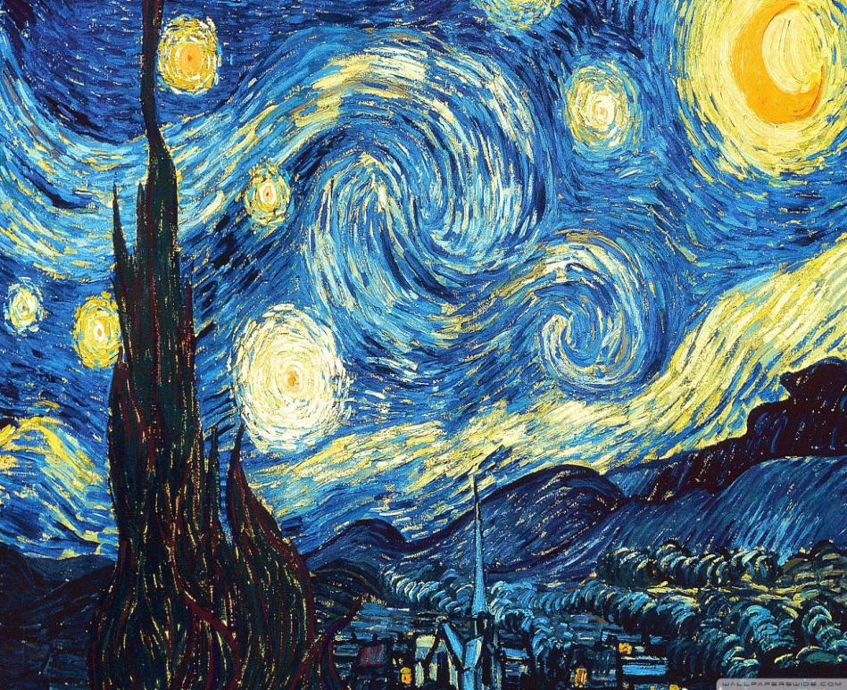
The unconscious in art
Salvador Dalì, The persistence of memory (1931)
Vincent Van Gogh, The Starry Night (1889)
Reality is a dynamic and subjective entity: it depends on men’s perspective about it.

