Slide 1
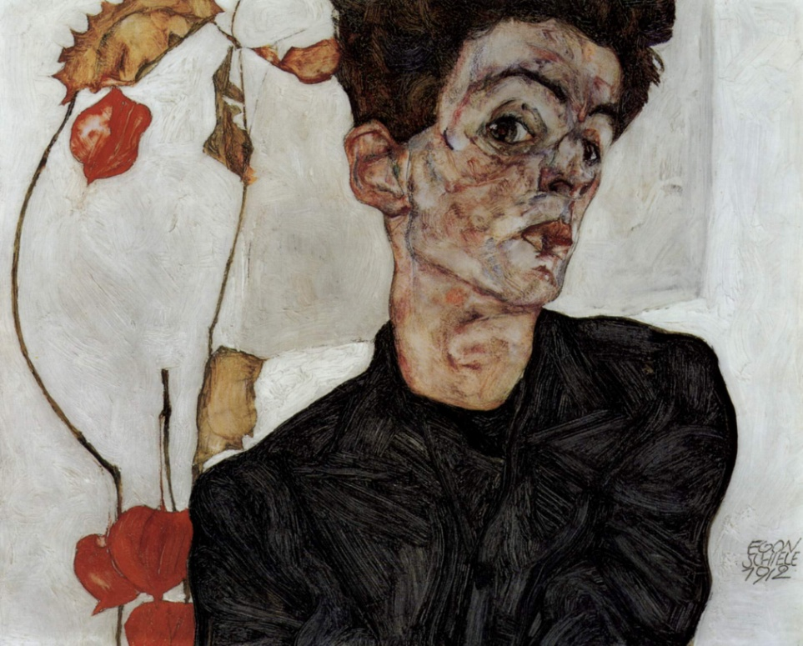
The Figure of Hamlet in T.S.Eliot’s The Lovesong of J.Alfred Prufrock

Slide 2
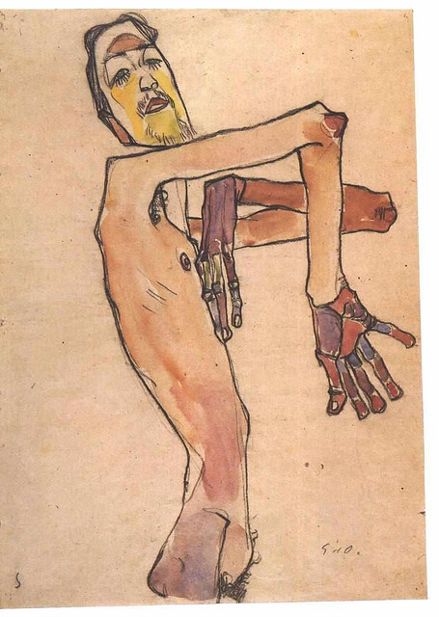
The Lovesong of J. Alfred Prufrock lines 111-119
‘’ No! I am not Prince Hamlet, nor was meant to be;
Am an attendant lord, one that will do
To swell a progress, start a scene or two,
Advise the prince; no doubt, an easy tool,
Deferential, glad to be of use, 115
Politic, cautious, and meticulous;
Full of high sentence, but a bit obtuse;
At times, indeed, almost ridiculous—
Almost, at times, the Fool. ‘’

Slide 3
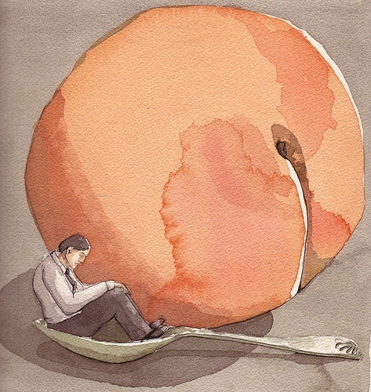
Hamlet and Prufrock
Prince Hamlet and Prufrock are parodically compared for their tendency for procrastination and indecision (‘’to be or not to be’’/to act or not to act).
Prufrock and Hamlet both are figures never achieving their purpose.
Prufrock never defines his love and Hamlet never kills Claudius.
Both suffered from the ‘’paralysis of the will’’.
Prufrock's paralysis is not over murder and the state of a corrupt kingdom, but whether he should "dare to eat a peach" .
Hamlet is still a hero but Prufrock is an anti-hero, a ''Fool'',
a frustrated and impotent modern individual with social and
sexual anxieties ("pinned and wriggling on the wall’’)

Slide 4
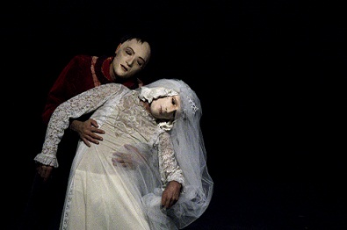
Hamlet and Prufrock
Prufrock debates certain instances in his mind: whether or not he will approach his love; whether he will continue upon his current path or will he "dare" to do anything at all.
Prufrock is paralyzed by ''his tedious argument'‘/ ‘’ overwhelming question’’ as Hamlet by his most famous question
Their reflection paralyze their action
the allusion Prufrock makes to Hamlet is defined by negation → He has already made a decision on that question: he was not "meant to be’’
text: Hamlet, act III, scene I
‘’ Thus conscience does make cowards of us all, And thus the native hue of resolution Is sicklied o’er with the pale cast of thought, And enterprises of great pitch and moment With this regard their currents turn awry, And lose the name of action. ‘’

Slide 5
Hamlet and Prufrock
Differently from Prufrock Hamlet hesitated but finally acted decisively
Prufrocks makes an ironic allusion to Hamlet
the reader can interpret his statement as saying that he is so insignificant that he could not even become famous for his inability to communicate and act.
Prufrock realizes that his life is "measured out by coffee spoons", while Hamlet warns Ophelia to hide safely until everything passes over by exclaiming "Get thee to a nunnery" (3.1.122).
Hamlet writes Ophelia letters proclaiming his love, but she is convinced that he is mad.
Prufrock never sends the woman with whom he is infatuated a letter or a sign of his love because he believes that she will misunderstand what he is trying to say: "'That is not it at all, / That is not what I meant, at all'" .

Slide 6
The Fool
Prufrock feels as if he were the Fool
The wisest character in a Shakespearean play is often the fool, the one who points what every other character fails to see.
But Prufrock sees himself as more like Polonius (Ophelia’s father), the old fool from the same play.
In Hamlet, Polonius is the father of Ophelia and everyone respects him because he always takes the cautious route and acts like "an easy tool."
Shakespeare uses him to "start a scene or two" in the play, then kills him off around the midway point.
Attendant lord: He is something that other use

Slide 7
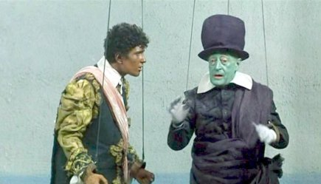
A hole in a papier sky : Orestes, Hamlet and Prufrock
Text: The Late Mattia Pascal, Chapter VIII - ‘’Papiano gets my eye’’
‘’ Se, nel momento culminante, proprio quando la marionetta che rappresenta Oreste è per vendicare la morte del padre sopra Egisto e la madre, si facesse uno strappo nel cielo di carta del teatrino, che avverrebbe? (…) Ma è facilissimo, signor Meis! Oreste rimarrebbe terribilmente sconcertato da quel buco nel cielo. (…) Oreste sentirebbe ancora gl’impulsi della vendetta, vorrebbe seguirli con smaniosa passione, ma gli occhi, sul punto, gli andrebbero lì, a quello strappo, donde ora ogni sorta di mali influssi si penetrerebbero nella scena, e si sentirebbe cader le braccia. Oreste, insomma, diventerebbe Amleto. Tutta la differenza, signor Meis, fra la tragedia antica e moderna consiste in ciò, creda pure: in un buco nel cielo di carta”.
”Beate le marionette (…) su le cui teste di legno il finto cielo si conserva senza strappi! Non perplessità angosciose, né ritegni, né intoppi, né ombre, né pietà: nulla! E possono attendere bravamente e prender gusto alla loro commedia e amare e tener se stesse in considerazione e in pregio, senza soffrir mai vertigini o capogiri, poiché per la loro statura e per le loro azioni quel cielo è del tutto proporzionato.

Slide 8
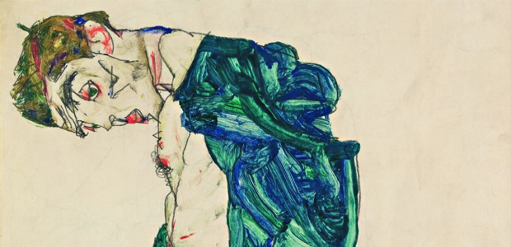
A hole in a papier sky : Orestes, Hamlet and Prufrock
Pirandello said ‘’ That’s the hole difference between ancient tragedy and modern...a hole torn in a papier sky’’
If a hole is thorn in this papier sky, Orestes would become as Hamlet distracted and anable to complete the task of avenging his father Agamemnom
The metaphor of the ‘’papier sky’’ refers to the ancient system of values that secured the individual with Truth and sense → Orestes’life is governed by fate
Truth was already given and the individual didn’t have to undertake a Quest -(ion)

Slide 9
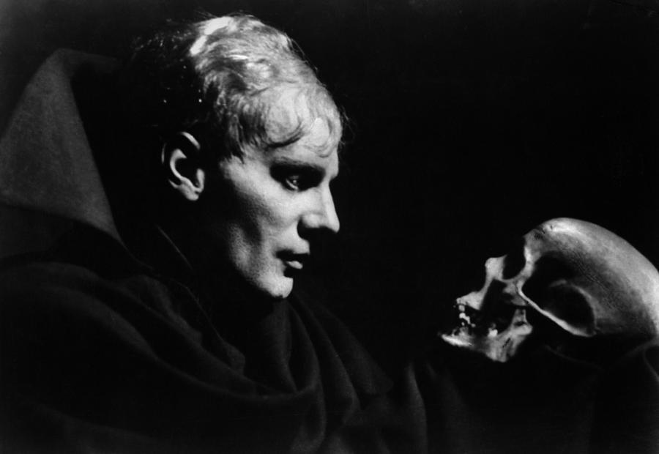
A hole in a papier sky : Orestes, Hamlet and Prufrock
Orestes is a hero: he takes a decision and acts because he beleves in fate
Hamlet is a modern hero: he has to find a sense to his actions, he’s undecided and he doesn’t act → at the end he takes a decision
Prufrock is a modernist hero: he doesn’t take a decision and he doesn’t act but he descends his own ‘’Inferno’’
The classic hero has to choose between two different systems of values
The modernist hero has to find out one

Slide 10
Credits:
Maria Rita Rmus

