Slide 1
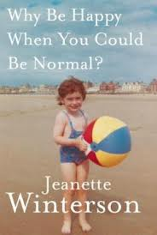
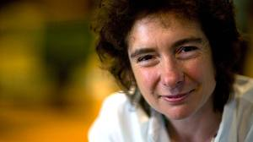
Why Be Happy When You Could Be Normal?
By Jeanette Winterson

Slide 2
What is the book?
It proposes some themes of Oranges Are Not The Only Fruit(1985)
It is a memoir→ focus on the writer’s feelings and behaviours in particular moments of her life
Memoir→ each chapter of the book not chronologically linked with the others
Feelings rule in the book, not time

Slide 3
Structure of the book
Title
Image of a child Jeanette Winterson
Dedication
Tributes
15 chapters

Slide 4
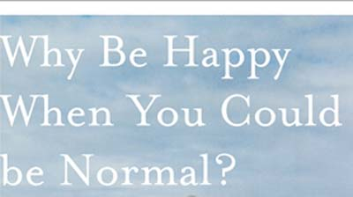
Title
Why be Happy When You Could Be Normal
Two important words within it: “happy” and “normal”
The important theme of the ethernal pursuing of happiness
The theme of escaping from the life imposed by other people( e.g. Mrs Winterson’s evangelical pentecostal life)

Slide 5
Dedication
Dedication to three mothers:
Constance Winterson, adoptive mother
Ruth Rendell, literary mother
Ann S., biological mother
Function of the dedication: make the reader understand people who have contributed to form Jeanette’s mind and personality

Slide 6
Tributes
Their function→to thank people who never abandoned the writer and help her to find the very happiness
Susie Orbach: Jeanette’s girfriend since when the writer found her adoption papers in the effects of her dad
Paul Sharer: tracer of Jeanette’s family tree

Slide 7
Organization of the 15 chapters
The main structure of the book is chronologically organised
Chapter 1, The Wrong Crib( crib = costola)→ idea of coming to the world
Last chapter, Coda→ to convey a sense of conclusion
Between them: chapters organised following the writer’s emotions and considerations

Slide 8
First chapter
Presentation of the crucial themes of the book→ pursuing of happiness, relationship writer – adoptive mother, lesbianism, search of the biological mother
Introduction to Mrs Winterson, a very strange woman—>a revolver in the duster drawer, waiting for Armageddon
First features of Jeanette’s teenage nature→ always refused to be friend of someone→ she had an imaginary friend

Slide 9
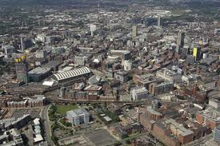
Second chapter
Description of Manchester, where the writer was born
Contradictions within the city→ capitalism→ massive spread between rich and poor people
Description of jobs of her biological family and adoptive one( with their living conditions and lifestyle)
Last pages—> the them of pursuing the happiness
The city of Manchester

Slide 10
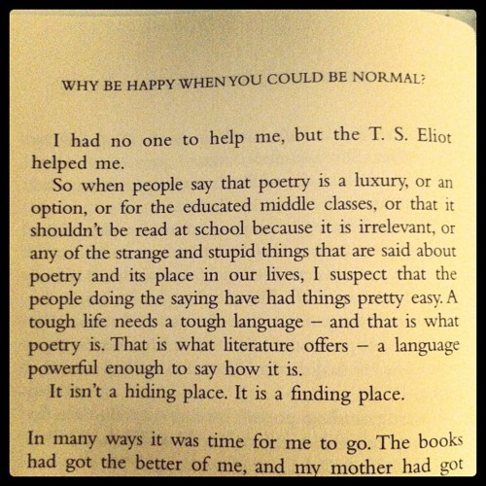
Personal Conclusions
The book is the story of a life’s work to find happiness
Literature can be a useful mean to help us when we are sick and without hopes for the future
The pursuing of happiness sometimes implies to be considered unnormal by certain people→ what really means is to reach happiness

Slide 11
Work by Nicola Buccolo

