Slide 1
ULYSSES
James Joyce
Analysis

Slide 2
Title | Ulysses
Author | James Joyce
Type of work | Novel
Genre | Comic Novel Modernist Novel Quest Novel
Publication | 1922
Original Language | English
Setting | Dublin Ireland
Themes | The search of a father/son The exile
Point of view | First Person Third Person

Slide 3
Charachters
The major characters are:
Stephen Dedalus as Telemachus
Leopold Bloom as Ulysses
Molly Bloom as Penelope
Molly, in the end of the novel, becomes the quintessence of the origin of men’s experience
The essence of female nature

Slide 4
Stephen Dedalus
James Joyce's literary alter ego
Stephen Dedalus
He appears as the protagonist and antihero of his first semi-autobiographical novel A Portrait of the Artist as a Young Man.
In Ulysses
He appears as the character who corresponds to Telemachus
He is the protagonist of the first three chapters
Stephen’s surname recalls the mythological figure Daedalus, a brilliant artificer who constructed a pair of wings for himself and his son Icarus as a means of escaping the island of Crete.

Slide 5
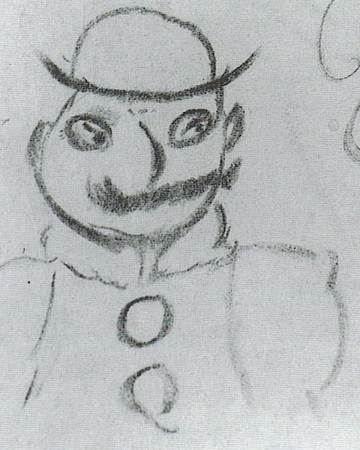
Leopold Bloom
Leopold Bloom
He is the fictional protagonist and hero of James Joyce's Ulysses
His peregrinations and encounters in Dublin on 16 June 1904 mirror, on a more mundane and intimate scale, those of Ulysses/Odysseus in The Odyssey.
He is the common man curious of new experiences

Slide 6
Molly Bloom
Molly’s Monologue
The estract belongs to the last part of the novel. It is called Penelope and consist of the last pages of Molly’s interior monologue.
The all episode is made up of thoughts and sensations in Molly’s mind in an unbroken river-likeflow.
Her thoughts, apparently at random and formless, do have a form. They begin with the word ‘yes’ and end with the same word.
Flow in a circle
Symbol of perfection
Molly

Slide 7
Narrative Techniques
The mythical method
«It is simply a way of controlling, of ordering, of giving shape and significance to the immense panorama of futility and anarchy which is contemporary history.»
T.S Eliot
Stream of consciusness
The stream of consciousness is a free association of thought, impressions, memories which suddenly breaks into the mind of the protagonists stimulated by a perfume, a color, music or a banal gesture.
Molly’s Monologue

Slide 8
ULYSSES
Joyce
Novel
English
Ulysses chronicles the passage of Leopold Bloom through Dublin during an ordinary day, 16 June 1904.
Molly is awake and thinking back on the events of the day and of happy memories from her and Bloom's past.
Emotional
1922
Dublin
vs
Author
Type of work
Language
Premise
Resolution
Tone
Publication
Setting
ODYSSEY
Homer
Epic Poem
Ancient Greek
The poem mainly centers on the Greek hero Odysseus and his long journey home following the fall of Troy.
Odysseus and his son, Telemachus, fight and kill all the suitors.
Celebratory Nostalgic
-
Aegean

