Slide 1
What do I need to know to study in the UK?

Slide 2
Differences between Italy and the UK
Less hours in class (9-15 hours).
Terms are shorter (10-12 weeks).
The final mark is made up of your exams and your essays mark.
You have only one date per year to do an exam.
You cannot refuse a mark.
Marks go from 40 (D) to 70 (A).

Slide 3
Why the UK?
English is the most spoken language in the world.
UK degrees are recognized world wide.
Cheaper than other English speaking countries such as the USA, Australia and South Africa ($20.000)

Slide 4
What shall I study?
Research the courses you are interested in.
Find out what they offer to you that is not offered in Italy.
Examples:
Architecture, medicine, engineering are as good in Italy as in the UK
The UK may offer better courses in theatre, economics, journalism.
Law is specific to the country in which you study it.

Slide 5
Which University?
University Ranking: remember to check the ranking for your specific course.
The Russel Group: gathers 24 of the best universities in the country.
Open days.
Ask to take part to a lesson.

Slide 6
How do I apply? UCAS website
(Max 5 choices, £23 fee)
Provide your personal and education details.
Personal Statement.
Reference
Meet the entry requirements (specific for each course)
IELTS (or English course at University)

Slide 7
What is the IELTS?
Academic English test.
Lasts only 2years (Use it or lose it)
Has a 9-band scale
Most universities ask for 6.5 – 7.5
Fee: £135

Slide 8
IELTS Structure
Listening Module: 4 sections, 40 questions – 30 minutes.
Academic Reading: 3 sections, 40 questions – 60 minutes.
Academic Writing: 2 tasks, 150 and 250 words – 60 minutes.
Speaking Module: face to face interview – 11/14 minutes

Slide 9
Where can I study for the IELTS?
All Schools of English accredited by the British Council.
You can choose how many hours you want to study.
You can live with a British family and pay for the accommodation.
You can study and work (au-pair)

Slide 10
Crest School of English
8 weeks intensive course with family accommodation
Intensive course: 21hours per week - £1.201.
Family accommodation (half-board): 150 per week - £1.200.
Test Fee: £135
Total: £2.536

Slide 11
12 weeks part-time course working as au-pair.
Part-time course: £792
Accommodation: free
Test fee: £135
Salary: £70 – 100 according to what you do in the house
Total Price: you earn £93 (salary £85)

Slide 12
How do I pay for my course?
Undergraduate course: £9.000
Student Finance
Lands Tuition Fees Loans.
You start paying the loan back only when you earn more than £21.000 per year (25.000 Euro)
Each month you pay back 9% of your income.
Interest rate between 1% and 3.6%.

Slide 13
Where do I live?
On Campus Accommodation
Lasts exactly the length of the semester.
You will live with other students.
Good way of meeting new people (on campus activity).
Close to university.
Price for en suite rooms: UEL £4.333. Brunel University £4226. Kingston University £4.510.

Slide 14
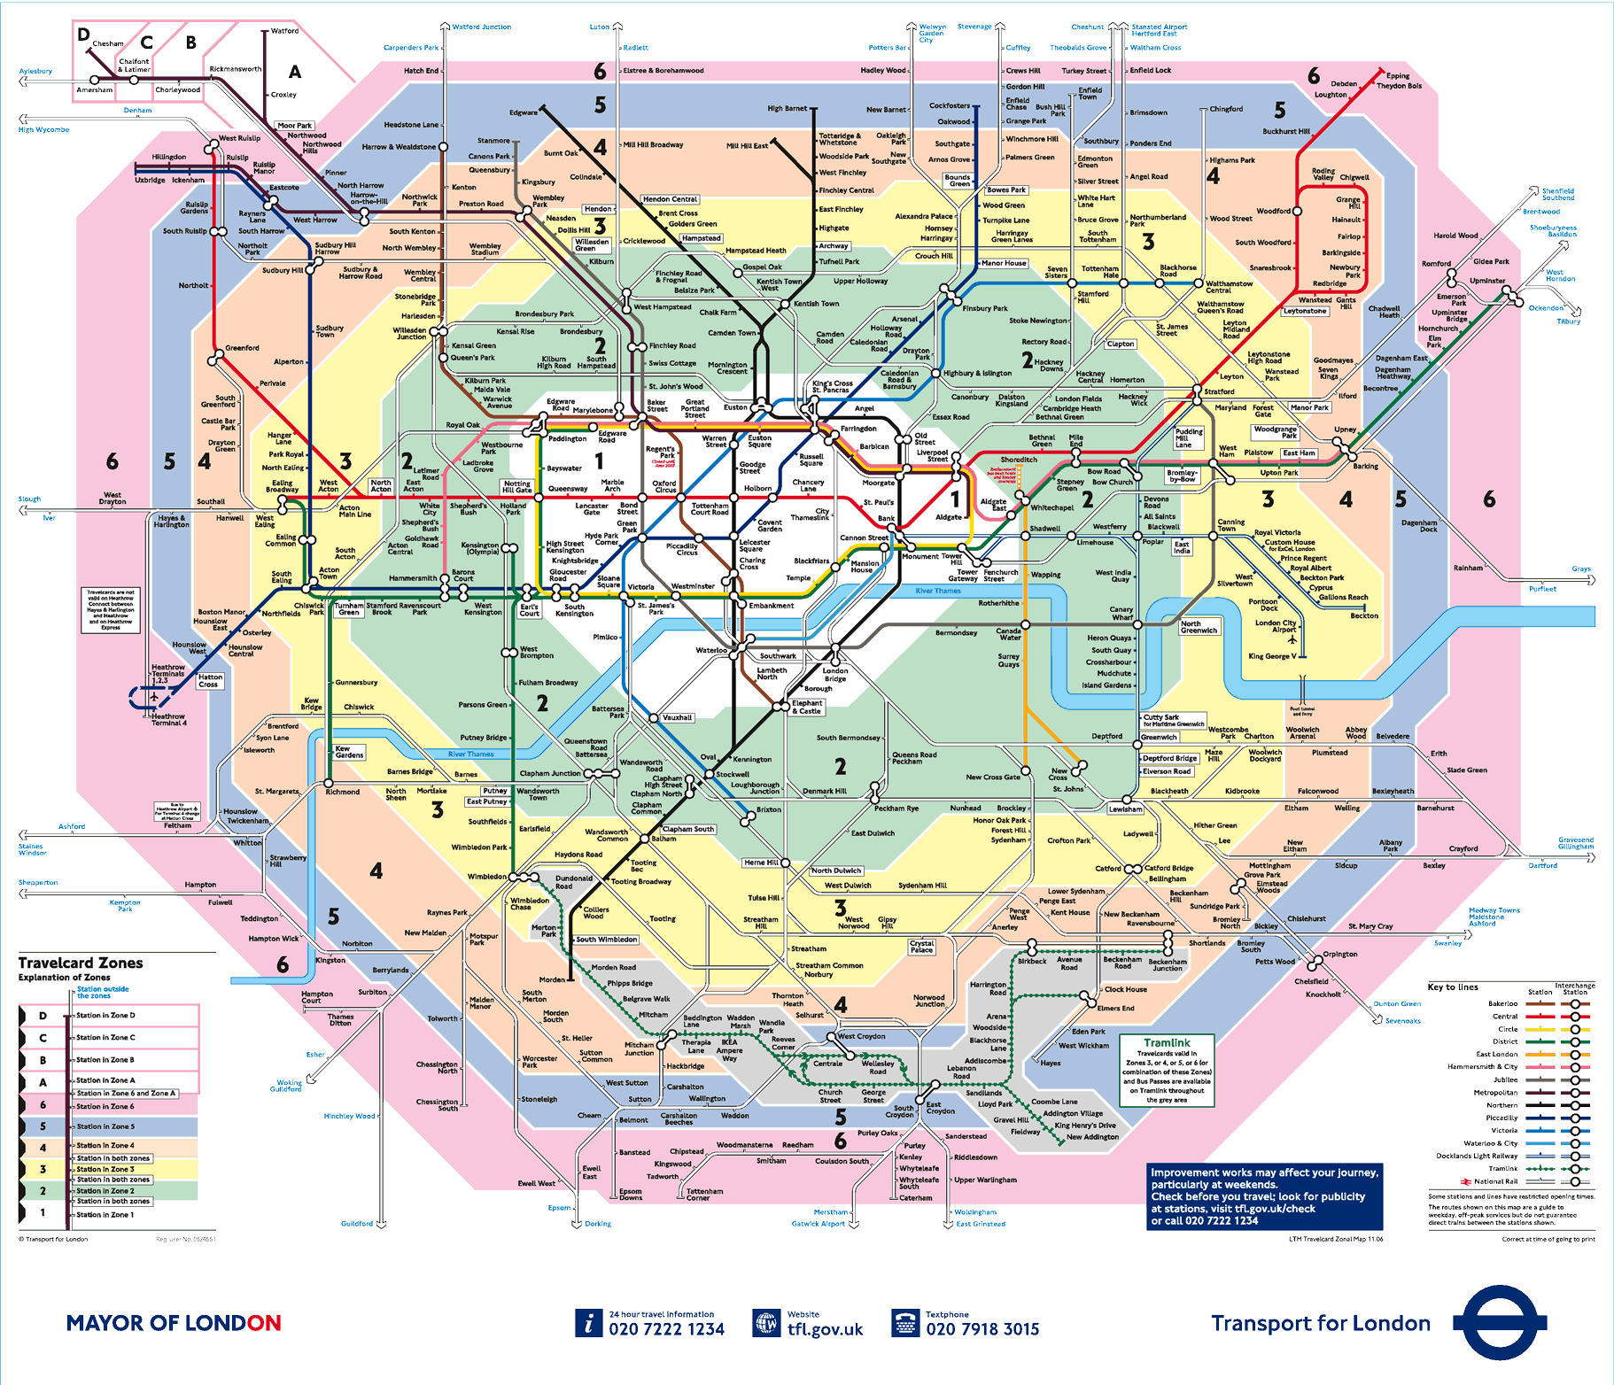
Off Campus Accommodation

Slide 15
Zone 2 – 3 – 4.
Reasonable size room: £350 per month + bills.
You can rent a full house with friends: shared bills.
You can live in a family.
Place next to a tube station.
If you live with professionals you will have to pay the Council Tax (IMU)

Slide 16
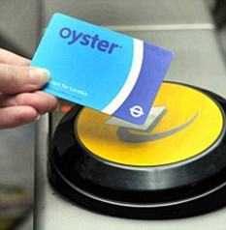
How do I travel?
Oyster Card
Students have 30% discount on weekly and monthly tickets.
Bus ride: £1.40
One way zone 3 to zone 1 off-peak: £2.70

Slide 17
Student Discounts
Oyster card: 30%.
16-25 Railway Card: 11%.
Amazon UK: 5%.
Apple: up to 15% on a Mac.
Selected shops: 10%
Odeon Cinema: 25%
You don’t pay Council Tax

Slide 18
Can I work?
Yes if you have a EU passport.
You need a work permit: National Insurance Number.
To get the NIN you need to book an appointment: 0845 600 0643 Mon-Fri 8am-6pm.
Flexible jobs: catering, restaurants, shops.
16 to 24hrs per week.

Slide 19
Opening a Bank Account
You can open a free bank account: no benefits such as travel insurance or phone insurance and no overdraft plan.
You can open a student account (NatWest £7.95 per month): benefits vary according to the bank and you can have an overdraft plan.
You might need a university letter in order to open a bank account.

Slide 20
Getting a mobile number
Pay as you go is very expensive
SIM-only deals: SIM card with either 30days rolling contract or 12 months contract.
Phone deals: from 12 to 24 months contract, phone included.

Slide 21
What happens if I get sick?
You should register with a GP.
You need to bring your ID and a proof of address (bank statementent, bills)
If you want to see your GP you need to book an appointment (2-3 days)
If it is an emergency dial 999.

Slide 22
Study in the USA
Columbia College Chicago.
More hours in class compared to the UK (min. 16hrs per week).
Littler classes: 15 students.
Teacher willing to meet you outside the regular schedule.
More expensive: $24.000 per year.

Slide 23
What do I need?
J-1 Visa
Appointment at USA embassy
Proof you can support yourself during your stay (tax papers)
Proof of vaccination.
University papers.
Online questionaire.
Can I work with a J-1 visa? You need to change your visa status, you can get the Social Security Number and work up to 20hrs per week.

