Slide 1
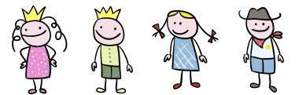
Learning about America
Crosscultural_CLIL@school
Proposta per un percorso di formazione in servizio
a.s. 2008 - 2009

Slide 2
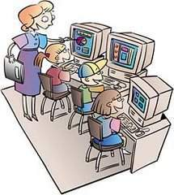
CLIL - Language Across the Curriculum
Verso una progettazione trasversale condivisa e negoziata …
Educazione = Linguistica
Competenze chiave = Asse dei Linguaggi
Competenza privilegiata = Imparare a imparare
Tema = Learning about America Across the Curriculum
Lingua comunitaria = Inglese
Apprendimento = Trasversale

Slide 3
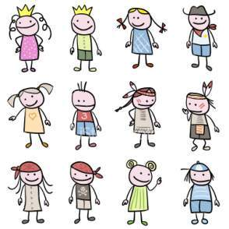
Proposta di un percorso CLIL
Learning about America
Cicli scolastici
- Infanzia
- Primaria
- Secondaria I grado
Assi
Asse dei linguaggi
Asse storico-antropologico
Educazione alla cittadinanza
Condivisione esigenze reciproche
Presa di decisioni condivise rispetto a:
- Mangement (individuale, coppie, gruppo)
Metodologia
- Uso TIC
Costituzione gruppo/i di riflessione (brainstorming, input , language grading, spiral approach )
Alto grado flessibilità nell’implementazione dei percorsi
N.B.
I percorsi potranno essere usati in tutti i cicli scolastici previ debiti adattamenti

Slide 4
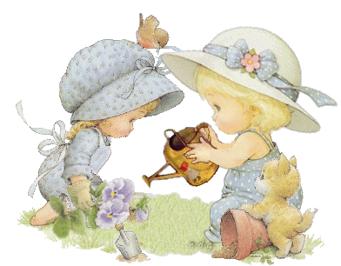
Decisioni condivise I
Management
Verranno utilizzate attività
individuale
a coppie
di gruppo
in plenaria
Rationale
Gli allievi/e devono familiarizzare con ii nuovi input e le modalità di ascolto e interazione
Approccio
Comunicativo e Umanistico
Rationale
Mettere al centro del processo la comunicazione e la relazione abbassando il filtro affettivo.

Slide 5
Decisioni condivise II
Linguaggi
La proposta viene sviluppata nell’ambito dell’ Asse culturale dei linguaggi
Lingua italiana
Lingua comunitarie
Uso TIC
Risultati attesi
Costruzione di una proposta didattica attenta al processo di
apprendimento-insegnamento di contenuti in lingua inglese
volto a potenziare le abilità degli allievi tenendo presenti le quattro abilità
parlato
ascolto
lettura
scrittura
Conoscenze = studiare l’America
Competenze = comprensione e costruzione di competenze su contenuti in lingua inglese
Costruire un segmento omogeneo per
assunti pedagogici (considerando in particolare la modalità dell’input)
proposte educativo-didattiche pur nella differenza di livello del target
Costituzione gruppo/i di riflessione in verticale

Slide 6
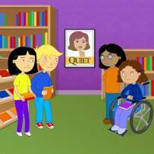
GEOGRAPHY
Ciclo scolastico ⇨ Scuola Primaria
Finalità
Presentare e far apprendere e produrre contenuti specifico in lingua inglese, utilizzando strategie adatte al target

Slide 7

Target
From six to seven years of age
CONTENT AREA = GEOGRAPHY
TOPICS
CONTINENTS AND THE USA
Assumed knowledge
- what is
- colours
- affirmative, interrogative and negative forms of 3rd person to be
Children Revise
Numbers
Ordinals
Wh questions (what, where, …)
SKILLS
- listening
- speaking

Slide 8
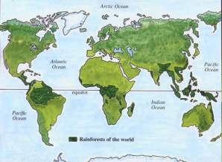
Content and Language
NEW INPUT
Children Learn
To identify , numbr and locate continents
To identify, recognize and speak about Cardinal Directions/Points
Members States of America
Microlanguage
- lowland
- ocean
- sea
- river
- lakes
- mountains
- hills
- deserts
- names of cities and capital cities

Slide 9

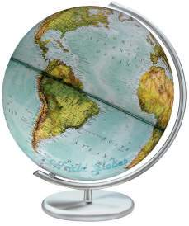
BRAINSTORMING
Teacher puts a globe on her desk
Teacher’s prompt children
what is this? (it is a globe)
what colours can you see? (green-blue-brown-black)
what is green? (lowland)
what is blue? (sea-rivers-lakes)
what is brown? (mountains-hills-deserts)
what is light blue? (ocean)
what is black? (names ...)
Rationale
Teacher resorts to children’s previous
knowledge of the world

Slide 10
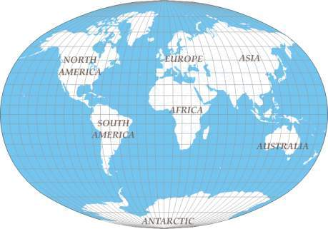
Locating places
Activity 1
Teacher shows children a big map about the continents (OHP)
Teacher invites children to look at the map and prompts their answer
How many continents can you see on the map?
(teacher points at the continents on the map)

Slide 11

Locating places II
Activity 2
Teacher invites chain work
Let’s repeat the names of the continents aloud
EUROPE
AFRICA
ASIA
AUSTRALIA
NORTH AMERICA
SOUTH AMERICA
ANTARTIC
Activity 3
Teacher invites chain work again.
Now children are invited to put names in alphabetic order

Slide 12
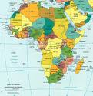
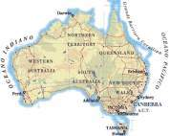
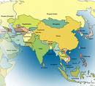
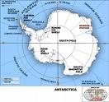
CONTINENTS
Let’s put them in alphabetic order:
one Africa 3. three Australia
2. two Asia 4. four Antartica

Slide 13
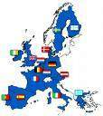
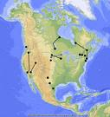
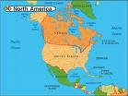
CONTINENTS II
5. five Europe 6. six North America
7. seven South America

Slide 14
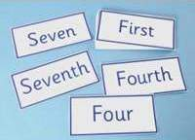
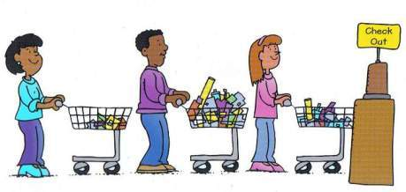
Ordering
Activity four
Teacher writes on the blackboard
Children repeat
1st - the first is Europe
2nd - the second is Asia
3rd - the third is …
4th - the fourth is …
5th - the fifth is …
6th - the sixth is …
7th - the seventh is …

Slide 15
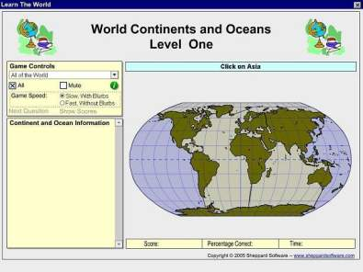
Interacting
Children are invited to interact in a manipulative activity resorting to the Web
Watch and play
Play Continent’s Game

Slide 16
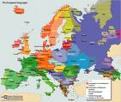
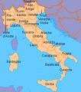
Connecting Continent with Country
Activity three
Teacher asks children:
What is our continent?
Children and teacher together
It’s Europe
Teacher
“We live in Europe” teacher invites children to repeat
PLENARY
Children: “We live in Europe”
Teacher We live in Europe. Italy is in Europe

Slide 17

Matching pictures with names
Game
Teacher uses some pictures and invites children to match the pictures with the corresponding continent.
Memory strategy
Rationale
Children
get familiar with new sounds and names
learn about the continent
revise numbers
recognize different continents in a game-like activity.
Activities as forms of discovery learning

Slide 18
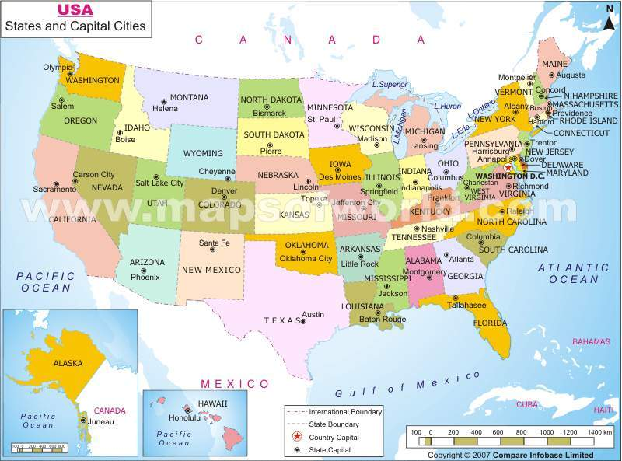
The United States of America
Children
are invited
to watch
the map
Teacher
points to
some of
the most important
States

Slide 19
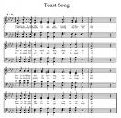
SINGING TOGETHER
Activity five
Teacher invites children to watch the video
Teacher teaches children the song
Rationale
Children get familiar with the sound and names of the member states of America
Teacher shows the map of the USA and points to the different States
She tells the children about America
“In America there are many States: California, Texas, …”

Slide 20
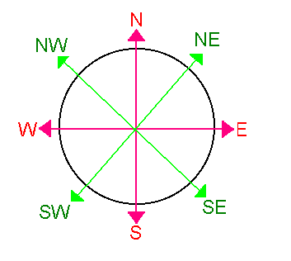
CARDINAL DIRECTIONS/POINTS
N North – S South – E East – W West
ANTARTICA IS IN THE SOUTH

Slide 21

FINDING DIRECTIONS
The Compass
Children experiment finding direction
Teacher tells children
Find …
The South
The North
The East
The West
What’s in the North?
What’s in the North East?

Slide 22
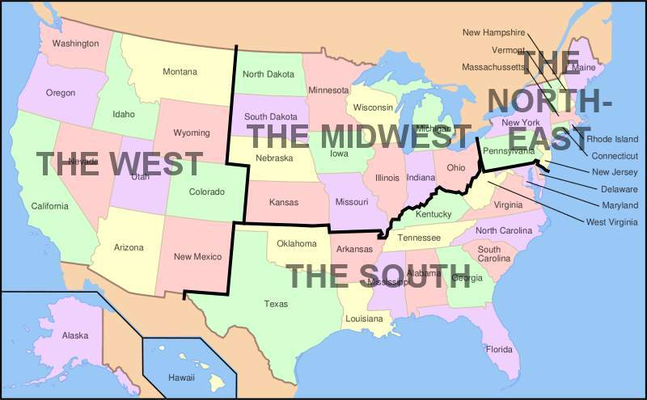
America and Cardinal Numbers

Slide 23

Locating States
Pupils refer to the map of America and
Say the names of the member states aloud
Ex:
The State of Washington is in the West
Texas is in the South
Pennsylvania is in the northeast
……
……
Game
After previous practice children will take pert to a game.
Teacher will ask:
Is Washington in the south of America?
Children have two options
- No, it’isn’t
- Yes, it is

Slide 24
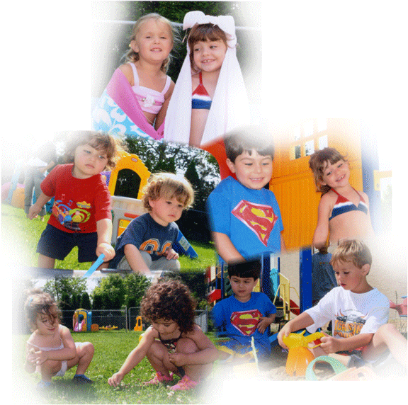
CLIL for Nursery School Children
Content -- HISTORY
Topics
The Mayflower and the Thirteen Colonies of America
Thanksgiving Day
This is My Land
Approach
Humanistic
Roles
Children
Active and collaborative
Teacher
- Mediator
- Encourager
- Supporter

Slide 25


CLIL at nursery school
TARGET
Children from five to six years of age
Content: “The Thirteen Colonies of America”
Step 1
Warm up
The teacher uses a puppet to introduce the subject.
Mousy is carrying his baggage and says:” Bye bye children, I’m going to America! I have still a long journey, America is so far!!”

Slide 26
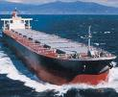
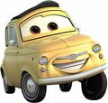


GOING TO AMERICA BY…
The teacher asks children:
“ Is Mousy going to America BY … ?”
“Which do you prefer?”
I am going to America by … PLANE
I am going to America by … SHIP
by ship?
by car?
by plane?
by train?

Slide 27

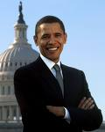
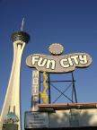

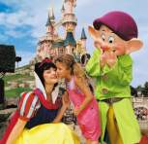
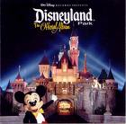

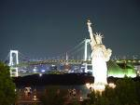


What do you know of America?
Step 2
Everybody says
what he/she knows of America.

Slide 28
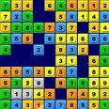

Numbers
Step 3
Numbers
Activity 1
Let’s count from one to thirteen or more.
Activity 2
Teacher shows one number to the children and they say the number aloud
Playing BINGO
Children can play a simplified Bingo to practice numbers

Slide 29



Manipulating Numbers
Skills
Recognizing – Familiarizing - Playing
Children draw numbers
- ONE
TWO
THREE

Slide 30
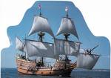

A story about America
Step 4
The teacher tells the story to the children:
“Once upon a time there were people, called Pilgrims, in Europe.
Someone lived in England, someone in Germany, someone in Spain, someone in France and in other countries. The Pilgrims had different religions so their king said: ”You, can’t stay here, go away!”
The Pilgrims were very poor and sad, but they heard that many years ago Christopher Columbus had gone to America, so they said: “Let’s go to America! When we are there, we will produce tobacco, cotton and sugar”. They made a big ship and called it “Mayflower”.
“Let’s start our voyage!” they said. But it was a hard long voyage. There were storms in the sea and the “Mayflower” was often in danger Finally the pilgrims arrived in America. The first pilgrim said: “This land is my land ! I’ll stay here!”
The second said:” this land is mine! I’ll stay here! The same for the third, fourth and so on and so on .
The Pilgrims founded 13 colonies and became colonists. But when they arrived, it was winter and very cold, they didn’t have houses and food. There were Indians in that place. Indians helped colonists . They offered them a big dinner and they became friends. The colonists said thanks to Indians and invited them for a big dinner and
stuffed turkey was the special food

Slide 31

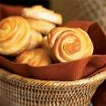

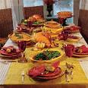
Thanksgiving Day
“The colonists said thanks to Indians and
invited them for a big dinner.”
This was the first
Thanksgiving Day

Slide 32



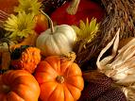
THE UNITED STATES CELEBRATION
Even now, every year
on the 27th of November
Americans celebrate Thanksgiving Day
with a friendly big dinner.

Slide 33
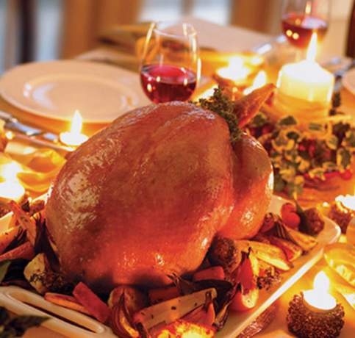
Typical food for Thanksgiving
They eat delicious food
Turkey
Vegetables
Pumpkin cake

Slide 34
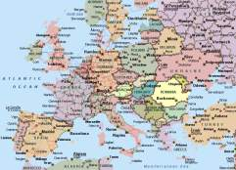

Learning History Through Stories
BODY STORY TELLING
Teacher tells the story to her children by using
“Total Physical Response”.
After that, HE/she shows children some flash cards with important key words as:
Map of Europe
Map of America
Pilgrims

Slide 35
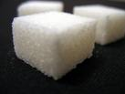
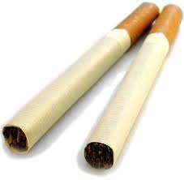

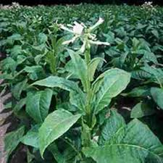


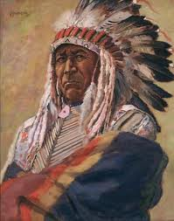
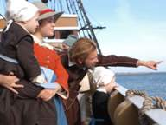
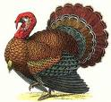
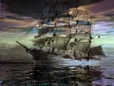
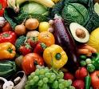
Key words
Pilgrim/s
Vegetables
Ship/s
Pumpkin
Tobacco
Cotton
Sugar
Food
Turkey/ies
Indian/s

Slide 36

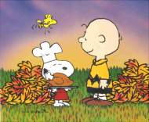
The Mayflower. A Picture story
Activity
Skills
Listening, Comprehension, Matching
Children choose the correct flash cards while the teachers tells the story again. Children associate words with suitable cards while listening to the story again.
Children watch
Charlie Brown’sThanksgiving
Mayflower video and Pilgrims’ Progress

Slide 37



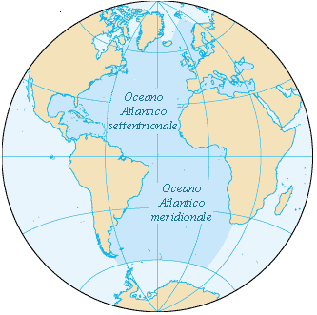
Where is America?
Europe and America. Finding location
Children look at the map and discover the big sea between Europe and America.
The Atlantic Ocean
The Atlantic Ocean is BETWEEN Europe and America
Between Europe and America there is the Atlantic Ocean
Italy is in Europe
The Unitred States are in America
DRAWING ACTIVITY
They draw the globe and the Continents.
They draw a line between Europe and America.

Slide 38




ROLE PLAYING
Living history in the class context
Some children pretend to be Pilgrims from different countries Spanish, Germanic ……
They say “Let’s go to America!” and enter a circle in the shape of a a ship.
They travel along the sea (the floor). The voyage maybe dangerous because sharks could be in the sea and some Pilgrims could die.
When they arrive in America (a big place parted in 13 places) the others say : “I’ll stay here, this is my land”.
The Pilgrims who cannot find a land, are out of the game
The children who are able to catch a piece of land will be the winners.

Slide 39
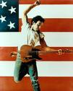
Listening about American History
Listening Activity
The teacher asks children to watch the video.
The video provides a collection of shots
on American different landscapes and is accompanied
by the song Bruce Springsteen- Live, This Land is Your Land
Rationale
The video provides children with the occasion
to visualize the different landscapes of The United States of America

Slide 40

Singing about America
Children to listen to the song
This Land is your land
Teacher and children sing the song together. They also invite their Music teacher to rehearse
This Land is your land
this land is my land
from California
to the New York Island
from the redwood forest
to the gulf stream water
this land was made for you and me
As I went walking
that ribbon of highway
I saw above me that endless skyway
I saw below me that golden valley
This land is made for you and me
I roamed and rambled
and followed my footsteps
O'er the sparkling sands of her diamond deserts
While all around me a voice was sounding, saying
This land was made for you and me

Slide 41


From listening to production
Listening to a personal experience
The teacher tells children about her experience.
She went to a Thanksgiving dinner with her friends and tells children about the food she had.
She shows children photos about the dinner and a typical menu on the net
Group work
In small groups, children search pictures of food in magazines and
cut them out to create a visual menu for their Thanksgiving day dinner
They will paste the pictures on a card
provided by the teacher
Cooking
Teacher and children cook a simple pumpkin cake
Drawing
Children draw an imaginary meeting between the Pilgrims
and the Indians.
Children draw the Thanksgiving dinner party of their imagination

Slide 42


CLIL AT PRIMARY
TARGET Primary School II form
Intercultural Education
Content: Learn about multiracial America and its problems
Area storico-geografico - sociale (storia, geografia)
Assumed Knowledge
Colours
What ⇨ What is this? What colour?
Where ⇨ Where is ? Where are?
Numbers
Microlanguage (states, continents, south , north, east, west …)
New input
Race
Melting Pot
Multiracial
White
Hispanic
African American
American Indian
Asian
Hawaian
Non-white

Slide 43


BRAINSTORMING
Activity I
Teacher invites children to look at the photo and prompts them:
Picture 3
Picture2
Picture1

Slide 44






PROMPTS
What can you see in the pictures? (children)
What colour is their skin? (White, Black, Yellow, Red,…)
What do they look like? (...similar, different …)
Do they seem happy to you? (Yes, they do; no, they don’t .......)
Are they friends? (Yes, they are ; No, they aren’t)
Do you know children of different races? (.........)

Slide 45

MUTIRACIAL COUNTRY
Activity II
Teacher focuses children’s attention on words like
multiracial
non-white
white
black
Teacher invites children to watch a map of USA
Showing the Different Races in America
Look http://www.msnbc.msn.com/id/24543231

Slide 46


Learning about the Melting Pot
Activity III
Children are invited to recognize and distinguish the different races present in the United States of America.
Teacher shows them images and points to the different races
Teacher’s Talk
In American you can see different races: people of different origin.
People come from different areas, from different continents
Melting pot
è un nomignolo di New York, perchè in questa grande metropoli vivono milioni di persone di culture tra loro molto diverse

Slide 47
American Indian or Alaskan Native
American Indian or Alaskan Native
Origin Peoples of North and South America
(including Central America)

Slide 48

Asian
2. Asian Origin
Peoples of the Far East, Southeast Asia, and the Indian subcontinent including, for example, Cambodia, China, India, Japan, Korea, Malaysia, Pakistan, the Philippine Islands, Thailand, and Vietnam

Slide 49

Black or African American
3. Black or African American origin
Any of the black racial groups of Africa.

Slide 50

Hispanic or Latino
4. Hispanic or Latino Origin
A person of Cuban, Mexican, Puerto Rican, South or Central American, or other Spanish culture of origin

Slide 51


Hawaiian
5. Native Hawaiian or Other Pacific Islander

Slide 52







Learning and recognizing
Activity III
The teacher invites the children to repeat the names of the most widespread human races.

Slide 53

GAME
She uses flash cards or pictures with children from different origins and shows them to children.
While showing different pictures of different races teacher prompts:
Listen and repeat
She is … ASIAN
He is … BLACK
They are … AMERICAN INDIAN
…
…

Slide 54



Multiracial schools
The teacher shows children pictures of multiracial schools
American Schools
Children from many races live together in the USA.
Today there is friendship but many years ago there was slavery and Black Americans didn’t have the same rights of White Americans.

Slide 55

SLAVERY IN AMERICA
The teacher shows a video to the children and explains that slaves sang songs to communicate
Also children watch and listen
One more to introduce the poem
I, too

Slide 56


Slavery – Racism – Human Rights
ACTIVITY
The the teacher reads the poem and explains it also resorting to Italian
If needed
The teacher draws attention on these following key- words
darker brother
eat in the kitchen
laugh
eat well
grow strong
tomorrow
ashamed
Teacher and children learn the poem by heart: they repeat it and rehearse it together
The teacher says that nowadays discrimination doesn’t exist anymore.

Slide 57

Children Human Rights
Children of different races have the same rights

Slide 58


CLIL AT PRIMARY
TARGET Primary School form III to V
Intercultural Education
Content
Learn about multiracial America and its problems
Area storico-geografico - sociale (storia, geografia)
Area linguistico-espressiva (musica)
CONTENTS
Learning about Music in America ( SPIRITUALS and BLUES)
Slaves from Africa to the States
Plantation and Plantation songs
The birth of spirituals
The birth of blues
MICROLANGUAGE
sing, singer, song, music, slave,
cotton plantation, choral song,
blues, blues singer, individual song, spirituals, work songs, field hollers, shouts and chants, and rhymed simple narrative ballads.
Metalanguge
What’s the English for …?

Slide 59



From History to Music
ACTIVITY I
The teacher shows the children some images and explains the English for the different pictures
Practicing
- What’s the English for Picture 1? ⇨ It’s cotton
- I can see cotton in picture 1
cotton
slaves
plantation

Slide 60

Life at Plantations
ACTIVITY II Looking at images as historical documents
The teacher shows the children a picture and explains slaves used to sing while working in plantations to communicate and pass the time.

Slide 61

Plantation songs
ACTIVITY III
The teacher shows children some pictures about plantation
and invites the children to watch the video and concentrate omn the audio
Video
After watching the children are invited to sing a spiritual

Slide 62

Singing together
Sing the song “Oh Lordly, pick a bale of cotton” Singing together
Gonna jump down, spin around, pick a bale of cotton
gonna jump down, spin around, pick a bale a day
gonna jump down, spin around, pick a bale of cotton
gonna jump down, spin around, pick a bale a day
Oh Lordy, pick a bale of cotton
oh Lordy, pick a bale a day
oh Lordy, pick a bale of cotton
oh Lordy, pick a bale a day
I said me and my buddy gonna pick a bale of cotton
now me and my buddy gonna pick a bale a day
I said me and my buddy gonna pick a bale of cotton
now me and my buddy gonna pick a bale a day
Oh Lordy, pick a bale of cotton
oh Lordy, pick a bale a day
oh Lordy, pick a bale of cotton
oh Lordy, pick a bale a day
Me and my wife gonna pick a bale o' cotton,
Me and my wife gonna pick a bale a day,
Oh Lordy, pick a bale o' cotton,
Oh Lordy, pick a bale a day,
My master say I'm gonna pick a bale o' cotton,
My master say I'm gonna pick a bale a day,
Oh Lordy, pick a bale o' cotton,
Oh Lordy, pick a bale a day,
Going down town, gonna pick a bale o' cotton,
Going down town, gonna pick a bale a day,
Oh Lordy, pick a bale o' cotton,
Oh Lordy, pick a bale a day,
Jump down, turn around, pick a bale o' cotton,
Jump down, turn around, pick a bale a day.
ACTIVITY IV
The teacher practices with the children and they rehearse the song together trying to reproduce the correct rhythm to understand the importance of rhythm .
In order to reach the objective the teacher mimes and uses body language to make rhythm more evident

Slide 63

ORIGIN OF SPIRITUALS
ACTIVITY V - Listening to learn
Learning about negros songs and spirituals using a podcast.
The teacher tells the children about the birth of spirituals in English first and later in Italian
During XVII and XVIII centuries when Negroes were taken to America as slaves from African beyond the Atlantic Ocean, they worked in the cotton plantations of South America and music helped them bear their hard life. They sang plantation songs that became work songs and calls that helped communication between workers.
While working in the plantation of the Missisipi, the Negro slaves used to sing in order to keep in rhythm with their monotonous manual work.
Later when Negroes converted to Christianity, Negroes started to sing religious songs called SPIRITUALS that recalled English hymns
SPIRITUALS were CHORAL SONGS
They were songs sung together by all workers
Teacher checks global comprehension and uses Italian in case of difficulties
True / False
Yes / No answers

Slide 64




From Spirituals to Blues
ACTIVITY VI - Learning about blues
Blues emerged at the end of the 19th century.
It was a form of self-expression in African-American communities of the United States from spirituals, work songs, field hollers, shouts and chants, and rhymed simple narrative ballads.
They have got a call-and-response model and show African influences.
The blues influenced jazz, rhythm and blues and other kinds of music like rock and roll.
BLUES IS A FORM OF SELF-EXPRESSION

Slide 65

Getting familiar with spirituals
ACTIVITY VII - Children listen and learn how to sing Watch the video
ACTIVITY VII - Learn lyrics
Oh, when the saints go marching in,
oh, when the saints go marching in,
Lord, I want to be in that number,
oh, when the saints go marching in.
Oh, when the saints go marching in,
oh, when the saints go marching in,
I will meet them all up in heaven,
oh, when the saints go marching in.
Oh, when the saints go marching in,
oh, when the saints go marching in,
We will be in line for that judgment,
oh, when the saints go marching in.
Oh, when the saints go marching in,
oh, when the saints go marching in,
Lord, I want to be in that number,
oh, when the saints go marching in.
Oh, when the saints go marching in,
oh, when the saints go marching in,
I will meet them all up in heaven,
oh, when the saints go marching in.
Oh, when the saints go marching in,
oh, when the saints go marching in,
We will be in line for that judgment,
oh, when the saints go marching in.
Oh, when the saints go marching in,
oh, when the saints go marching in,
Repeat refrain

Slide 66



Blues famous singers
Recognizing
Luis Armstrong
Bessie Smith
ACTIVITY VIII
Pair work: ask and answer
Who is the famous American blues singer?
Luis Armstrong
.
Was the blues inspired by labour?
No, It’s a continuation of fields songs.
Was the blues a choral song? No, It’s a personal music.
Big Bill Broonzy

Slide 67


ARTS and MUSEUMS
TARGET
Primary III Form
CONTENT
Children are expected to
come into contact with some typical images of American culture
understand the concept of arts and distinguish them
become familiar with American visual arts
visualize and learn about museums in the States
learn the basic microlanguage of visual arts
recap colours
distinguish cold and hot colours

Slide 68

BRAINSTORMING
ACTIVITY I
The teacher tells the children that After World War II, New York replaced Paris as the center of the art world.
She adds that Art in the United States today covers a huge range of styles.
Teacher shows the children some examples of American visual arts like:
New Museum of Contemporary Art 2007

Slide 69

TOMATO SOUP
POP ART Andy Wharol

Slide 70

MARYLIN MONROE
MASS PRODUCTION and POPULAR CULTURE
Andy Wharol

Slide 71


COKE
MASS PRODUCTION and POPULAR CULTURE
Andy Wharol

Slide 72

DONALD DUCK
A cartoon from
The Walt Disney Company

Slide 73

MICKEY MOUSE
A cartoon from
The Walt Disney Company

Slide 74


SITTING BULL
SITTING BULL
(1837—1890)
chief of the Sioux Indian tribe
born in about 1837 in North Dakota.

Slide 75

Blue jeans

Slide 76

ABRAHAM LINCOLN

Slide 77




BRAINSTORMING
Teacher asks questions about the images resorting to children’s previous knowledge
- what is this
- who is this
where can you see it
Activity II – Introducing the idea of ART
The teacher introduces the concept as ART resorting to children’s knowledge of the world.

Slide 78


Literature
She shows children
a poem ⇨ I, too
a famous novel ⇨
The Adventures of Tom Sawyer
The teacher tells children:
”Let’s read the poem”
”Let’s read the novel”
You read literature: A FORM OF ART

Slide 79


Cinema
Let’s watch and listen to a video
Let’s watch and listen to
a Walt Disney cartoon
a Walt Disney video
a Walt Disney film
My favourite film
You watch and listen to films, videos, …
Pocahontas is an Indian girl who brought peace
between her tribe and the Europeans looking for gold.

Slide 80




Music
Let’s LISTEN TO
children music
children’s songs
a CD track
a song
an Mp3 song
a concert
a record
Let’s sing together
Let’s play our song
Listen to
Play
Sing
MUSIC

Slide 81



VISUAL ARTS
Let’s see
pictures
paintings
Let’s visit some
famous Museums
well known collections
an exhibition
Let’s take
a virtual journey of an American museum

Slide 82

Famous Museums in New York
Teacher invites children to visit the most famous museums in New York
Smithsonian Arts Museum

Slide 83

American Museum of Natural History
In New York

Slide 84

What can you see at
American Museum of Natural History ?

Slide 85

Metropolitan Museum of Art
Metropolitan

Slide 86

Museum of Modern Art
MoMa
in New York

Slide 87

Solomon R. Guggenheim Museum
Guggenheim

Slide 88

Abraham Lincoln Presidential
Library Museum
Abraham Lincoln Presidential Library Museum

Slide 89


Choose Some Pictures You Like
Teacher visits the museums with the children and together
they learn about:
Collections
Exhibitions
Events
Lectures
After that they draw their favourite
painting choosing between
cold colours
hot colours
after the teacher has explained the difference

Slide 90

African American Visual Art and the Black Arts Movement
African American visual art and the Black Arts Movement
A Virtual Option

Slide 91

Colours
Children are asked to create drawings to paint with Cold and Hot Colours

Slide 92

Technology and Communication
TARGET Primary school (from 3rdto 5th form )
OBJECTIVES
Learn
about hi-tech area in America
about technological means of communication
how to create a message
CONTENT
Learning about the Silicon Valley
Learning about ICT
Messages
Learn about the keyboard of a computer
MICROLANGUAGE
The Silicon Valley, cell phone, play station, digicam, computer, psp, iphone, ipod, mp3 player, printer, dvd player, cd player, notebook
UP DOWN LEFT RIGHT
PREREQUISITES
numbers, letters of the alphabet, directions

Slide 93

Silicon Valley
ACTIVITY I – Brainstorming - New Input
The teacher asks children if they have ever listen about The Silicon Valley and after that invites children to look at the map below
Where isThe Silicon Valley?
The Silicon Valley is
the southern part of
the San Francisco Bay Area
In northern California
Why is it famous?
It is the high-tech
capital of the World.

Slide 94
Getting Started - High Tech
ACTIVITY II - New Input
The teacher tells children that Hi-tech is short for high technology and that the Silicon Valley is the hub of technology. After that the teacher invites children to consider the linked image so that children can recognize some of the most important names of innovation and research in the field of communication.
He/she adds that large numbers of engineers work and do research there and that most of the technological products of our everyday life are the result of their research.
ACTIVITY III
Teacher invites children to cut out examples of technological products from newspapers, reviews and magazines and shows some names of their names in a word box.
Students are expected to match picture with the words in the box
CELL PHONE PLAYSTATION XBOX DIGICAM COMPUTER PSP IPHONE
IPOD MP3 PLAYER PRINTER DVD PLAYER CD PLAYER CAMCORDER NOTEBOOK

Slide 95








Means of Communication
ACTIVITY IV
The teacher invites children to say how people can communicate showing them images of hi-tech products or technological tools
They have to match
phone call
e-mail
SMS
MMs
fax
chat
social network,
blog

Slide 96

Revising to learn something new
ACTIVITY V
Let’s look at the screen of a cell phone and repeat numbers, letters of the alphabet, arrows directions, other symbols. Children practice the language also miming directions.
1 2 3 4 5 6 7 8 9 0
ABCDEFGHIJKLMNOPQRSTUVWXYZ
UP 
DOWN 
LEFT ⇦
RIGHT⇨
HASH SIGN (#)
ASTERISK (*)
POINT (.)
COMMA(,)
EXCLAMATION MARK (!)
QUESTION MARK (?)

Slide 97

ICT in practice
Activity VI- Learning procedures
Teacher addresses children
Let’s learn the steps to send a SMS
and write a message to a friend.
Go to menu
Select “messaging”
Select “create message”
Write the SMS using the buttons on the display of your cellular phone
Select the phone number of your friend and send the message
ACTIVITY VII – The teacher explains all SMS are the result of
Information (what you write)
Communication (the contact you create with the number)
Technology (the mobile phone)

Slide 98
Silicon Valley
ACTIVITY I – Brainstorming - New Input
The teacher asks children if they have ever listen about The Silicon Valley and after that invites children to look at the map below
Where isThe Silicon Valley?
The Silicon Valley is
the southern part of
the San Francisco Bay Area
In northern California
Why is it famous?
It is the high-tech
capital of the World.

Slide 99
Getting Started - High Tech
ACTIVITY II - New Input
The teacher tells children that Hi-tech is short for high technology and that the Silicon Valley is the hub of technology. After that the teacher invites children to consider the linked image so that children can recognize some of the most important names of innovation and research in the field of communication.
He/she adds that large numbers of engineers work and do research there and that most of the technological products of our everyday life are the result of their research.
ACTIVITY III
Teacher invites children to cut out examples of technological products from newspapers, reviews and magazines and shows some names of their names in a word box.
Students are expected to match picture with the words in the box
CELL PHONE PLAYSTATION XBOX DIGICAM COMPUTER PSP IPHONE
IPOD MP3 PLAYER PRINTER DVD PLAYER CD PLAYER CAMCORDER NOTEBOOK

Slide 100
Means of Communication
ACTIVITY IV
The teacher invites children to say how people can communicate showing them images of hi-tech products or technological tools
They have to match
phone call
e-mail
SMS
MMs
fax
chat
social network,
blog

Slide 101
Revising to learn something new
ACTIVITY V
Let’s look at the screen of a cell phone and repeat numbers, letters of the alphabet, arrows directions, other symbols. Children practice the language also miming directions.
1 2 3 4 5 6 7 8 9 0
ABCDEFGHIJKLMNOPQRSTUVWXYZ
UP 
DOWN 
LEFT ⇦
RIGHT⇨
HASH SIGN (#)
ASTERISK (*)
POINT (.)
COMMA(,)
EXCLAMATION MARK (!)
QUESTION MARK (?)

Slide 102

NATURE AND PARKS IN AMERICA
TARGET Primary school (from 3rdto fifth form )
Education to Active citizenship Content
Learn about nature and parks in America
Nature and seasons
Learn about possible activities in the parks
Learn about sustainable development (economy, environment, society)
Area scientifica-tecnologica (storia, geografia)
Area linguistico (inglese)
CONTENTS
Learning about most famous parks in America
The most famous parks
Wild Life in the Parks
Activities in the Parks
Nature and seasons
MICROLANGUAGE
trees -lake-road-skyscrapers, natural reserve, wildlife, grizzly bears, wolves, bison, coyotes, jackrabbits, flying squirrels, river, otters rattlesnake and elk), geysers, prairie, hydrothermal features, public urban park
Activities Carriage horses – Climbing - Sports – Relax - Entertainment- Activities for children

Slide 103











BRAINSTORMING
NEW YORK’S CENTRAL PARK
ACTIVITY I
Teacher invites students to look at the different views of Central Park

Slide 104


Nature and Parks
ACTIVITY II - Teacher’s prompt/s
a. Children build up sentences using the words given
What is it?
park
New York
Central Park
It is a … in …. Its name is …
b. What can you see in the photos?
I can see …
Trees
Lake
Road
Skyscrapers
c. What season is it?
Spring – Summer – Autumn – Winter
d. What colours can you see?
white-yellow-green-blue orange-brown

Slide 105

What season is it?
TEACHER
invites
children
to watch
the park
In the
different seasons
Spring
Summer
Autumn
Winter
This is Central Park in …
IT IS SPRING

Slide 106

What season is it?
TEACHER
invites
children
to watch
the park
In the
different seasons
Spring
Summer
Autumn
Winter
This is Central Park in …
IT IS SUMMER

Slide 107

What season is it?
TEACHER
invites
children
to watch
the park
In the
different seasons
Spring
Summer
Autumn
Winter
This is Central Park in …
IT IS …

Slide 108

What season is it?
TEACHER
invites
children
to watch
the park
In the
different seasons
Spring
Summer
Autumn
Winter
This is Central Park in …
IT IS …

Slide 109












Colours and seasons
ACTIVITY II - Teacher’s invites children to make a list with the colours of seasons and say if they are mainly hot or cold
The colours of Spring
The colours of Summer
The colours of Autumn (BR English) Fall (Am English)
The colours of Winter
Hot colours - cold colours

Slide 110




National Park
Discover national parks in America
ACTIVITY IV - What is a national park?
National parks are protected areas
A national park is a reserve of land, usually declared and owned by a national government, protected from most human development and pollution.
Yellowstone National Park is America's first national park. Located in Wyoming, Montana, and Idaho, it is home to a large variety of wildlife.
It has got one of the world's most extraordinary geysers and hot springs, and the Grand Canyon of the Yellowstone.

Slide 111

What about Yellowstone National Park
ACTIVITY V
Teacher invites children to watch multimedia resources and discover about Yellowstone National Park
Virtual Visit for kids

Slide 112


You can see …
ACTIVITY VI Learning about
Geysers and hotsprings
A geyser is a natural hot spring that
intermittently ejects a
column of water and steam into the air.
Watch

Slide 113

Grand Canyon at Yellowstone Park
Grand Canyon
Teacher shows children pictures about the canyon. Children get familiar

Slide 114





WILDLIFE
ACTIVITY VII –
Teacher draws the children’s attention on wildlife at at Yellowstone Park
What animals can you see at Yellowstone Park?
You can see a large variety of wildlife
grizzly bears,
wolves,
bison,
coyotes,
jackrabbits,
flying squirrels,
river
otters
rattlesnake
elk
a. Children watch, listen and repeat
b. Guessing game - teacher shows pictures and children answer after two mistakes you are out of the game
wolf
grizzly bears
jackrabbit
bison
coyote

Slide 115




Matching to learn
Teacher asks children to match the picture with the suitable animal name
river otter
flying squirrel
rattlesnake
Male elk are called bulls.

Slide 116




PUBLIC PARKS
Central Park is a large public urban park in New York city

Slide 117






Parks and life
Teachers shows you can do a lot of activities in public parks
Going by horse carrige, doing sports, having fun, climbing., relaxing, practicing children’s activities
Children wtach, listen and reapeat. After that, they mime some sports, or entertainment, climbing, listening to an open-air concert

Slide 118

STUDY SKILLS
SIMULATING ROLES
ACTIVITY VII
Children listen and repeat
This is a geyser. It is a hot spring
You can see it at Yellowstone Park
…….
A CLASS PICTURE GALLERY
Children are provided pictures about parks in the USA.
They cut images and create class posters about parks in the USA and eventual activities or tours there. They are expected to ask the teacher or their peers for pictures to glue on posters in English,
they simulate a picture gallery and play the role of guides and visitors in turns
They learn to ask and answer about
Natural parks
Yellowstone
Geysers
Wildlife
Activities in public parks
After some re·hears·ing they take the floor I
n front of the other classes of the school

Slide 119

CREDITS
BELTRAMINI Marilena
BARBATO Teresa
CARLESSO Nicoletta
CASTELLANI CRISTINA
COVASSO Mara
DRIUSSI Francesca
MISCIALI Francesca
MULLONI Anna
RACCARDO Stefania
TREVISANI Lorena

