Slide 1
LICEO SCIENTIFICO «A. EINSTEIN» CERVIGNANO DEL FRIULI 2A LS - MY CLASS

Slide 2
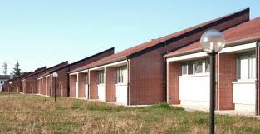

Slide 3
When we started the school, in September 2012, in the class we were twenty-two, ten boys and twelve girls. Only few of us knew each other. Last year four girls left the class. One was rejected and the other three changed school.
So now we are eighteen.

Slide 4
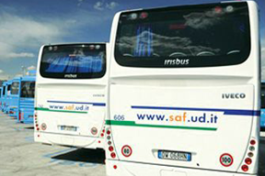
The most of the class weren’t from Cervignano and they come to school by bus.

Slide 5
Our teachers was :
Mrs. Inglese for Maths, Mrs. Virgolin for English, Mr. Castellan for Italian and Latin, Mr. Sgubin for Science, Mrs. Gambin for History, Mr. Iannello for Phisic and Mr. Zuttion for P.E. .

Slide 6
This year we have changed a lot of teachers.
We have a new English teacher, Mrs. Beltramini, a new Science teacher, Mrs. Princig, a new Phisic teacher, Mrs. Negri, and a new Hystory teacher, Mr. Betta.

Slide 7
When I arrived in this school I just knew only a student of my class, Luca Vianello, because we came from the same village.
In my class I felt well and I found some new friends.

Slide 8
Last year I and other two students didn’t study Religion.
This year we are two, me and Paolo Marega. During the Religion hour, on Sunday, we usually do homeworks.

Slide 9
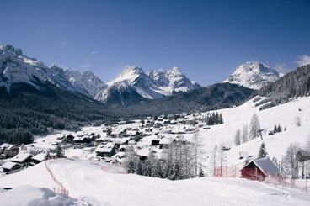
The last year we did only a school trip.
We went to a excursion with snowshoes in Sappada.
It was fantastic but very tiring.

Slide 10
Last year we joined to Comenius project, with Mr. Castellan. We did a power point about the meaning of some simbols from the past to the present.

