Slide 1
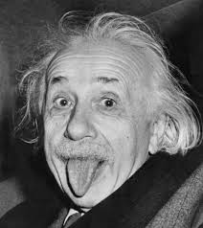
DISCOVERING EINSTEIN
WEB QUEST PER COMPETENZE
2ALS GROUPS

Slide 2
PURPOSE
To discover who Albert Einstein was;
To learn to work in groups and to use our competences to create an usable work;
To know the English language.

Slide 3
ORGANIZATION
We did this power point in the following way:
We have chosen the most important things between the arguments that had been committed us before.
We have done an outline of the arguments that we wanted to deal with.
We have started to write the power point.
We have sketched out the layout of the file.
We have completed the composition of the work.
We have completed the power point.
We have reviewed the file and corrected our mistakes.

Slide 4
SUMMARY
Albert's curiosities
Most relevant discoveries: 1905 – Annus Mirabilis
Nobel prize
Other prizes and awards
Was he a real genius or did he himself make some mistakes?
Personality
The story of his life
Childhood
Kind of student
His reputation among common people
Religion
Godliness
Einstein and Zionism
Peace and world war
What teaching did he leave posterity?

Slide 5
ALBERT’S CURIOSITIES
Einstein began to wonder what a light beam would look like if you could run alongside it at the same speed. If light were a wave, then the light beam should appear stationary, like a frozen wave. Yet, in reality, the light beam is moving.
He wrote his first "scientific paper" at age 16, "The Investigation of the State of Aether in Magnetic Fields." This question of the relative speed to the stationary observer and the observer moving with the light was a question that would dominate his thinking for the next 10 years.
Among other things, he pictured lightning striking at both ends of a moving train. A person on the embankment might see the strikes as simultaneous, but to someone on the speeding train they would appear to have happened at different moments. Because the train is speeding forward, the light from the strike at the front of the train would reach him a moment before the light from the strike at the back of the train. From that he realized that simultaneity is relative to your state of motion, and from that he came up with the idea that there is no such thing as absolute time. Time is relative. Hence the special theory of relativity.

Slide 6
MOST RELEVANT DISCOVERIES: 1905 – Annus Mirabilis
In 1905, the Annus Mirabilis, he published in the Annalen der Physik, four works that contributed substantially to the foundation of modern physics and changed views on space, time, and matter.
Photoelectric effect: it gave rise to quantum theory by suggesting that energy is exchanged only in discrete amounts (quanta).
Brownian motion: It describes the random motion of particles suspended in a fluid resulting from their collision with the quick atoms or that the speed of molecules in the gas or liquid.
Special relativity: It explains that the speed of light is independent of the motion of the observer.
E = mc2: The matter-energy equivalence estabilished that energy (E) equals mass (m) times the speed of light (c) squared. It means mass is just one form of energy and that a small amount of mass can be converted to a phenomenal amount of energy.

Slide 7
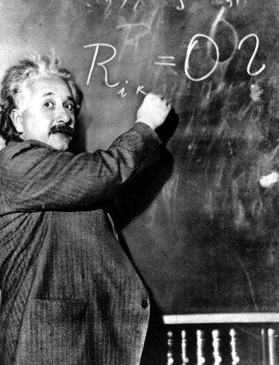
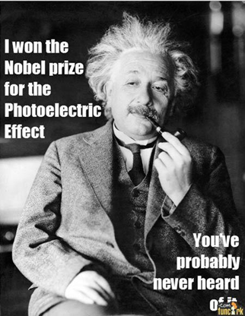
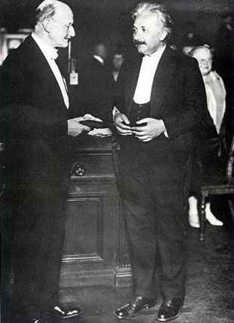
WHY WAS HE AWARDED THE NOBEL PRIZE?
In 1921 Albert Einstein received the Nobel Prize in Physics especially for his discovery of the law of the photoelectric effect and for his services to theoretical physics.

Slide 8
OTHER PRIZES AND AWARDS
Albert Einstein received lots of others prizes and awards. The most important are:
In 1925 The Royal Society awarded him the Copley Medal;
In 1934 he gave the Josiah Willard Gibbs lecture;
In 1936 he was awarded the Franklin Institute's Franklin Medal for his extensive work on relativity and the photo-electric effect;
In 1990 in his name was added to the Walhalla temple for "laudable and distinguished Germans", which is located in Donaustauf in Bavaria.
In 1999 Time magazine named him the Person of the Century. In the words of a biographer, "to the scientifically literate and the public at large, Einstein is synonymous with genius". Also in 1999, an opinion poll of 100 leading physicists ranked Einstein the "greatest physicist ever”. A Gallup poll recorded him as the fourth most admired person of the 20th century in the U.S.
In 2008 he was inducted into the New Jersey Hall of Fame.

Slide 9
WAS HE A REAL GENIUS OR DID HE HIMSELF MAKE SOME MISTAKES?
Einstein published more than 300 scientific papers along with over 150 other works. His great intellectual achievements and originality have made the word "Einstein" synonymous with genius, but he also made some mistakes:
1905 Mistake in transverse mass of high-speed particles;
1905 Multiple mistakes in the mathematics and physics used in calculation of viscosity of liquids, from which Einstein deduced size of molecules;
1905 Mistakes in the relationship between thermal radiation and quanta of light;
1905 Mistake in the first, second, third, fourth, fifth, sixth and seventh proof of E = mc²;
1907 Mistakes in the Principle of Equivalence of gravitation and acceleration;
1911 Mistake in the first calculation of the bending of light;
1915 Mistakes in several attempts at theories of general relativity;
1919 Mistakes in two attempts to modify general relativity;
1933 Mistakes in interpretation of quantum mechanics;
1939 Mistake in the interpretation of the Schwarzschild singularity and gravitational collapse (the “black hole”).

Slide 10
PERSONALITY
Albert Einstein was brilliant and immature, changeable, not sociable, far from the deep and durable love. Arrogance, individualism, cynism and sexism backed up the unlimited gift for study, application and intuition, which gave him fame and eternity.
He was uncomfortable with the principle of absolute obedience and the military drills that dominated the school's atmosphere.
He used to wear very eccentric clothes for a scientist and a famous professor like him. In old age, in addition to his uncombed hair, he used to wear a sweater, a pair of old threadbare trousers and a pair of sandals.
With women, he had an adversarial relationship, and he despised the intelligence and the character of the fair sex. Einstein considered women's intellect subordinate.

Slide 11
THE STORY OF HIS LIFE
1879 Albert Einstein was born in Ulm (Wȕttemberg) on the 14th of March 1879.
1880-96 his family moved to Italy but Albert continued his education in Aarau, Switzerland, and in 1896 he began to attend the Swiss Federal Polytechnic School in Zurich.His years in Zurich were some of the happiest of his life. There he met many students who would become good friends, such as Marcel Grossmann, a mathematician, and Michele Besso, with whom enjoyed lengthy conversation about space and time.
1900 he gained his diploma as a teacher in physics and mathematics. One year later, he became Swiss citizen and, unable to find a teaching job, he accepted a position as technical assistant in the Swiss Patent Office.
1900-03 During this time he had a very difficult moment: he couldn’t marry Mileva because he couldn't support a family without a job and his father’s business had gone bankrupt. However, they got married in 1903 in Zurich. In 1904 he had his first son, Hans Albert
1909 to 1913 he taught at the Polytechnic School in Zurich-
1910 he had his second son, Edward, with Mileva
1914 he moved to Berlin where he worked as a director of the Kaiser-Wilhelm Institute.
1919 His marriage with Mileva was over, and in the same year he married his cousin, Elsa Lowenthal.
1921 he won the Nobel Prize for physics for his explanation of the photoelectric effect.
1933 he renounced his German citizenship for political reasons and emigrated to America to work as Professor of Theoretical Physics at Princeton.
1939 his letter to Roosevelt was decisive for the construction of the atomic bomb.
1940 he became a United States citizen and he retired in 1945.
Einstein died on the 18th April 1955, at the age of 76 years. His parents sympathized with his feelings, but were concerned about the enormous problems that he would face as a school dropout and whimsical genius with no employable skills.

Slide 12
CHILDHOOD
Einstein was slow in learning how to speak and his parents even consulted a doctor; he probably was affected from autism.
He also had a cheeky rebelliousness toward authority.
His slow verbal development made him curious about ordinary things, such as space and time, that most adults take for granted and he tended to think in pictures rather than words.

Slide 13
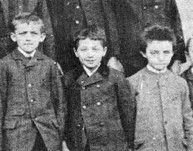
KIND OF STUDENT
Einstein always appeared to have a clear view of the problems of physics and the determination to solve them. He had a strategy of his own and was able to visualize the main stages on the way to his goal.
Einstein laughed. "I never failed in mathematics," he replied, correctly. "Before I was fifteen I had mastered differential and integral calculus." In primary school, he was at the top of his class and "far above the school requirements" in math. By age 12, his sister recalled, "he already had a predilection for solving complicated problems in applied arithmetic," and he decided to see if he could jump ahead by learning geometry and algebra on his own. His parents bought him the textbooks in advance so that he could master them over summer vacation.

Slide 14
WHAT WAS ALBERT EINSTEIN’S REPUTATION AMONG THE COMMON PEOPLE?
The academic and the scientific community did not consider quickly A. Einstein’s ideas true. Perhaps it was difficult to take seriously a young person who until this time had only earned disdain from his former teachers
During the rise of German nationalism he was the target of campaigns to discredit his theories by reason of his Jewish descent. Einstein’s theories on relativity became a convenient target for Nazi propaganda.
It was after World War I that the scientists approved his ideas and of the same way the common people began to believe in him. Not only his revolutionary theories but also his appearance endeared him to the most part of people. Albert Einstein denoted the typical look belonging to everyone of 20th century.
When he became famous, Einstein was hounded by reporters and photographers wherever he went. Einstein's launch into fame contributed to the birth of a new celebrity age. He became a scientific icon and humanist star, one of the most famous faces on the planet. The public earnestly puzzled over his theories, elevated him into a cult of genius, and canonized him as a secular saint.
A century after his great triumphs, we are still living in his universe. Now Einstein is considered a real genius.

Slide 15
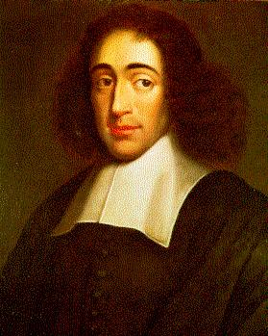
RELIGION
Einstein believed in a pantheistic God, and not in a personal one, who was represented by the harmony of nature's laws and the beauty of all that exists;
In his opinion all scientists felt a big amazement in front of the harmony of natural laws, and this cosmic religious feeling was the motivation for scientific work;
He identified very closely with the Dutch Jewish philosopher Baruch Spinoza, who believed that the universe is governed by mechanical and mathematical laws of cause and effect. They both shared the love of solitude and intellectual independence.
He understood that science and religion were connected very closely and he added: "Science without religion is lame, religion without science is blind".
Baruch Spinoza
(1632-1677)

Slide 16
GODLINESS
He defined God in an impersonal, deistic fashion, but he deeply believed that God's handiwork was reflected in the harmony of nature's laws and the beauty of all that exists. Einstein's belief in something larger than himself produced in him a wondrous mixture of confidence and humility.
When asked directly if he believed in God, he always insisted he did, and explained it once this way: "We are in the position of a little child entering a huge library filled with books in many languages. The child knows someone must have written those books. It does not know how. It does not understand the languages in which they are written. The child dimly suspects a mysterious order in the arrangement of the books but doesn't know what it is. That, it seems to me, is the attitude of even the most intelligent human being toward God. We see the universe marvelously arranged and obeying certain laws but only dimly understand these laws."

Slide 17
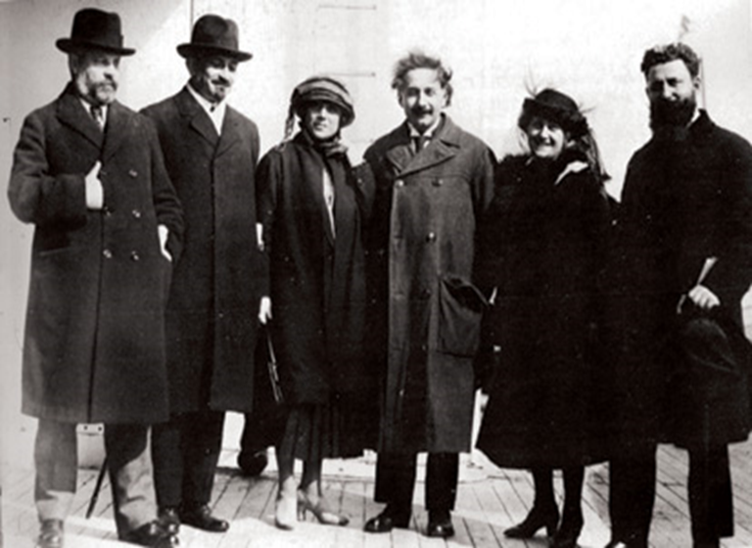
EINSTEIN AND ZIONISM
Zionism was a movement of the nineteenth and twentieth century that promoted a Jewish state in Palestine;
Einstein was passionate about preserving the Jewish values of social justice and intellectual aspiration and he wanted to create a place where Jewish could gain an education;
He was a strong supporter of Hebrew University and in 1921 he went on a worldwide tour to raise money for this establishment.
In his opinion a Jewish state would serve as a cultural centre and not as a real state.
April 2, 1921
Zionist Movement fundraising tour.

Slide 18
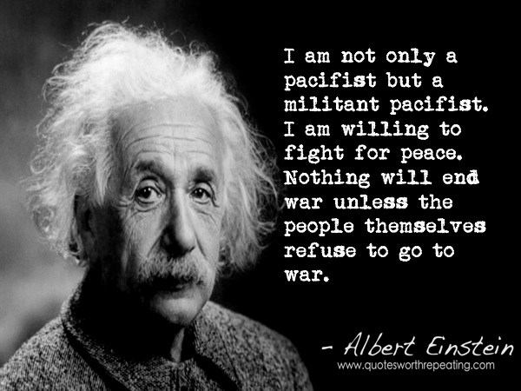
PEACE AND WORLD WAR
As a young man he did not in principle oppose to the using of arms, but the first world transformed him into a hard-core pacifist;
During the 1920s and 1930s he criticized the evils of armed struggle, he urged young men to refuse military service and he lent his name to international commissions to prevent future wars;
However, before the Second World War he declared that the situation was so grave that war was the only solution;
He urged the building of the atom bomb, but then he became a leader in the movement to find ways to control it.
Albert Einstein
(1879-1955)

Slide 19
WHAT TEACHINGS DID HE LEAVE POSTERITY?
In addition to all his Physics discoveries he taught us that the war is the worst kind of evil and that humanity mustn’t be destroyed by his own thirst of power.
For Einstein, "war was a disease ... [and] he called for resistance to war." By signing the letter to Roosevelt he went against his pacifist principles. In 1954, a year before his death, Einstein said to his old friend, Linus Pauling:
"I made one great mistake in my life, when I signed the letter to President Roosevelt recommending that atom bombs be made; but there was some justification: the danger that the Germans would make them ..."

Slide 20
GRAZIE PER L’ATTENZIONE
CREDITS
Bais Valentina
Franco Riccardo
Beltramino Davide
Marega Paolo
Bodigoi Davide
Martinello Federico
Candotti Sara
Paolini Leonardo
Cecchetto Riccardo
Parlati Vittoria
Del Stabile Sofia
Vianello Luca
De Luca Alessandro
Vidal Roberta
Donaggio Valentina
Vita Giorgia
Ferro Giada
Waschl Andrea

