Slide 1
THE HISTORY OF OUR CLASS: THE 2ALS

Slide 2
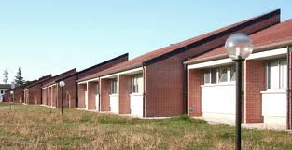
THE ENCOUNTER
The first encounter took place on the 12th September 2012, in a class of the scientific high school " Albert Einstein " of Cervignano del Friuli.

Slide 3
CREATING RELATIONSHIP
At first nobody knew nobody .
We were shy, surprised and curious to know how were our classmates.
Little by little we started to know one another and so it was born a good relationship.

Slide 4
THE GUYS
Last year we were twenty-two guys.
At the end of the school year, two girls decided to change school and other two girls were rejected.
This year we are eighteen guys:
Ten spiteful and intelligent boys;
Eight crazy and cheerful girls.

Slide 5
THE BOYS
Paolo Marega
Andrea Washl
Davide Bodigoi
Luca Vianello
Riccardo Franco
Davide Beltramino
Riccardo Cecchetto
Federico Martinello
Alessandro De Luca
Leonardo Paolini

Slide 6
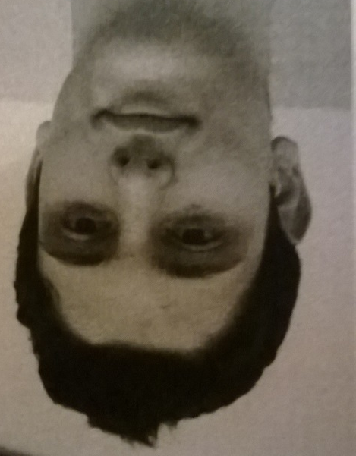
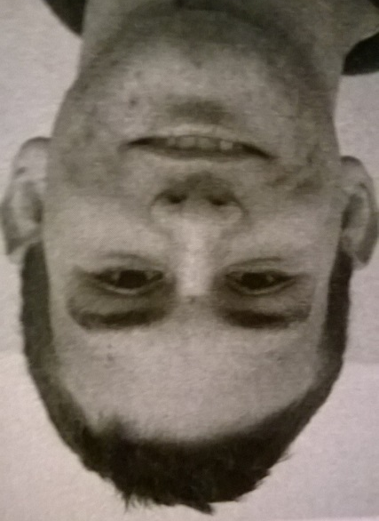
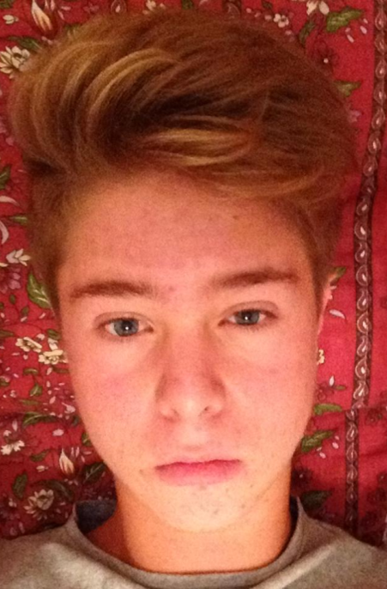
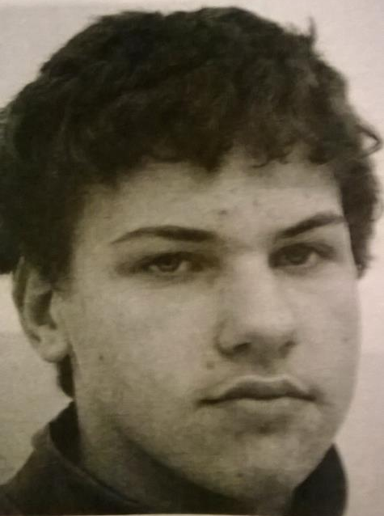
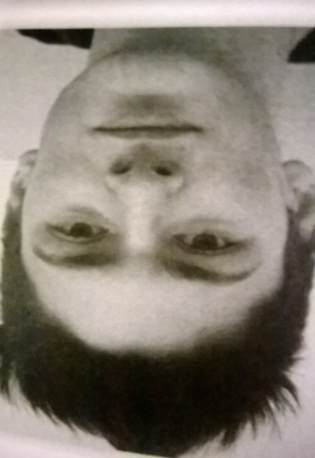

Slide 7
THE GIRLS
Giorgia Vita
Vittoria Parlati
Valentina Bais
Sara Candotti
Sofia Del Stabile
Valentina Donaggio
Roberta Vidal
Giada Ferro

Slide 8
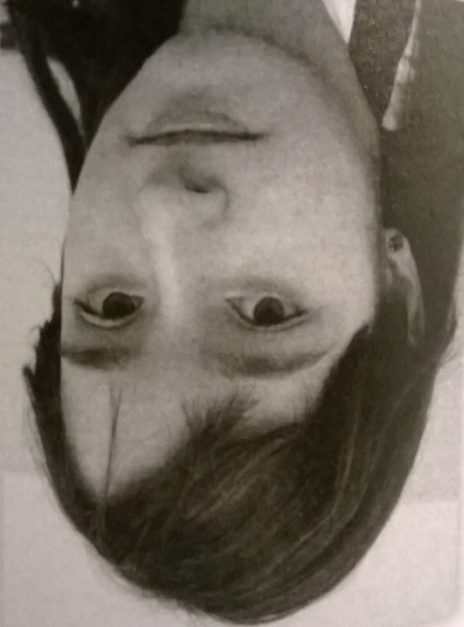
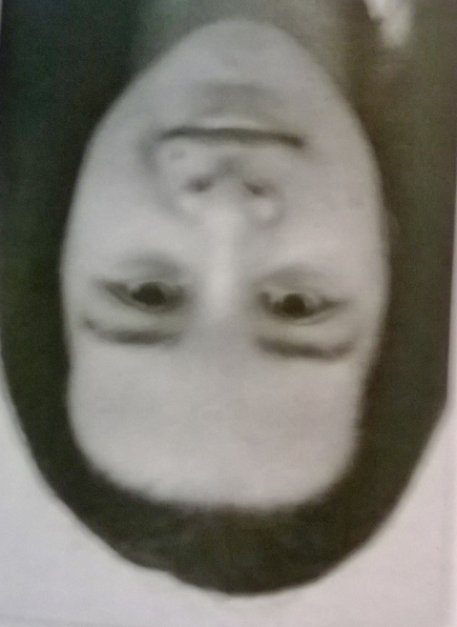

Slide 9
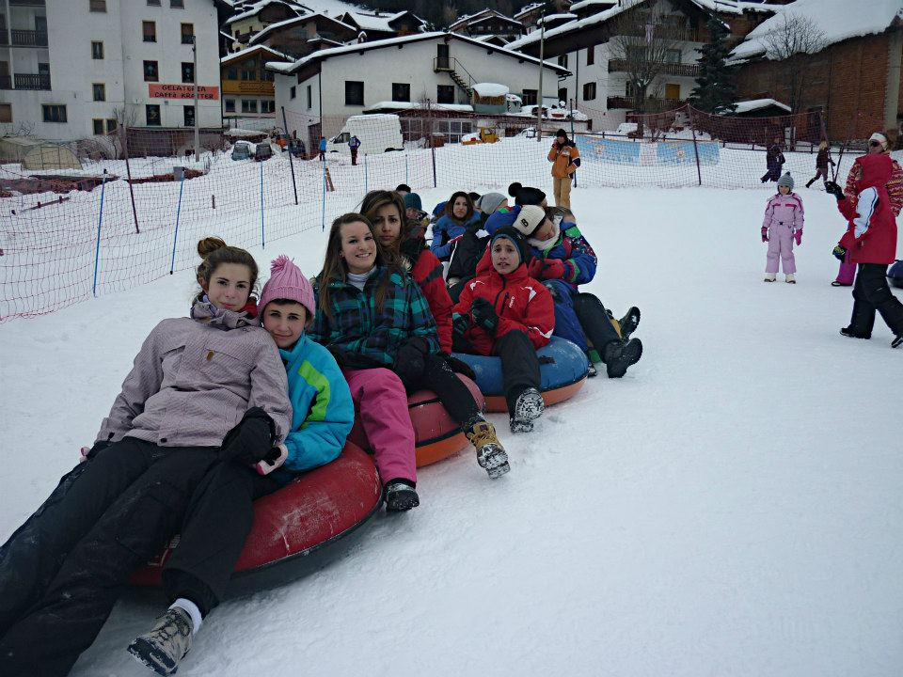
EXPERIENCES
During the last year we had several experiences which strengthened our bond and taught us many things:
The excursion to Sappada;
Some workgroup in History, Italian and Religion;

Slide 10
OURS TEACHERS
Beltramini Marilena: the English teacher
Castellan Vittorio: the Italian teacher
Betta Claudio: the History teacher
Zuttion Gabriele: the Physical Education teacher
Princig Chiara: the Science teacher
Negri Stefania: the Physic teacher
Inglese Emanuela: the Maths teacher
Giolo Liliana: the Religion teacher
De Monte Claudia: the Art History teacher

Slide 11
One year ago we were twenty-two guys
but now
We are…

Slide 12
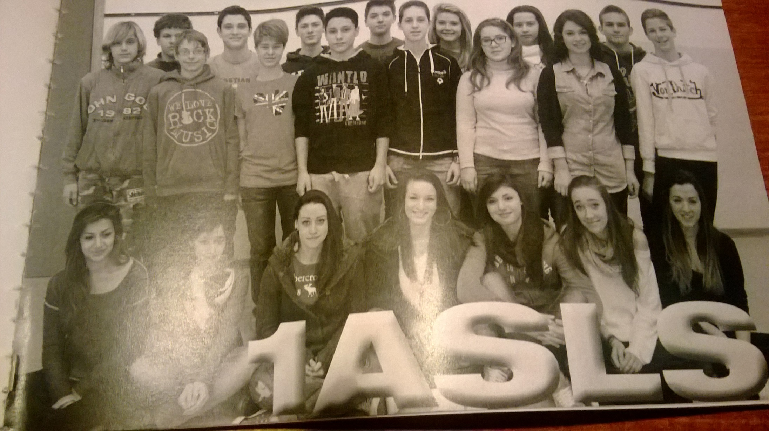
THE CLASS
2ASLS

